Slide 1
Module 2. Human rights of older people

Slide 2
About
The human rights training toolkit has been developed for HelpAge International staff members, network members and partners to learn about the rights of older people and key elements of a human rights-based approach to ageing.
This is the second of three PowerPoint slide decks to accompany each of the three training modules. Module 2 focuses on the rights of older people, relevant rights provisions and gaps in the human rights framework.
Notes:
If you this module immediately follows a training session on Module 1 (including an introduction), then hide this slide.

Slide 3
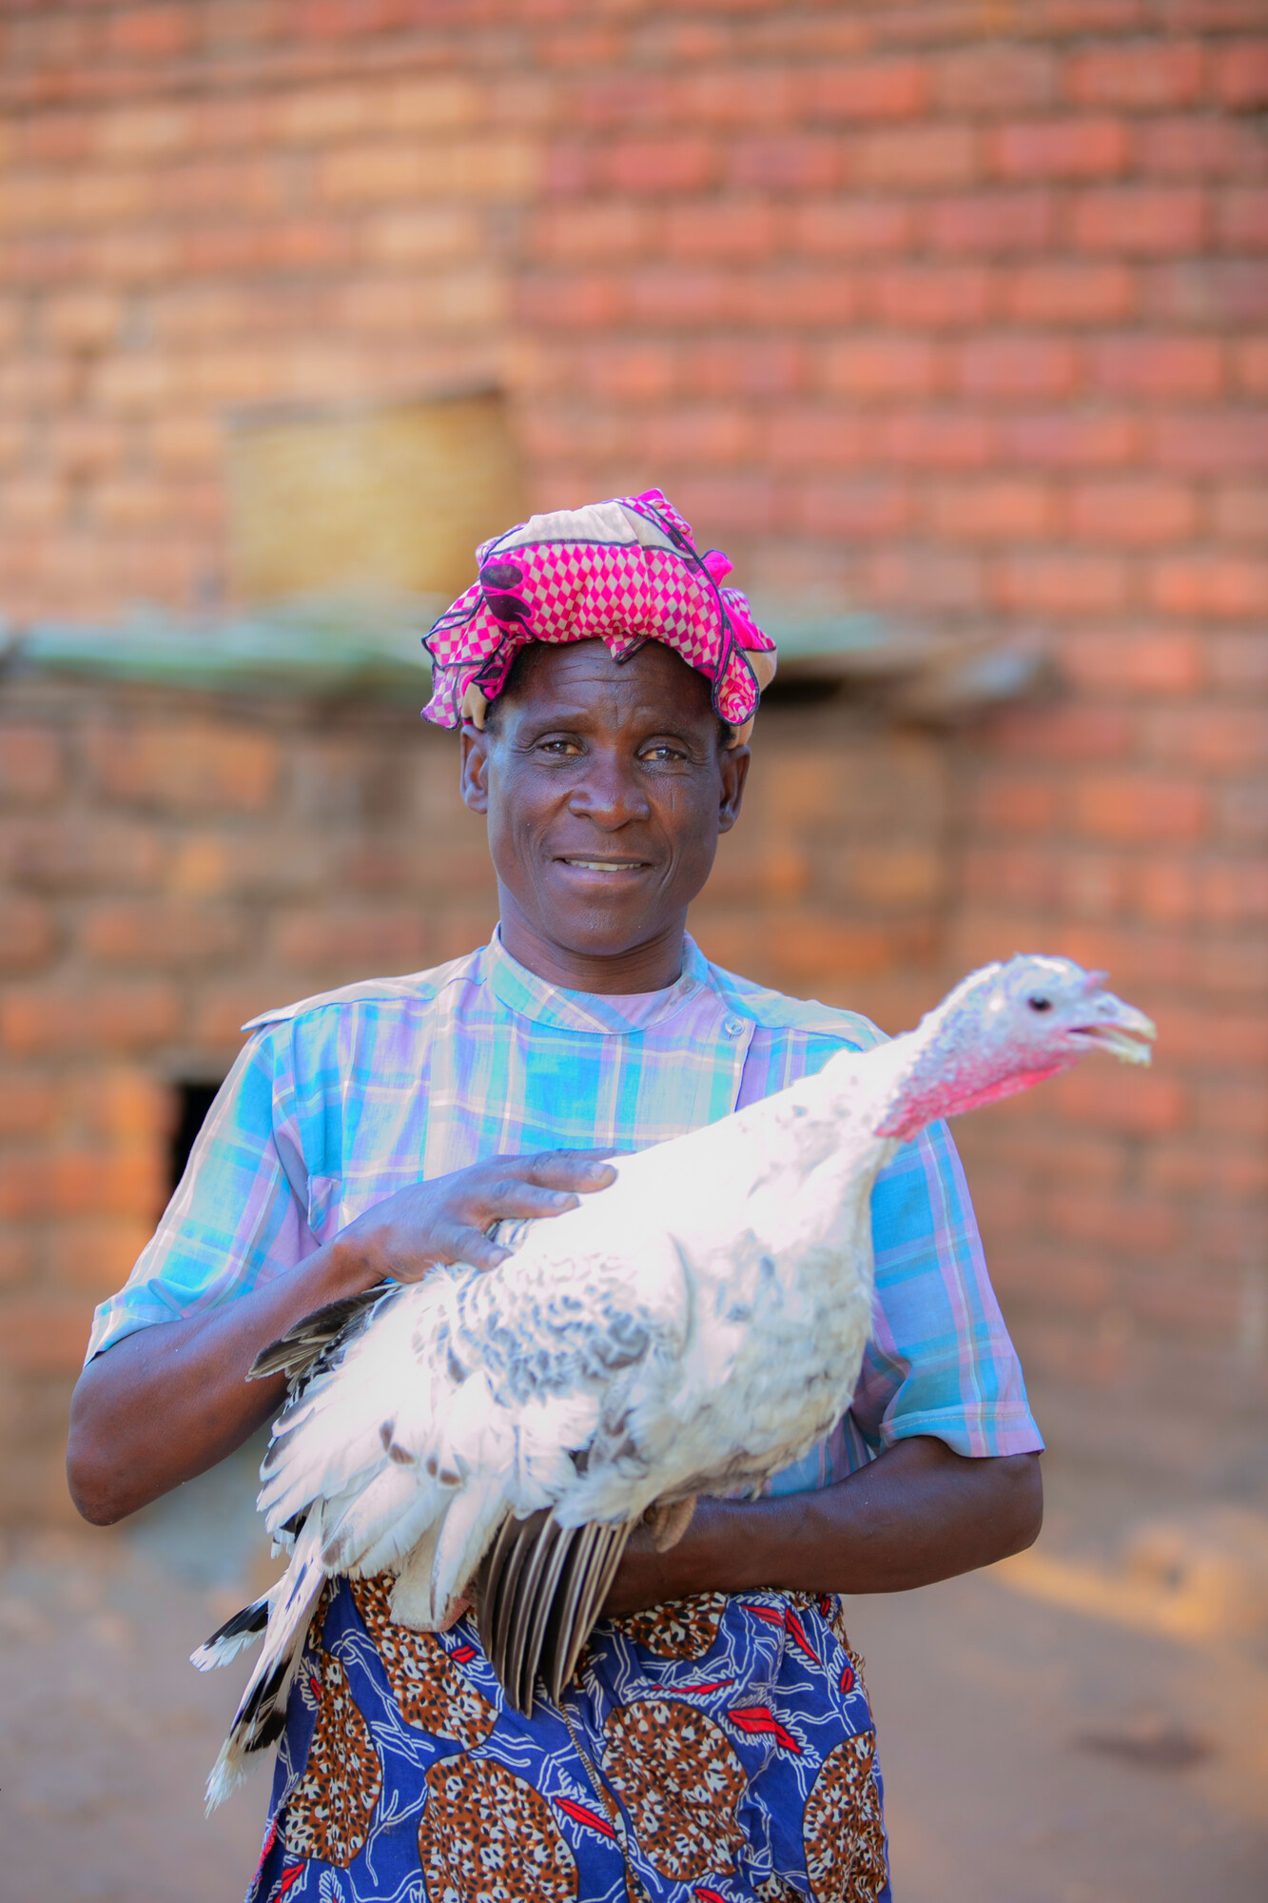
Module 2: Outline
Older people in the existing human rights framework
Income security
Healthy ageing
Inclusion and participation
Situations of conflict and disaster
Climate change
Gaps in the rights framework and the need for a new Convention

Slide 4
Objectives and expectations
Notes:
If you this module immediately follows a training session on Module 1 (including an introduction), then hide this slide.

Slide 5
Older people in the
human rights framework

Slide 6
Existing norms & standards
International human rights framework
All human rights apply in older age
No specific UN Convention on the rights of older persons
Regional frameworks
Inter-American Convention on Protecting the Human Rights of Older Persons (2015)
Protocol on the Rights of Older Persons in Africa (2016)
Not yet in force

Slide 7
Older people’s human rights
Life
Justice
Work
Participation
Education and learning
Equality
Accessibility
Social protection
Freedom from VAN
Care
Legal capacity
Health

Slide 8
Income security

Slide 9
Right to social security
Article 9 International Covenant on Economic, Social and Cultural Rights (CESCR)
Protection against income insecurity, unaffordable healthcare and insufficient support from families
Core elements
Availability
Adequacy
Affordability
Accessibility

Slide 10
Right to an adequate standard of living
Adequate standard of living
Food
Housing
Clothing
Water & sanitation
Art. 11 CESCR
Core elements:
Availability
Adequacy
Affordability
Accessibility
…

Slide 11
Access to work and employment
Articles 6-7 CESCR
Includes right to fair wages, equal remuneration for work of equal value, equal opportunity for promotion
Includes right to safe and healthy working conditions
Core elements
Availability
Accessibility
Acceptability and quality

Slide 12
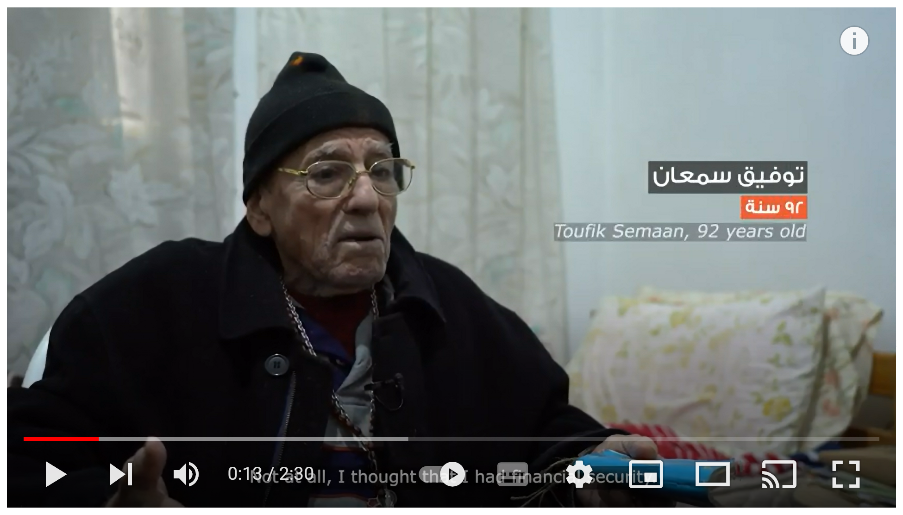
What older people say about their rights
https://www.youtube.com/watch?v=kJ_MKWIRK-o
Notes:
HelpAge consults with older people regularly about the challenges they face in the enjoyment of their human rights. A recent video shows some of these particular challenges in Lebanon.

Slide 13
Group discussion: which human rights challenges do older people face that affect their income security

Slide 14
Healthy ageing

Slide 15
Right to health
Article 12 CESCR
Requires an integrated approach, combining elements of preventive, curative and rehabilitative health treatment with measures to maintain older people’s functionality and autonomy, and the provision of palliative and end-of-life care
Core elements
Availability
Accessibility
Affordability
Acceptability and quality

Slide 16
Rights of older people in residential care
The right to live independently and be included in the community: article 19 Convention on the rights of persons with disabilities (CRPD)
Other relevant rights:
Prohibition of cruel, inhuman or degrading treatment
Right to privacy
Right to liberty and security
Right to free and informed consent
…

Slide 17
Group discussion: which human rights challenges do older people face that affect their health

Slide 18
Inclusion &
participation

Slide 19
Right to participate in public and political life
Article 25 International Covenant on Civil and Political Rights (ICCPR)
It includes older people’s right to:
participate in the conduct of public affairs, either directly or through their freely chosen representatives;
vote and be elected; and
have access to public service positions.
Closely linked to right to accessibility, right to freedom of expression and right to freedom of association.

Slide 20
Right to participate in social and cultural life
Article 15(1)(a) CESCR
Older people as transmitters of information, knowledge, traditions and cultural values
Closely linked to older people’s right to education
Core elements
Availability
Accessibility
Affordability
Acceptability
Appropriateness

Slide 21
Right to independent living
Article 19 Convention on the rights of persons with disabilities (CRPD)
The right to living independently and being included in the community includes:
Choosing freely where to live and with whom
Access to support services – including personal assistance
Access to general community services and facilities
Closely linked to the right to legal capacity (art. 12 CRPD)

Slide 22
Right to accessibility
Article 9 CRPD
Older people must have equal access to:
the physical environment
transportation
information and communications
other public facilities and services, in urban and rural areas
Accessibility | Reasonable accomodation
Groups | Individuals
General solution | Individual solution
Proactive | Reactive
Unconditional | Only if no undue burden

Slide 23
Group discussion: which human rights challenges do older people face that affect their inclusion and participation

Slide 24
Situations of conflict
& disaster

Slide 25
International human rights law | International humanitarian law
Protects life, health and dignity | Protects life, health and dignity
Applies at all times | Applies in armed conflict
Principal source = UN human rights treaties | Principal source = Geneva Conventions
Government can suspend human rights (with some exceptions) in emergency situations | Cannot be suspended

Slide 26
Older people’s rights in conflict & disaster situations
Article 11 CRPD
Article 29 Inter-American Convention on OP Rights
Article 14 African Protocol on OP Rights
Non-derogable human rights
Right to life
Prohibition of torture
Prohibition of slavery
Principle of legality and non-retroactivity of the law
Freedom of thought, conscience and religion

Slide 27
Group discussion: which human rights challenges do older people face in situations of conflict and disaster?

Slide 28
Climate change

Slide 29
Older people’s rights in the context of climate change
Rights to life, health and safety
Right to adequate standard of living
Right to clean, healthy and sustainable environment

Slide 30
Group exercise: which human rights challenges do older people face in the context of climate change?

Slide 31
Gaps in the human rights framework

Slide 32
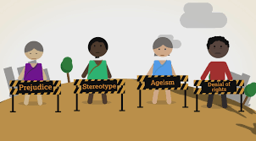
Gaps in the human rights framework
Standards
Vague, generic, scattered
Interpretation & implementation
Ageism
Information
Lack of data
Monitoring & accountability
No monitoring mechanism
How older people's human rights are denied - animation
Notes:
Watch this video: https://www.youtube.com/watch?v=ekLjnHtwPc8

Slide 33
Why we need a UN Convention
https://www.youtube.com/watch?v=yw_pzeh4WNI&t=4s

Slide 34
HelpAge’s advocacy for a UN Convention
Open-ended Working Group on Ageing
Human Rights Council
OHCHR
UN Independent Expert
UN Treaty Bodies
Notes:
The UN Open-ended Working Group is now at the pre-negotiation phase of a UN convention on the rights of older people. This means it is building consensus among Member States on the need for a new convention. We want the Open-ended Working Group to move to a negotiation phase where it will start drafting and negotiating the text of a new convention. We need more governments to voice their support for a new convention to reach this phase.
HelpAge is therefore also engaging with other human rights bodies , such as:
the Human Rights Council,
the Office of the High Commissioner on Human Rights (OHCHR) and
the UN Independent Expert on the rights of older persons.
It has in the past also submitted reports to UN treaty bodies and will engage more them in the future.
For more information, see https://www.helpage.org/what-we-do/rights-of-older-people/un-convention-on-the-rights-of-older-people/

Slide 35
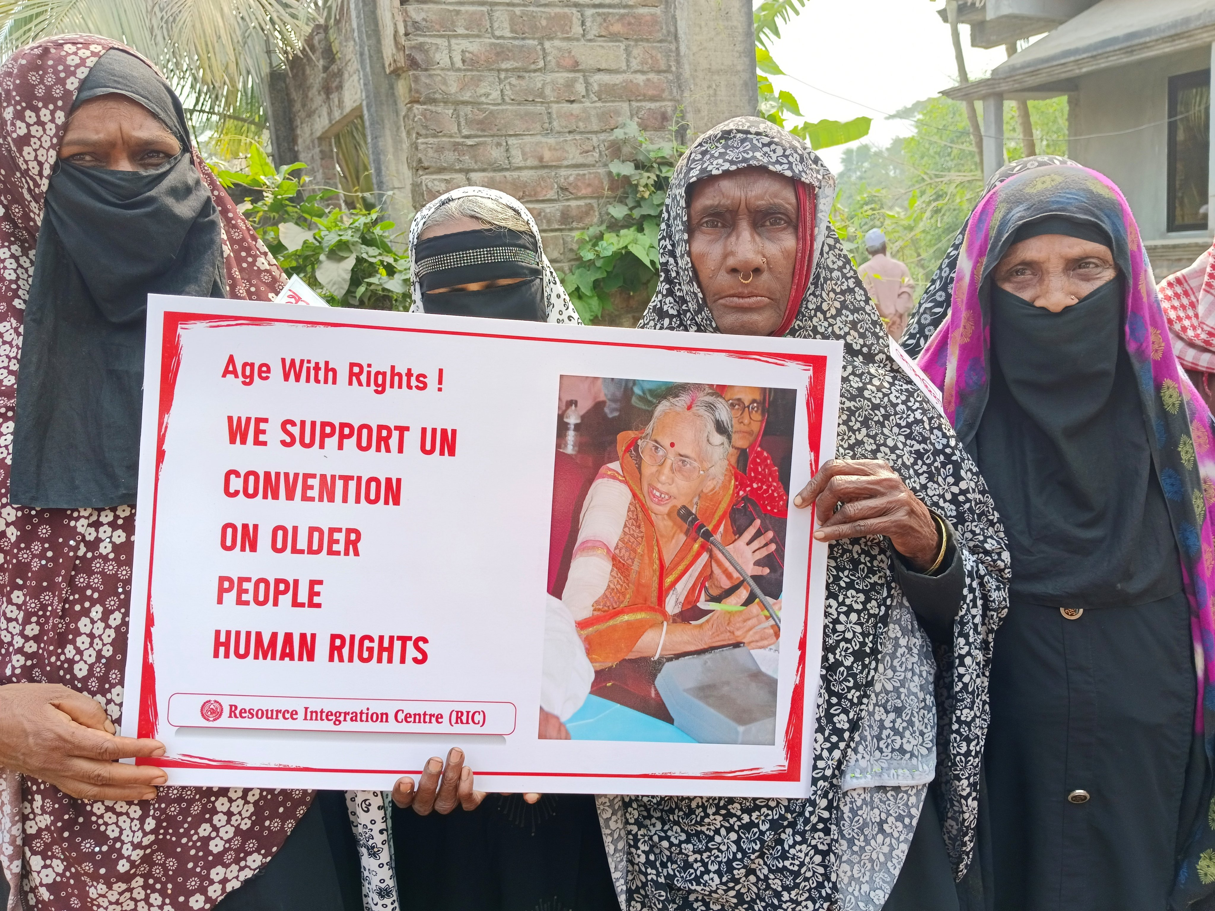
The Global Alliance on the Rights of Older People
Established in 2011 with over 400 members worldwide
Mission = to support and enhance civil society engagement with Member States and NHRIs at all levels around a convention on the rights of older persons
Annual Global Rally
More information: https://rightsofolderpeople.org/

Slide 36
Group exercise: What should be included in the UN Convention on the Rights of Older Persons?

Slide 37
It’s quiz time!

Slide 38
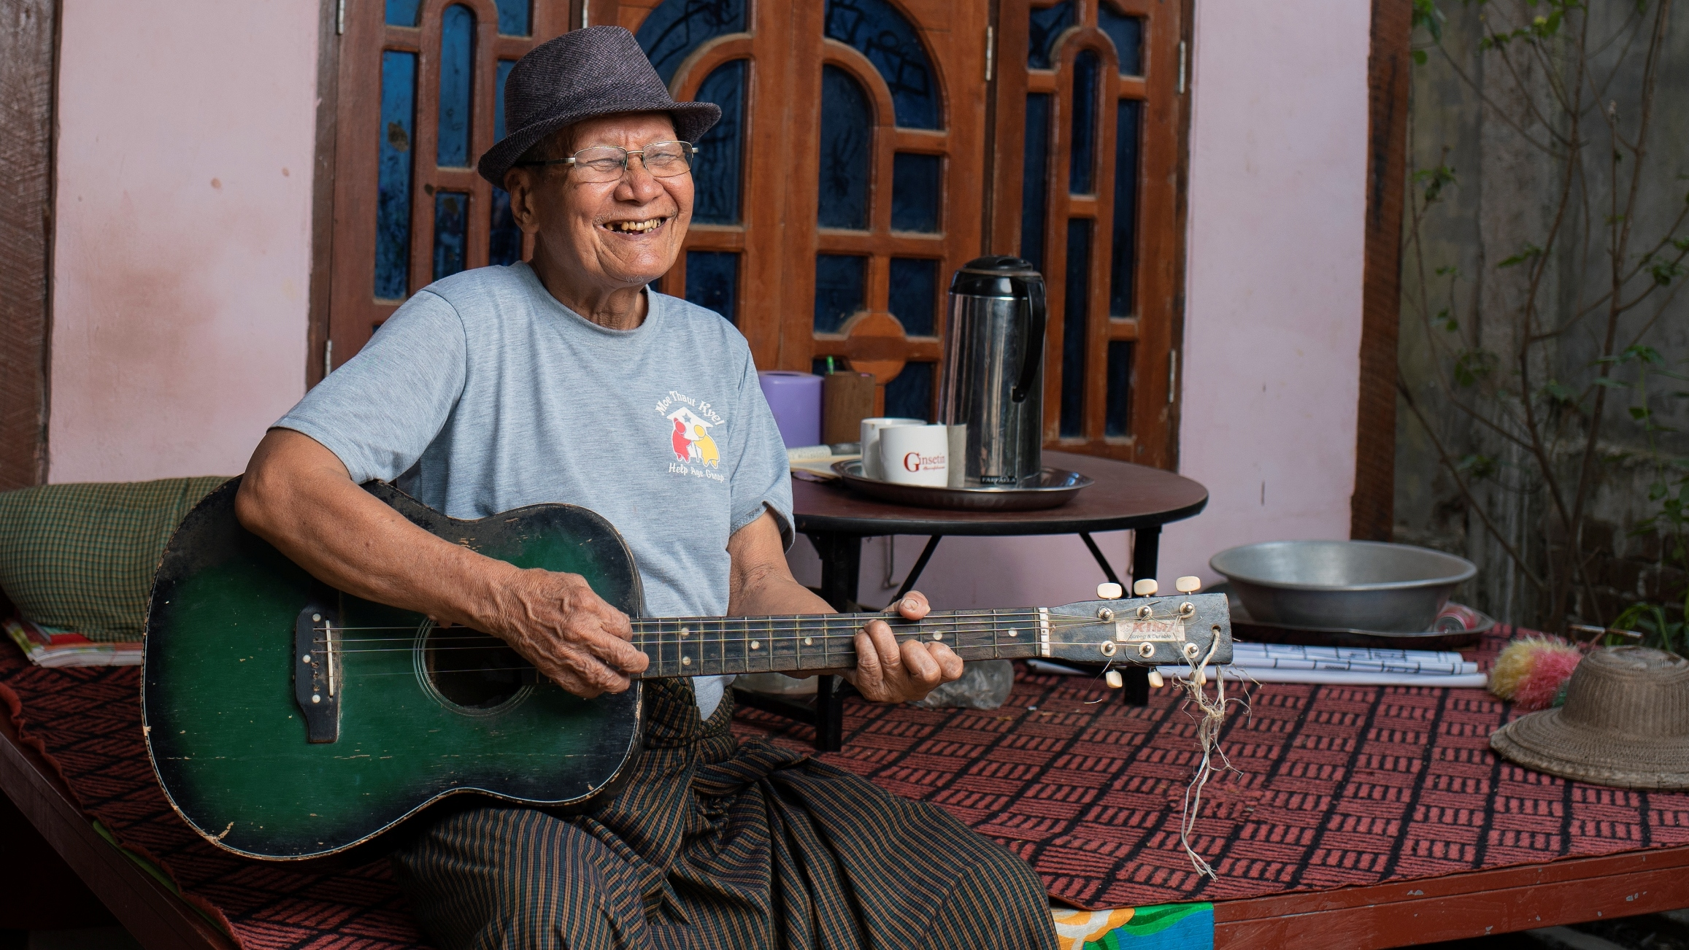
Thank you!
www.helpage.org
HelpAgeInternational
@HelpAge

