Slide 1
Module 1. Introduction to human rights

Slide 2
About
The human rights training toolkit has been developed for HelpAge International staff members, network members and partners to learn about the rights of older people and key elements of a human rights-based approach to ageing.
This is the first of three PowerPoint slide decks to accompany each of the three training modules. Module 1 provides an introduction to the main human rights principles, instruments and monitoring mechanisms.

Slide 3
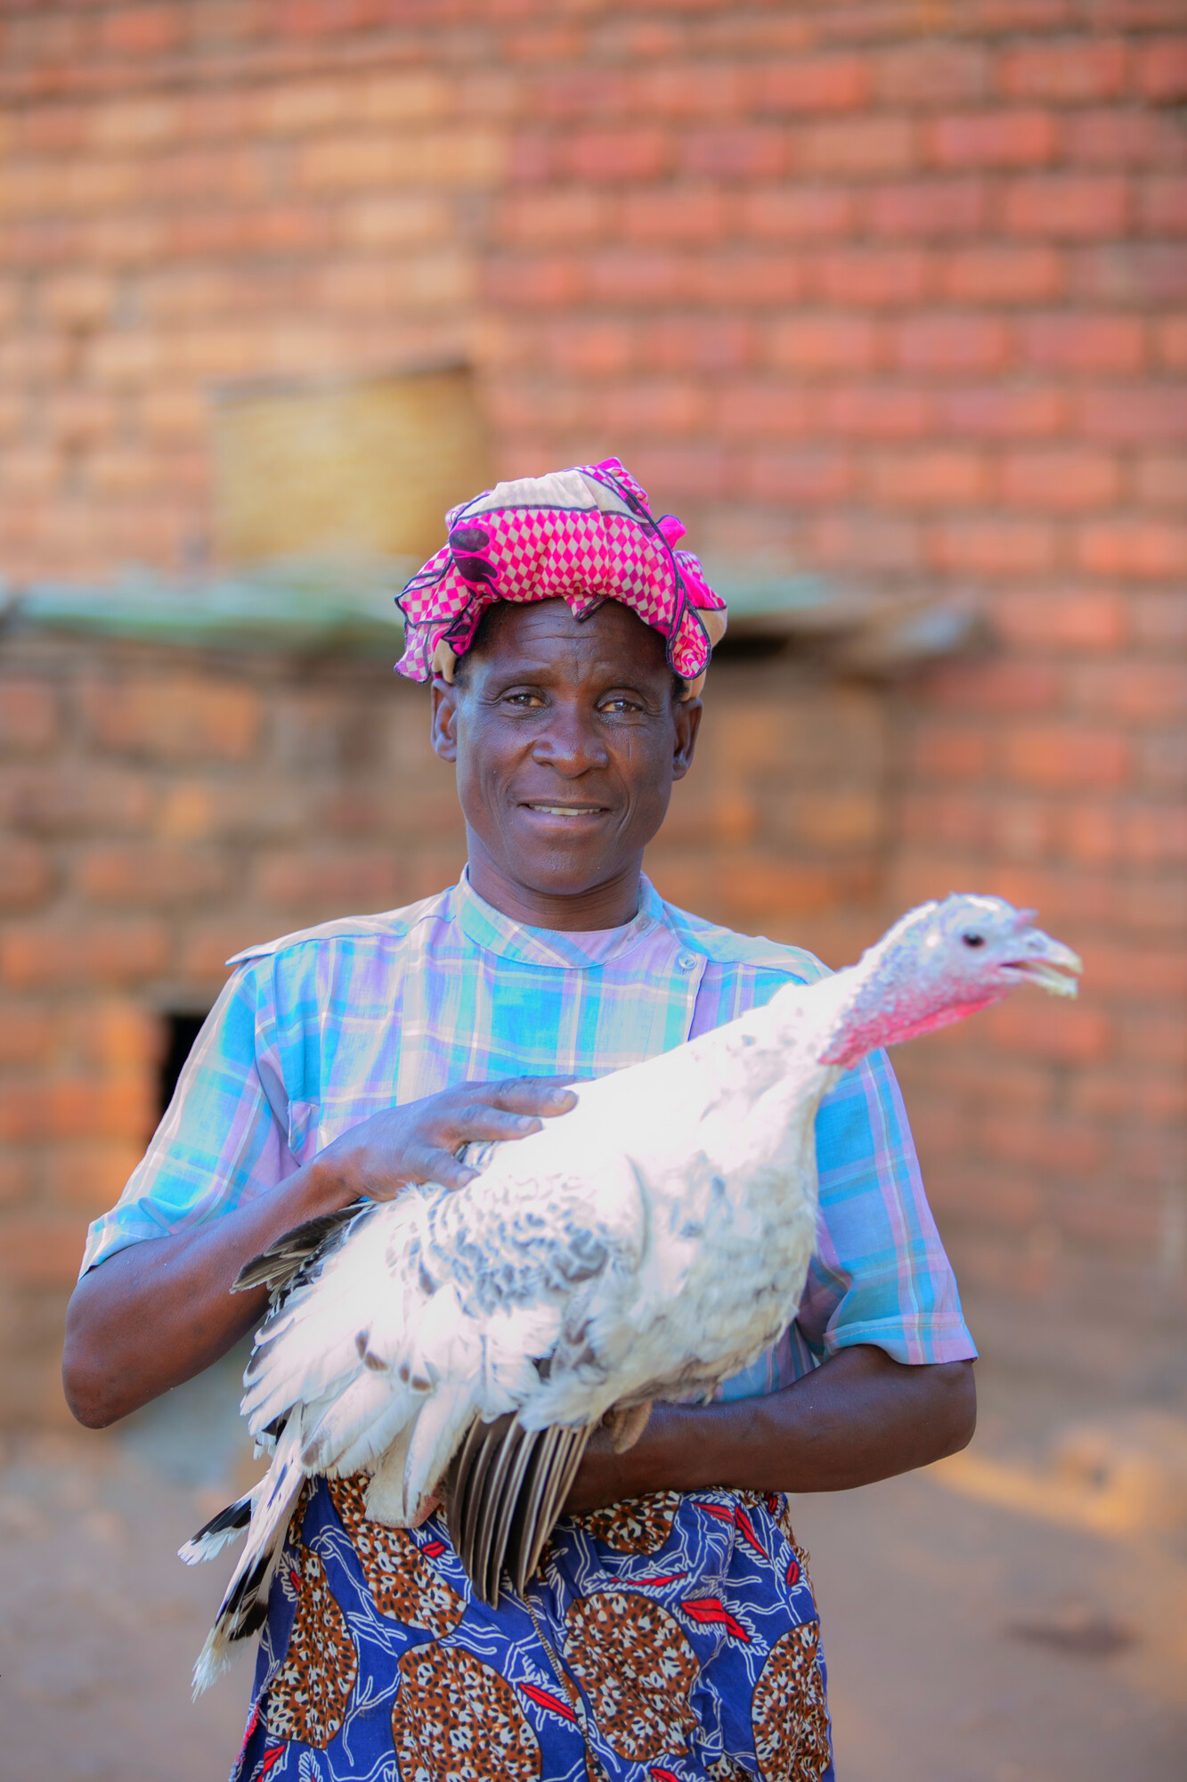
Module 1: Outline
What are human rights?
Human rights instruments
Human rights monitoring
Regional human rights systems
Quiz or group exercise

Slide 4
Objectives and expectations

Slide 5
What are human rights?

Slide 6
What are human rights? Group discussion

Slide 7
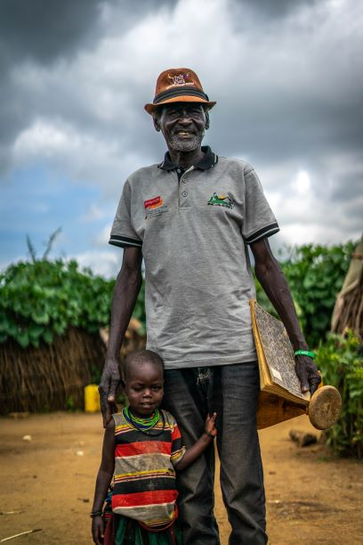
Human rights are universal legal guarantees protecting individuals and groups against actions and omissions that interfere with fundamental freedoms, entitlements and human dignity. They are a set of performance standards against which duty-bearers can be held accountable.

Slide 8
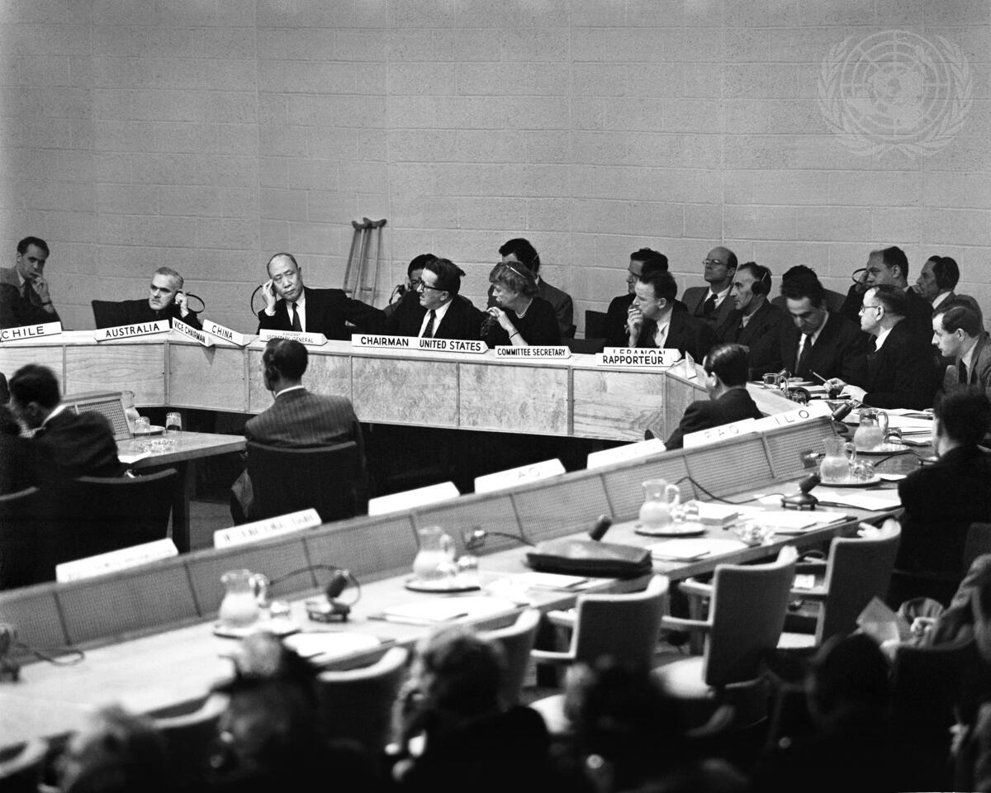
The Universal Declaration on Human Rights A milestone in the history of human rights
UDHR
ICCPR
ICESCR
Notes:
Caption Description: The first session of the Drafting Committee on International Bill of Rights, Commission on Human Rights, at Lake Success, New York, on Monday, 9 June 1947.
© UN Photo

Slide 9
Human rights principles
Universal
Inalienable
Indivisible
Interdependent
Both rights and obligations
Equal and non-discriminatory

Slide 10
Human rights principles
Inclusion
Autonomy
Accessibility
Participation

Slide 11
Human rights obligations
States have an obligation to
respect
protect
fulfil human rights
Immediate obligations vs. progressive realisation
Civil and political rights vs. socio-economic rights
No hierarchy

Slide 12
Example: right to health Group exercise

Slide 13
Human rights instruments

Slide 14
Human rights instruments
UDHR & International treaties
Regional treaties
Constitutions
National laws
ICPPR
ICESCR
CAT
CRC
CEDAW
CMW
CPED
CERD
CRPD
Soft Law

Slide 15
ICCPR
ICESCR
Economic, Social and Cultural Rights
ICERD
Racial Discrimination
CEDAW
Civil and Political Rights
Discrimination Against Women
CAT
Torture
CRMW
Rights of the Child
CRPD
Rights of All Migrant Workers and their Families
CPED
Enforced Disappearances
CRC
Rights of Persons with Disabilities

Slide 16
Human rights monitoring

Slide 17
Who monitors human rights?
Treaty bodies
Human Rights Council
Special Procedures
Universal Periodic Review

Slide 18
Human rights treaty bodies
Periodic reports
Individual complaints
Country inquiries
Interpretation guidelines

Slide 19
Regional human rights systems

Slide 20
Regional human rights systems
African Union
Organisation of American States
Council of Europe
European Union

Slide 21
It’s quiz time!

