Slide 1
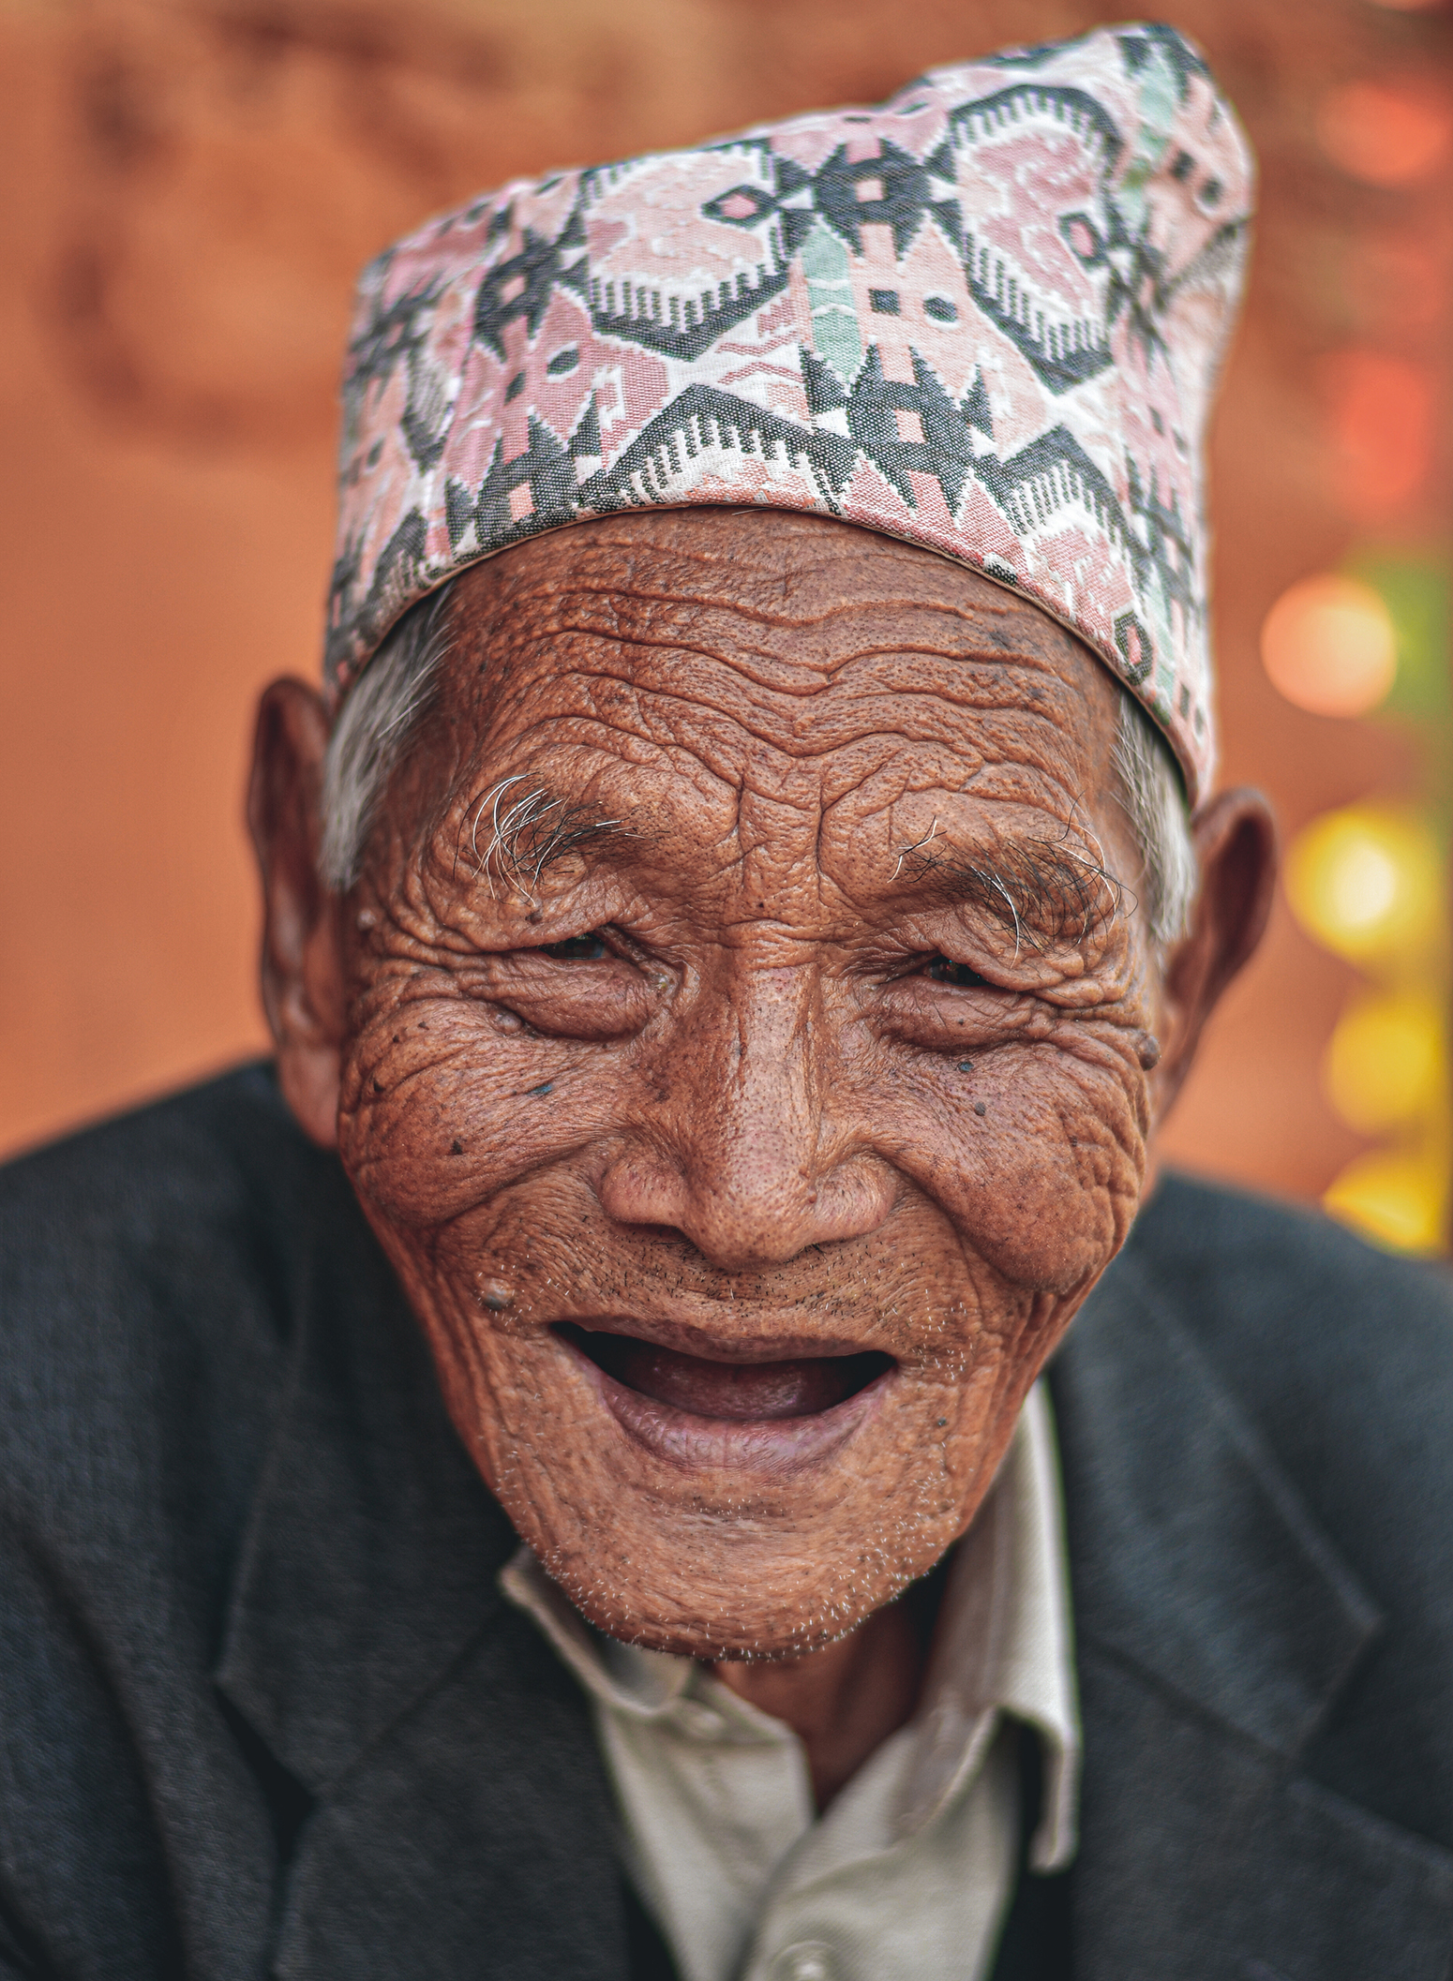
Voice training
Module 6:
Voice and healthy longevity
Ganesh Bista/Ageing Nepal

Slide 2
Module 6: Voice and healthy longevity
      The Voice training toolkit has been developed for training HelpAge staff and network members to understand the key elements of the Voice framework and the concepts underpinning it, and to strengthen their ability to implement Voice-related activities.
      This is the sixth PowerPoint module designed to accompany the Voice facilitator’s guide.
      Module 6 looks at understanding Voice and why it’s important for healthy longevity, provides background to the Global Roadmap for Healthy Longevity and explores the enablers and barriers to longevity.

Slide 3
Session 1:
Background to the Global Roadmap for Healthy Longevity, and workshop objectives

Slide 4

Objectives of the workshop
      Understand the principles of healthy longevity
      Explore the barriers to health and wellbeing for older people at the community level
      Recognise the enablers and disrupters to healthy longevity
      Consider the importance of older people’s Voice in relation to healthy longevity
      Consider what actions can be taken at the community level to promote healthy longevity

Slide 5
Workshop outline
      Background to the Global Roadmap for Healthy Longevity
      Understanding Voice and why it’s important for healthy longevity
      Overview of the vision of healthy longevity and the virtuous cycle
      Enablers of healthy longevity: volunteering and work
      Enablers of healthy longevity: Social infrastructure
      Enablers of healthy longevity: Health and care systems
      Ageism as a barrier to healthy longevity
      Taking action
      Wrap-up

Slide 6

Demographic shift
      By 2030, older people will outnumber younger people for the first time
      There is an opportunity to look
      at how this demographic shift could result in more vibrant societies

Slide 7
Longer and healthier lives?
      While life expectancy increased over six years between 2000 and 2019, healthy life expectancy (HLE) increased by just over five years
      The World Health Organization (WHO) estimates that at least 142 million older people globally are unable to meet their basic needs. (Including income security, adequate diet, clothing, suitable housing, access to quality health and care services and support)
      Need urgent action to reorientate societies, systems, services and communities so that they effectively promote healthy ageing across the life course

Slide 8

Definition of healthy longevity
      Healthy longevity is the state in which years in good health approach the biological life span, with physical, cognitive and social functioning that enables wellbeing across generations.

Slide 9

Background to the Global Roadmap for Healthy Longevity
      The National Academy of Medicine (NAM) convened an international, independent, multidisciplinary expert commission to create the Global Roadmap
      Report highlights the need for an all-of-society transformation
      Builds on key documents, including the United Nations (UN) Decade of Healthy Ageing and the UN Sustainable Development Goals (SDGs)

Slide 10
Key Voice concepts and how they relate to healthy longevity
      Participation – Older people have a right to participate in decision-making processes
      Empowerment – Older people must be informed and empowered to exercise their rights in relation to the health and care they receive
      Accountability – Health and care must be accountable and transparent in all areas of service design, delivery, monitoring and evaluation

Slide 11
Session 2:
Understanding Voice and why it’s important for healthy longevity

Slide 12
Key concepts underlying Voice work
      Agency
      Rights-based approach
      Autonomy
      Governance and good governance
      Citizenship
      Spaces (formal and informal)
      Participation
      Accountability, responsiveness and answerability
      Empowerment
      Access to information
      Power
      Advocacy and campaigning
      Independence
      Leadership

Slide 13
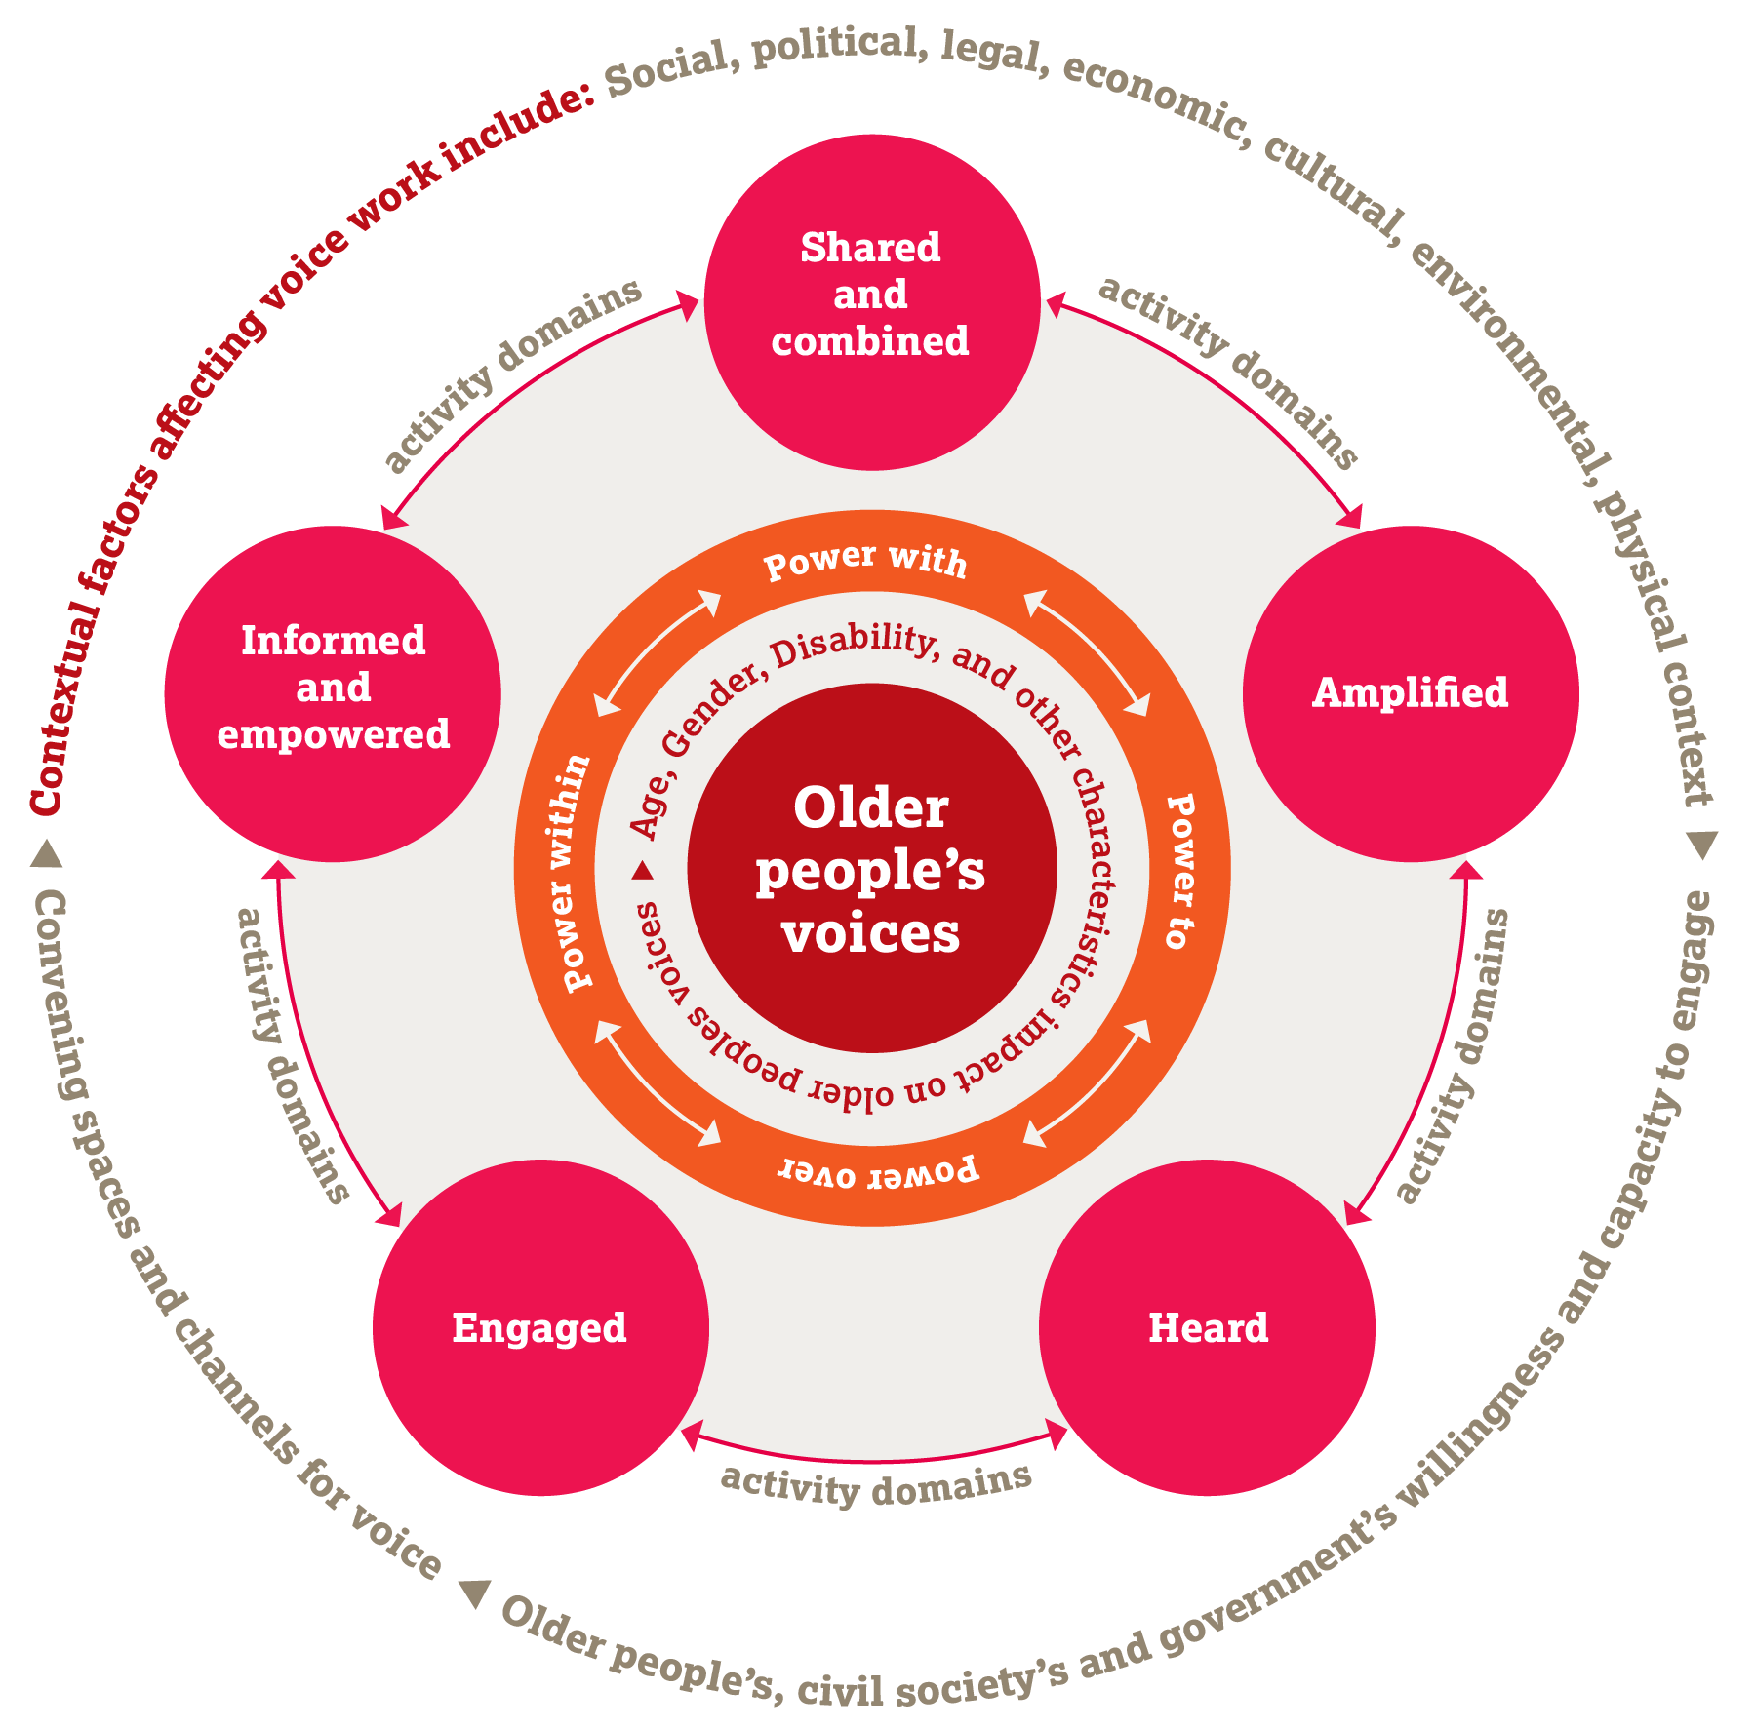
The Voice framework

Slide 14
The Voice domains
      Engaged – activities to motivate older people to engage in decision-making processes
      Informed and empowered – activities to support older people to be informed about issues affecting their lives and empowered to participate in decision-making processes
      Shared and combined – activities to enable older people to share their experiences, identify their needs and rights, and combine their views to create a collective Voice
      Amplified – activities to support older people to communicate their views by using different channels of communication
      Heard – activities to support older people to have their Voice heard and responded to by people in positions of power

Slide 15

Plenary discussion
      Can you share an example of a time when you felt that your Voice was heard in your community? What was the outcome?

Slide 16

Value of Voice
        Intrinsic value
      The opinions we hold, the decisions we make, and the actions we take constitute a significant part of who we are. Having choice and agency is central to our dignity, wellbeing and sense of self-worth, and to a rights-based approach to ageing.
      Instrumental value
      Including people’s voices in decision-making about issues that affect them can improve access to services, and improve the quality of those services.

Slide 17
Session 3:
Overview of the vision of healthy longevity and the virtuous cycle

Slide 18
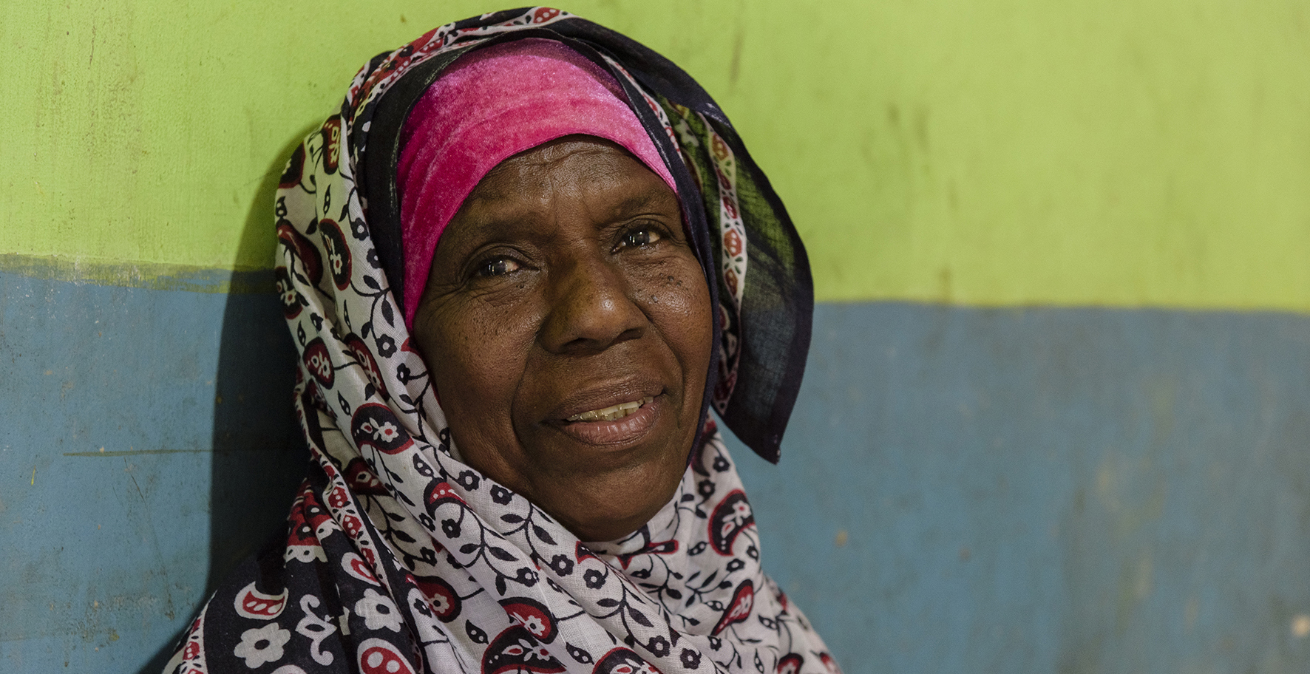
Healthy longevity
Michael Goima/Fairpicture/HelpAge International

Slide 19

Vision for healthy longevity
      All people enabled to live long lives with health and function
      Older people have the right to participate in a range of activities according to their wishes and values
      All of society benefits from the contributions of older people
      When older people thrive, all people thrive
      Equity between and within countries

Slide 20



How do we achieve healthy longevity?
      All-of-society approach
      Older people
      must be
      central in
      designing
      systems
      Action must be anchored at
      the community
      level

Slide 21
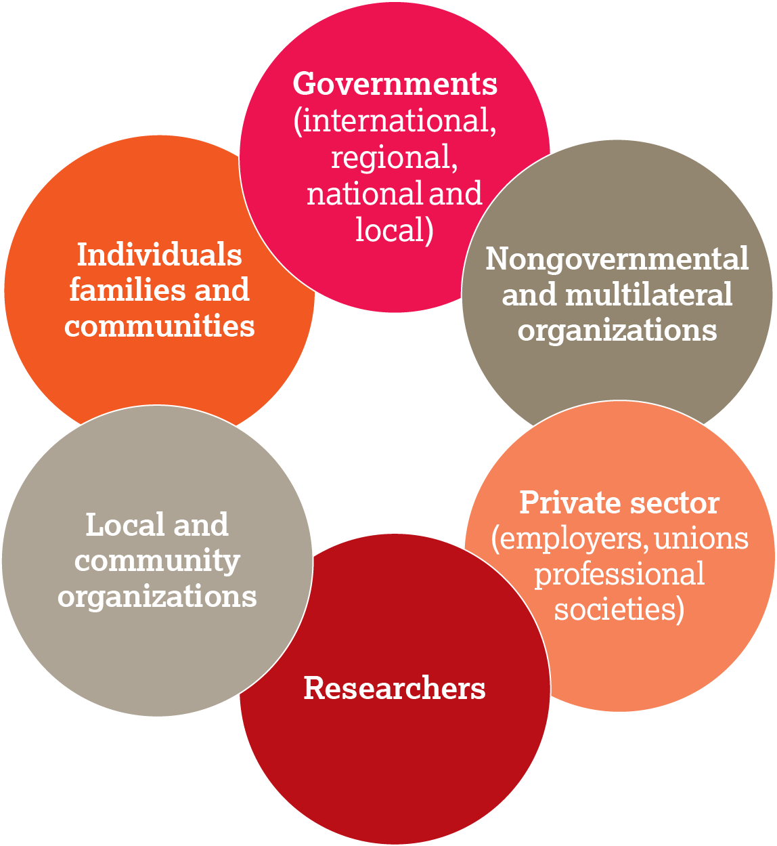
An all-of-society approach to healthy longevity
National Academy of Medicine. 2022. Global Roadmap for Healthy Longevity.

Slide 22
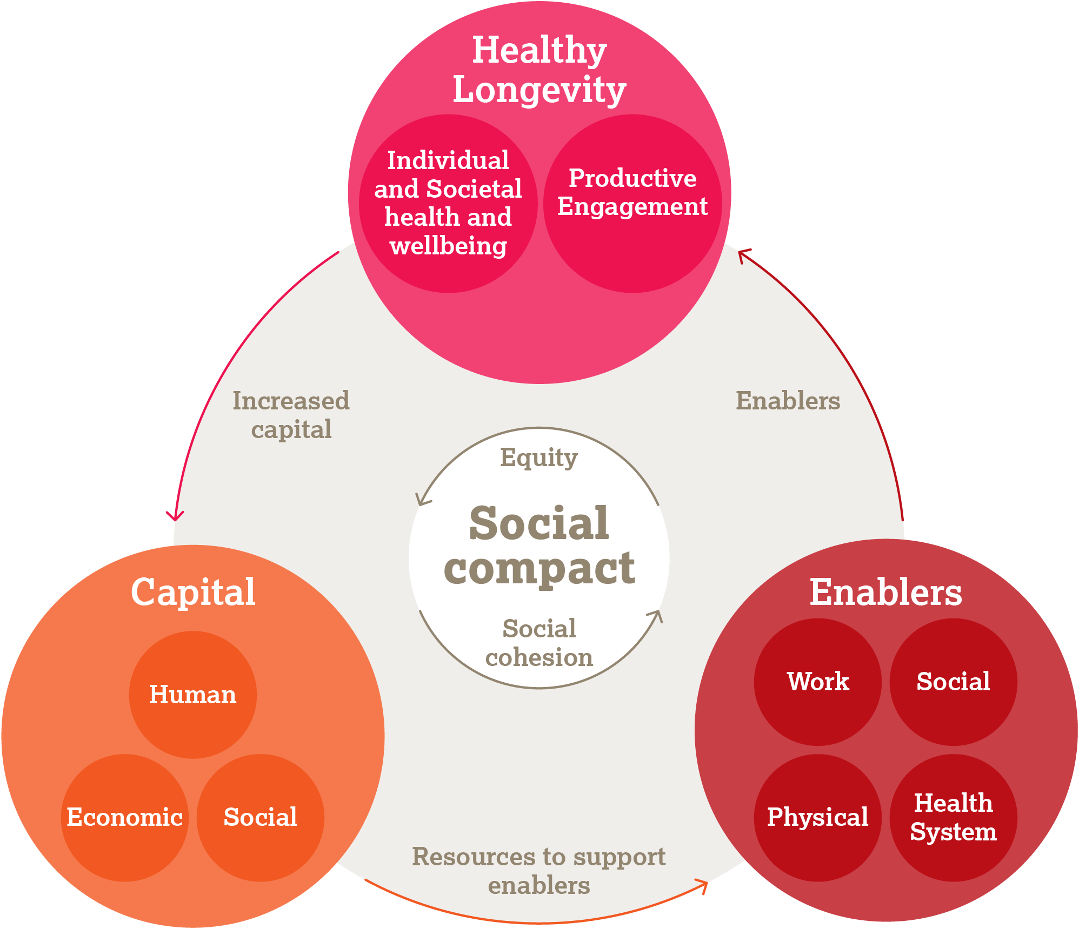
The virtuous cycle of healthy longevity
National Academy of Medicine. 2022. Global Roadmap for Healthy Longevity.

Slide 23
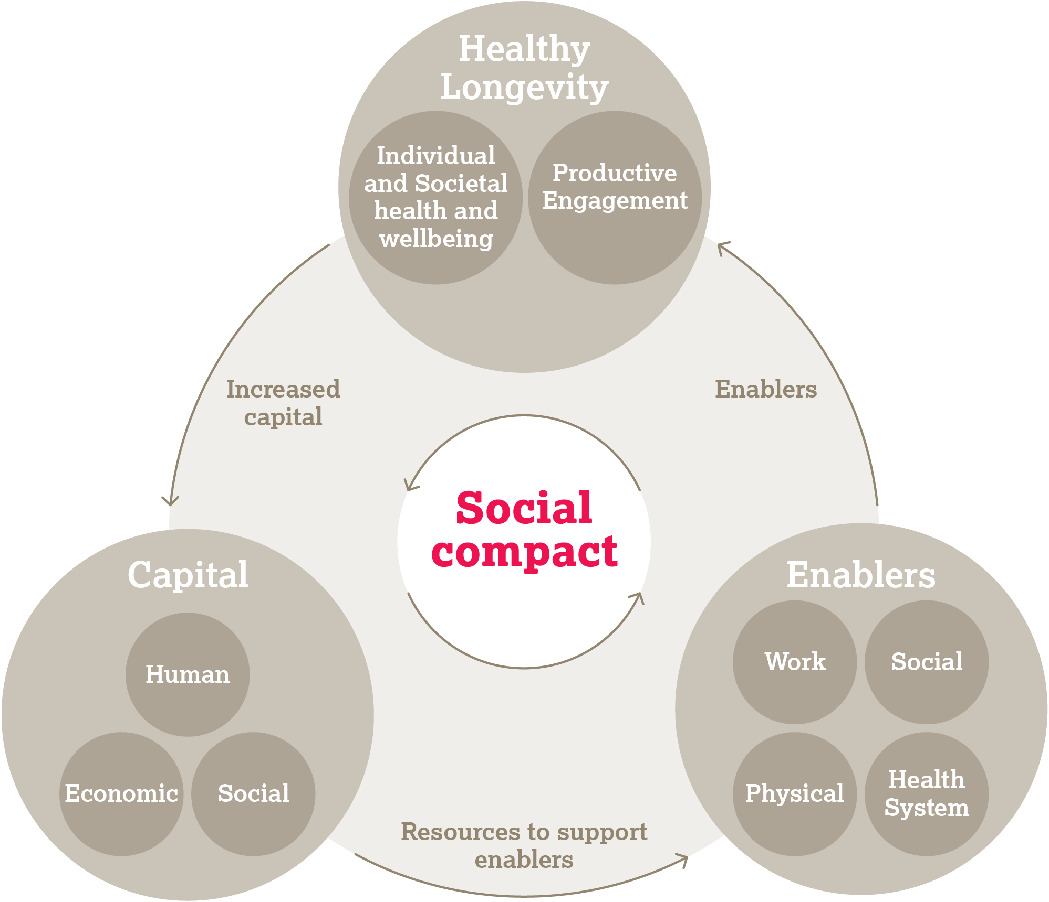
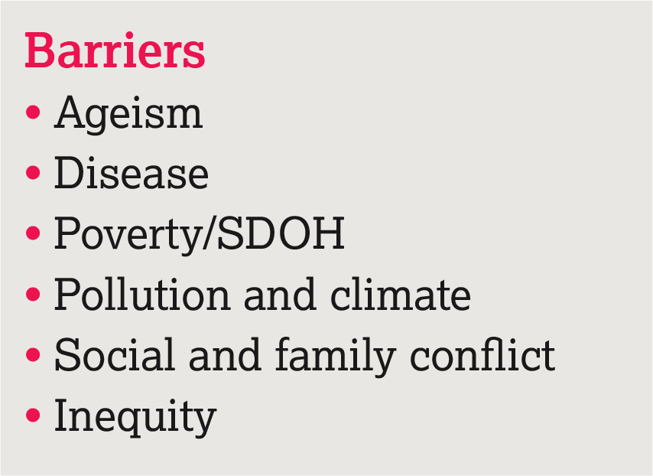
Social compact and disrupters (barriers)
National Academy of Medicine. 2022. Global Roadmap for Healthy Longevity.

Slide 24
Plenary discussion
      What do you think about the vision for healthy longevity? What aspects do you think are relevant to your community?

Slide 25
Session 4:
Enablers of healthy longevity: Volunteering and work

Slide 26
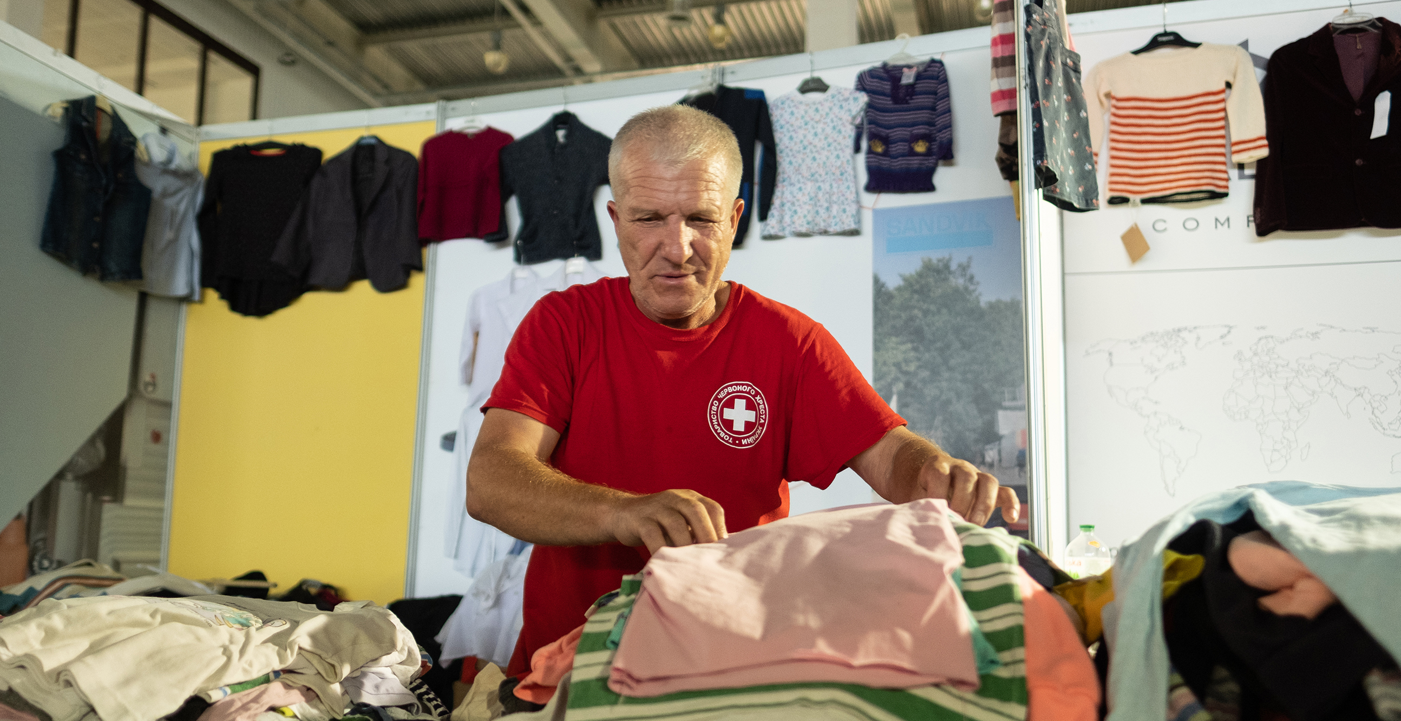
Volunteering and work
Jonathan Moore/HelpAge International

Slide 27
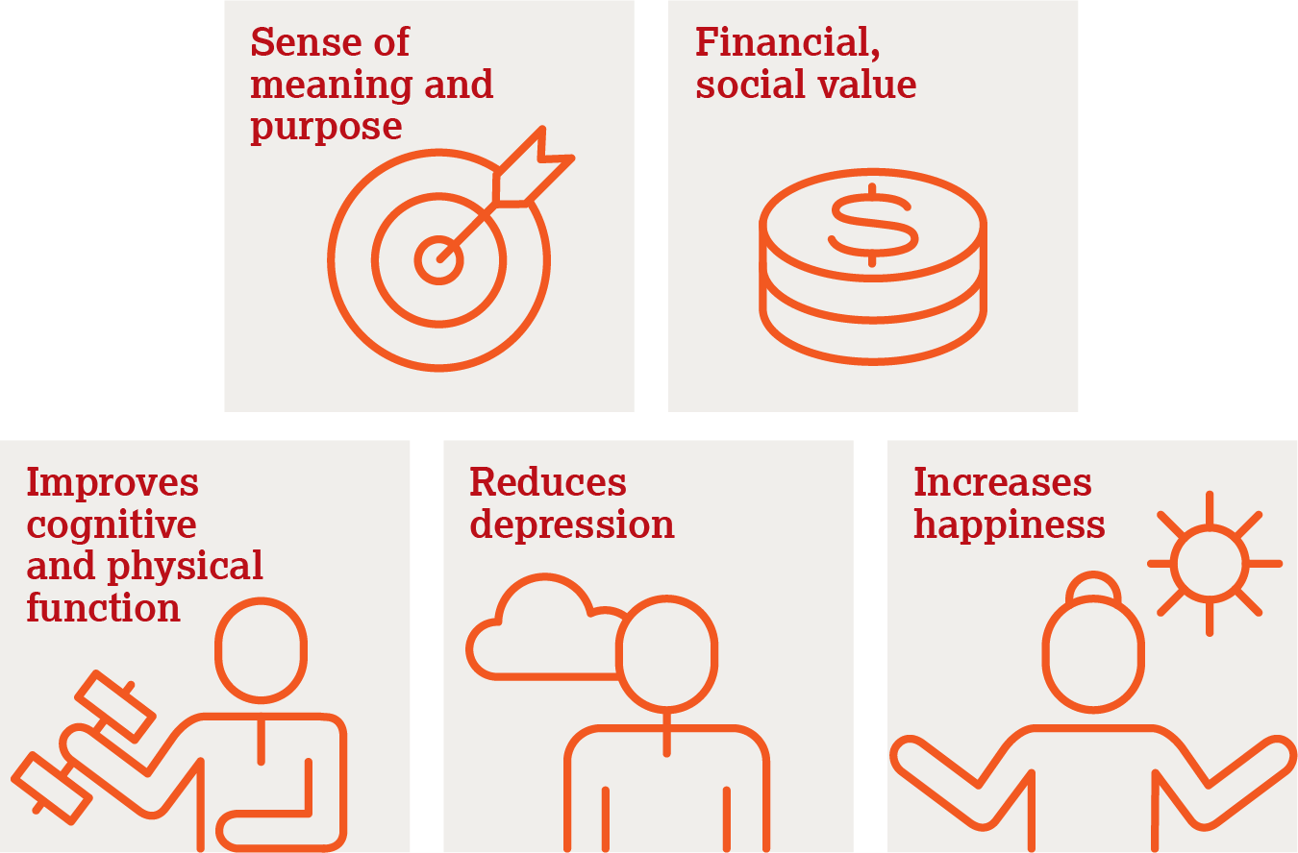
Impact of volunteering

Slide 28

Older people’s associations (OPAs)
      Community-based groups that include older people working together to improve the situation of older people and the communities they live in.

Slide 29
Older people’s experiences of volunteering
      “As an older citizen monitor, my job is to give information to older people so they know their rights and to understand their problems. Then I start gathering the information and I take that to the leaders who are able to help them.”
      Oto Augustino, an older citizen monitor in Karamoja, Uganda
      “These activities help seniors in having physical exercise. And apart from that, it gives older people some emotional support because these activities preoccupy their minds, taking them off their problems. That’s why we are really into these social activities... Older people feel that they are still important and part of society, it takes us off thinking that we are alone and isolated… It affects our mental health and wellbeing.”
      71-year-old woman, Philippines

Slide 30
Plenary discussion
      Do you volunteer in your community?
      Do you have an example of any volunteer programmes for older people in your country?

Slide 31
Work
      Governments and the private sector can support opportunities for older people in the workforce, especially older women
      Older people have decades of knowledge and experience
      Mentor young
      people
      Create social and human capital
      Increases
      wellbeing
      Reduces
      depression

Slide 32

Supporting participation in the workforce
      Remove structural barriers
      Establish incentives to encourage work
      Increase educational opportunities
      Introduce anti-age discrimination laws

Slide 33
Working versus retirement
      Good, safe jobs protects against cognitive
      decline
      Retirement
      may lead
      to decline if leads to inactivity
      vs

Slide 34

Enablers to access work in older age
      Education, re-training
      Mentoring opportunities
      Volunteering opportunities
      Address barriers to participation
      Recognise, redistribute and reward caregiving
      Promote equity
      Advocate for more community services, career opportunities
      Advocate for legal protections, incentives
      Part-time, flexible work schedules

Slide 35
Plenary discussion
      Which of the enablers of healthy longevity mentioned in Slide 34 do you think would support older people’s access to work in your communities?

Slide 36
Session 5:
Enablers of healthy longevity: Social infrastructure

Slide 37
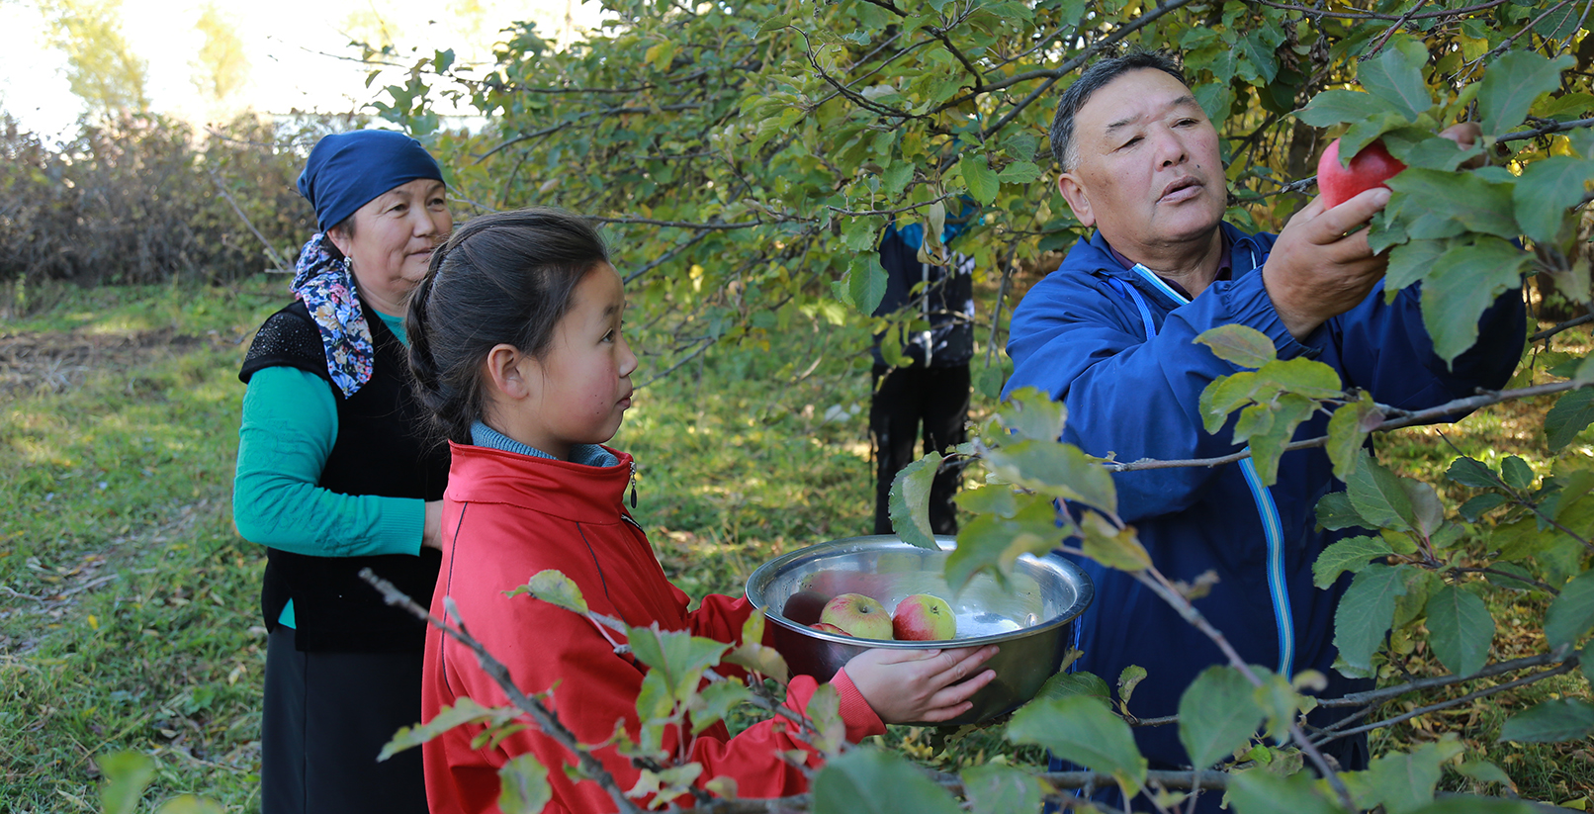
Why social infrastructure is critical for healthy longevity
Chingiz Namazaliev/HelpAge International

Slide 38
Social connections
      Drivers of
      health and wellbeing
      Lead to
      social and intergenerational cohesion
      Start in local communities
      and should be
      fostered

Slide 39
Isolation and loneliness
      Isolation and
      loneliness
      are associated
      with poor mental
      and physical
      health

Slide 40

Addressing isolation and loneliness through social inclusion
      Minimize age segregation
      Ensure ongoing social connections
      Leverage religious, spiritual connections
      Empower older people
      Create opportunities for intergenerational connections

Slide 41

Empowering communities and engaging older voices
      Community advocacy
      Empowering older voices
      Engaging older people through participatory design

Slide 42
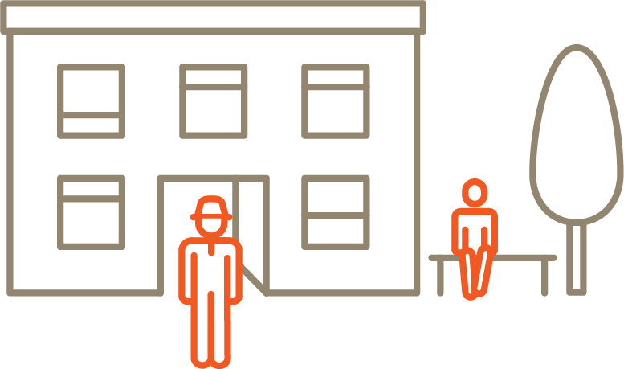
Community-level interventions to support social inclusion
      Community-based centres where older people can gather
      Intergenerational self-help club

Slide 43

Promoting intergenerational cohesion
      Intergenerational approach encourages two or more generations to work together
      Intergenerational activities promote generational cohesion
      Intergenerational groups combine voices of older and younger people

Slide 44
Plenary discussion
      Can you share how you are socially active in your community?
      How does it make you feel?

Slide 45
Session 6:
Enablers of healthy longevity: Health and care systems

Slide 46

Why health and care systems are important for healthy longevity
      Health and care systems were designed to respond to needs of younger populations with a focus on infectious disease
      Health systems have not adapted to changing populations and needs of older people
      Adapting health and care systems to better support older people and promote healthy ageing is crucial for healthy longevity

Slide 47
Integrated Care for Older People (ICOPE)
      Functional outcomes
      Integrated care
      Community dissemination
      Policy guidance

Slide 48
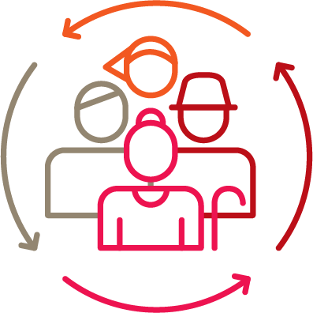
Person-centred care
      Places perspectives of individuals, families, communities
      Places older people at the centre of their care, as as participants in rather than recipients of care
      Responds to older people’s needs in holistic ways and provides care in a joined-up, integrated way
      Relationship-based

Slide 49

Health and care and support should be proactive, not reactive
      Healthcare should be proactive
      Focus on preventing illness and early detection of disease and to encourage good health
      Health and care should focus on the whole person and not just their illness

Slide 50

Improving health systems
      Build trust in communities
      Educate people from a young age about healthy lifestyles
      Ensure accessible healthcare facilities
      Focus on integrated and person-centred care

Slide 51

Plenary discussion
      Why are older people’s voices essential for health and wellbeing?
      What roles can older people play in addressing healthy longevity?

Slide 52
Session 7:
Ageism as a barrier to healthy longevity

Slide 53
Ageism affects older people’s health
      Ageism
      Disease
      Poverty/
      Social determinants of health
      Pollution
      and climate
      Social
      and family
      conflict
      Inequity

Slide 54
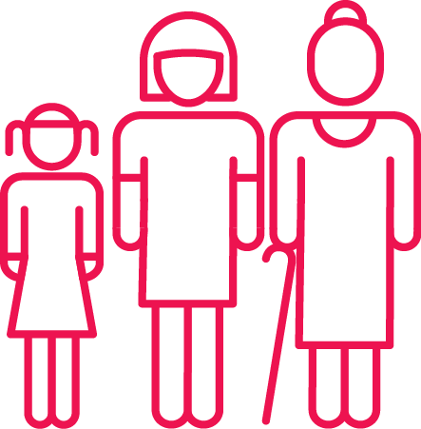
Definition of ageism
      “Ageism is the stereotyping and discrimination against individuals or groups on the basis of their age.”
      World Health Organization

Slide 55
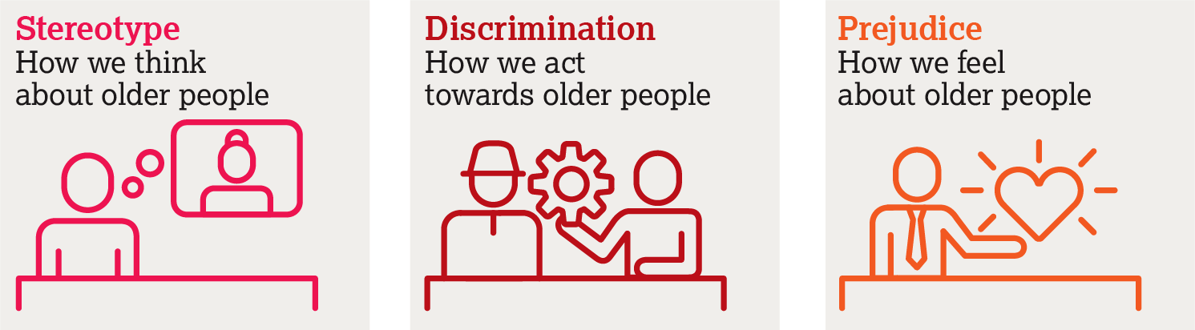
Three dimensions of ageism
World Health Organization

Slide 56

Group activity
      Discuss:
      What stereotypes exist about older people in your community?
      Are there different stereotypes for older men and older women?

Slide 57
Plenary discussion
      How do stereotypes about older people affect their health and wellbeing?

Slide 58
Lived experiences of ageism
      “There are cases in the hospitals when we have to wait in long queues to see a doctor and when we are seen some doctors don’t bother to listen to everything we have to say,
      let alone examine us properly.”
      Vera, Kyrgyzstan

Slide 59
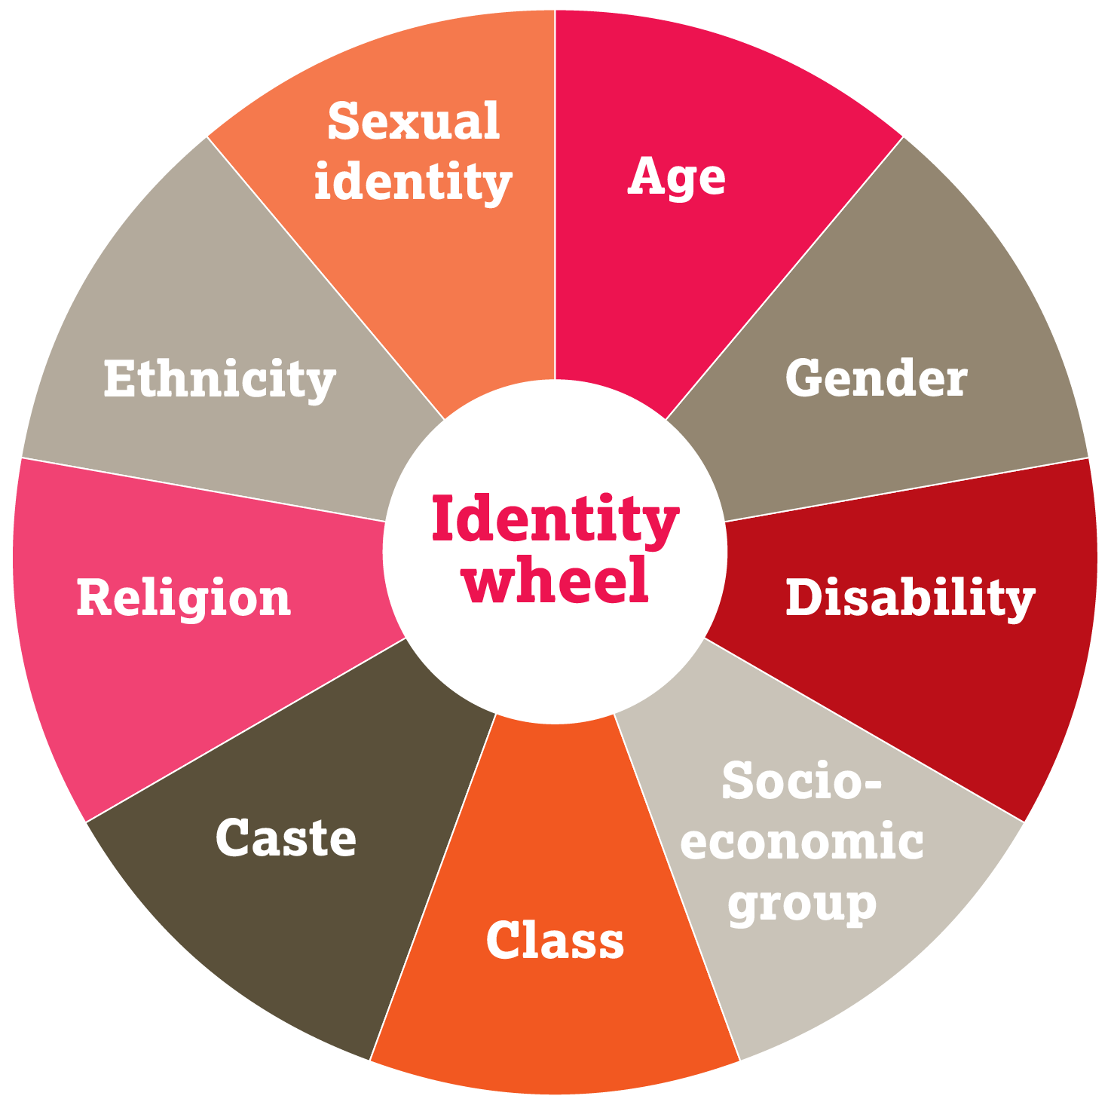
Ageism intersects with other individual characteristics

Slide 60
The impact of ageism on older people’s health and access to healthcare services
      Negative attitudes towards older patients is widespread among health workers, including medical, nursing and physiotherapy staff
      Medical staff have been found to withhold treatment options or exclude older people from medical trials
      Research has found poorer management of illnesses like cancer and depression among older people
      Age caps on free healthcare programmes
      Excluded from decision-making about individual health and care
      Policy level – excluded or not meaningfully involved

Slide 61
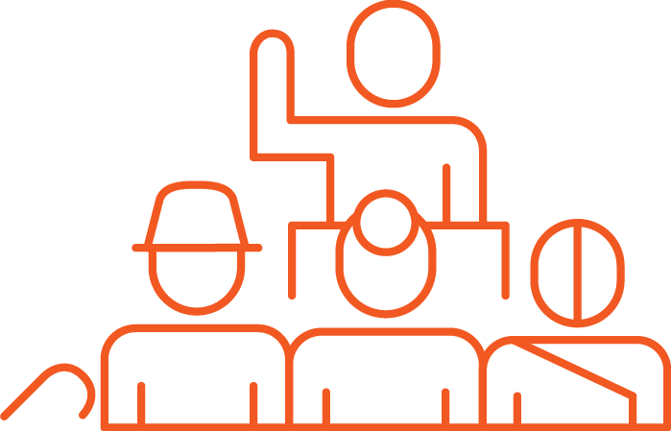
Why it’s important to dispel myths and challenge ageist stereotypes
      Ageism and age discrimination violate people’s right to equality and non-discrimination
      Ageing myths should be dispelled and stereotypes challenged
      Ageism is also a barrier to older people’s participation and Voice

Slide 62
Session 8:
Taking action

Slide 63
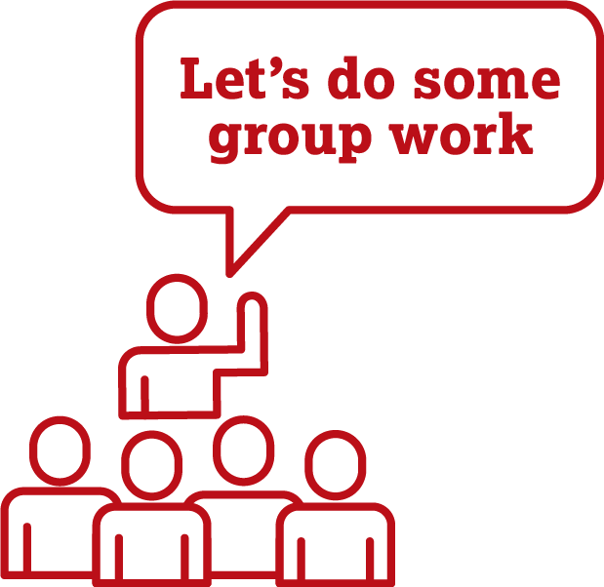
Taking action for healthy longevity

Slide 64
Questions for group action plans
      What is the issue? What could be changed, expanded, or enhanced at the community level, however big or small, to improve older people’s health and wellbeing?
      Who needs to be involved? Consider the issue you want to tackle and identify who needs to be involved.
      What actions can be taken? Identify actions to improve health and wellbeing of older people at the community level.

Slide 65

Presentation of group action plans

Slide 66
Session 9:
Workshop wrap-up

Slide 67

Any final questions or reflections?

Slide 68

Reflection time
      One new thing you have learned
      One action you will take as a result of the training
      One piece of information or knowledge that was reinforced as a result of the training

