Slide 1
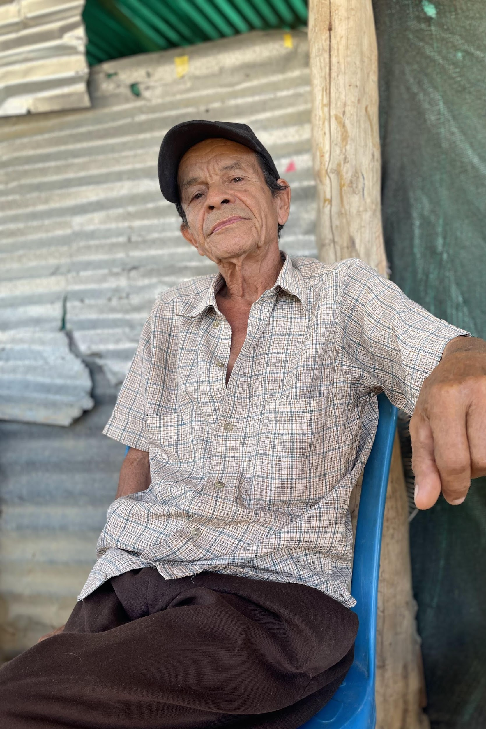
1
Valentina Pardo/HelpAge International
HELPAGE’S VOICE TRAINING TOOLKIT:
Age-friendly Cities and Communities Module
Charity Registration no. 288180 © HelpAge International 2023
Notes:
ICEBREAKER
INTRODUCTIONS

Slide 2
Session 1
Introduction to Age-friendly Cities and Communities (AFCC)

Slide 3
Session 1:
Introduction to Age-friendly Cities and Communities (AFCC)
Workshop objectives
1. Help participants understand why the voice of older people is important and how it can be raised.
2. Introduce urban design principles and concepts to encourage communities to think about the issues they may want to look at in more detail.
3. Provide ideas and examples of how communities can articulate voice to bring about change on these issues.
Notes:
Present Slide 2 (Workshop objectives). Explain that the purpose of the workshop is to introduce participants to the design principles, concepts and ideas behind Voice and age-friendly cities and communities. Explain that it also aims to encourage participants to think about what actions they can take to make cities and communities more age-friendly and governance systems more inclusive, focusing on the built environment and the use of public spaces and public transport.

Slide 4
Workshop schedule
Date: x to xxxxx | Time: xx:xx - xx:xx hrs
Date: x to xxxxx | Time: xx:xx - xx:xx hrs
Date: x to xxxxx | Time: xx:xx - xx:xx hrs
*Each session includes a 10-minute break
Notes:
Be sure to adjust your workshop schedule, and amend the accompanying slide, according to your delivery method (online or in person) and numbers of days necessary.
Present Slide 4 (Workshop schedule). Outline the schedule for the day; explain how the different modules/days will build on each other.
Ask if anyone has any questions or concerns about the workshop or the timings. Explain the different ways of workshop delivery, whether online or in person (including break-out groups, online whiteboards, other adapted activities).
Propose an interactive, or ‘icebreaking’, approach for participants to introduce themselves to each other (to adapt online and offline).

Slide 5
How the communities we live in impact our experience of older age
The World Health Organization (WHO) definition of healthy aging is:
“
The process of promoting and maintaining the functional capacity that allows well-being in old age.
“
Notes:
Present Slide 5 (How the communities we live in impact our experience of older age). Explain to participants why different characteristics of the communities we live in affect our day-to-day lives. Use the following statements and questions to lead the discussion:
The community we live in – including the buildings we live in or visit, the streets we walk down, the public spaces we sit in and the public transport we travel on – affects our experience of older age.
The community we live in also affects the process of ageing itself, when examined from a life-course perspective.
The World Health Organization’s (WHO) definition of healthy ageing is “the process of developing and maintaining the functional ability that enables wellbeing in older age”.
A number of factors influence how these elements of the community around us affect our day-to-day lives.
Ask participants to think about these questions, not just from their own perspective, but from the perspective of older people in their communities:
Are the streets and public spaces around us places where we feel comfortable, safe, welcomed, and have a sense of belonging?
Can we easily make comfortable and affordable journeys to the places we want to go?
If we can’t, how does this affect our lives, our decisions about where we can go, where we spend our time, and who we can see?
How are decisions made about urban planning and do older people feel included in these decisions?

Slide 6
How design and policy affect equity in our communities
Decisions affect our lives in different ways according to a range of factors, including age, gender, disability, socio-economic group, class, caste, religion, ethnicity, race and sexual identity.
Notes:
Present Slide 6 (How design and policy affect equity in our communities). As discussed in Slide 4, the decisions and policies involved in planning, designing and building our communities affect different people differently.
Decisions affect our lives in different ways according to a range of factors, including age, gender, disability, socio-economic group, class, caste, religion, ethnicity, race and sexual identity.
While some streets, public spaces and buildings are accessible and welcoming to some people, they may not be so to others.
Decisions about a street or building include how it is designed, how physically accessible it is, what businesses and services are permitted there, how expensive it is to buy or rent a property there, and how safe it feels for different people at different times of the day or night.

Slide 7
What are the benefits of age-friendly cities and communities for older people?
Get involved and understand
Planning
Age-friendly environments
Measure
Acting
Notes:
Present Slide 7 (What are the benefits of age-friendly cities and communities for older people?). Ask participants what they think the benefits of age-friendly cities or communities are.
Explain that there are many benefits of having communities that better support ageing and older people. They include:
reduced social isolation and increased social connectedness
reduced loneliness
increased physical activity
improved physical and mental health
access to services and opportunities (including health services, education and economic opportunities).

Slide 8
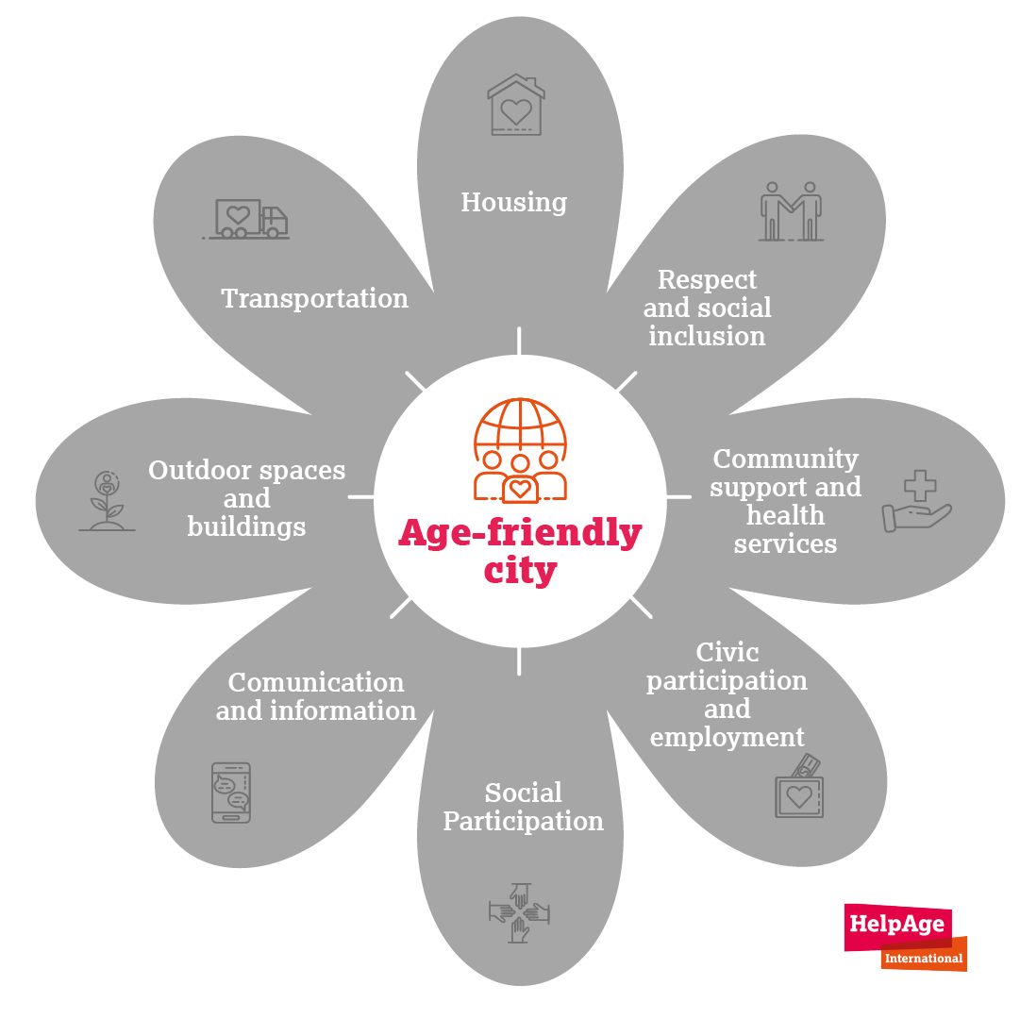
Discussion in pairs
1
What does an age-friendly city or community look like?
2
Do you have an example of something age-friendly from the place where you live?
3
Do you have an example of something not age-friendly?
Notes:
Present Slide 8 (Discussion in pairs). Ask participants to introduce themselves to the person next to them and to share what they think age-friendly cities and communities look like. Can they share something that is age-friendly where they live? Can they share something that is not age-friendly? Allow 10 minutes. Then ask participants to feedback what they discussed in their pairs. Allow 5 minutes for this.
Give an overview of the step-by-step age-friendly cycle. In this way, we provide a way to set a baseline against which we can assess results.
Ask participants if they know about the WHO’s
8 domains for an age-friendly environment. Briefly describe each of the domains. Note that the domains can be adjusted to local realities. For example, issues such as migration or climate change might be more important in certain cities or communities.

Slide 9
Welcoming, green, safe and walkable communities
&
Mobility and transportation for everyone
Notes:
Present Slide 9 (Welcoming, green, safe and walkable communities, and mobility and transportation for everyone). While there are many domains that affect older people’s experiences in their communities, later in this module we look in more detail at how communities can be more welcoming, green, safe and walkable. We also look at how mobility and transportation can work for everyone, and the impact this has on older people.

Slide 10
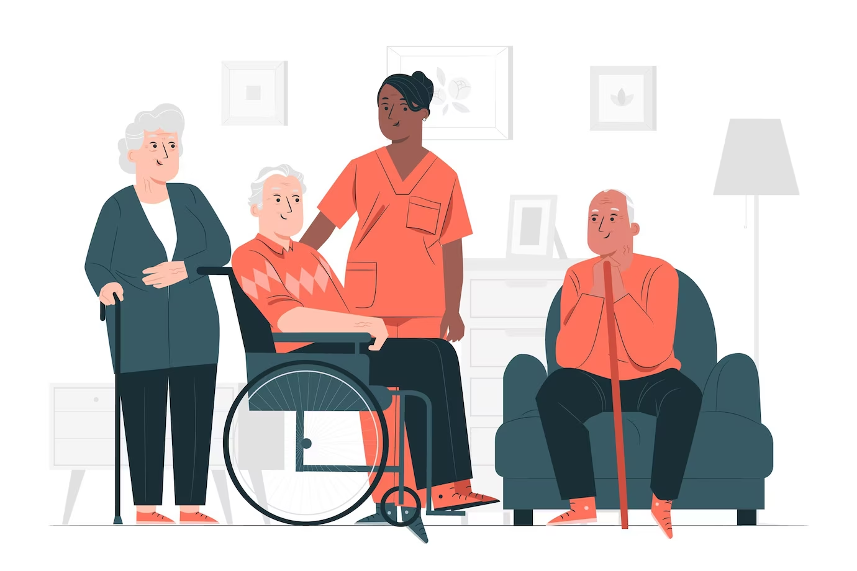
Age-friendly cities and communities are…
In general, age-friendly cities and communities are places that adapt the environment to what older people say is relevant and reduce barriers identified by older people.
Notes:
Present Slide 10 (Age-friendly cities and communities are…). Ask participants how they would define age-friendly cities and communities.

Slide 11
Session 2
Understanding Voice

Slide 12
Plenary discussion
What comes to mind when you think of Voice (in relation to a community or individual)?
Notes:
The objective of this session is to explore what Voice means and introduce key concepts.
Present Slide 12 (Plenary discussion). Ask people to share in plenary what comes to mind when they think of Voice.
As participants share their ideas, write them down on a piece of flipchart paper (or online whiteboard or post it note applications). Summarise the discussion and ideas to wrap up. Allow 10 minutes.

Slide 13
Key concepts underlying Voice work
1
2
3
Notes:
HelpAge uses Voice as an umbrella term, covering participation, empowerment, agency, autonomy and accountability.
Present Slide 13 (Key concepts underlying Voice work). Read out the list of key concepts.
Explain that these are the key concepts underlying Voice work and that they will be referred to throughout the workshop. Participants will also think about how these concepts relate to Age-friendly Cities and Communities, and specifically the built environment.
Explain that Voice work is cross-cutting and it is important to think about how we relate it to the different areas we work on. Whether it’s health, social protection or age-friendly communities, thinking about older people’s participation, empowerment and autonomy is crucial to thinking about our programming or advocacy from a rights-based approach. It means that we are putting older people’s needs and rights at the centre of our work, and that we value listening and responding to the Voice of the older people we work with.
To discuss how Voice relates to other areas of work, such as accountability, you can refer to the HelpAge Voice Framework and Toolkit, which is available here.

Slide 14
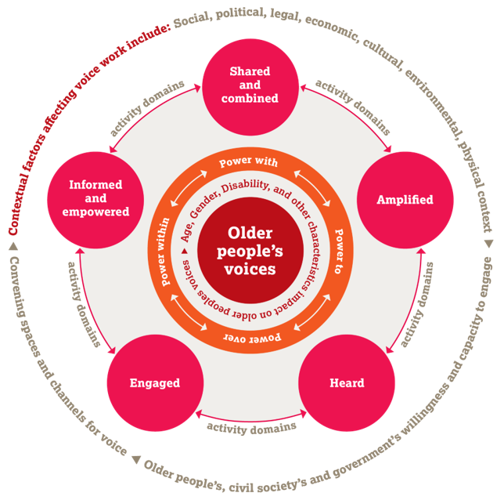
Voice framework diagram
Notes:
Present Slide 14 (Voice framework diagram).
Explain that HelpAge developed this framework to better understand how to strengthen older people’s Voice. Explain that you will briefly unpack the Voice framework now. Distribute Handout 1: Voice framework diagram. Later in the workshop we will think about how the different elements of the framework can relate to age-friendly communities.
Explain that the outer circle of the diagram shows that we need to consider the contextual factors that affect what we do around Voice. These include the social, political, legal, economic, cultural, environmental and physical contexts. This can include the existing built environment, public spaces and public transport, which can either help or hinder older people in exercising their Voice. In some places it may be easier for older men to exercise Voice about issues that affect their lives (social and cultural) while in other countries the economic and political environments may mean that social and political rights are under threat. The physical environment can also have an impact on older people’s ability to engage in community life.
The bottom of the outer circle refers to the willingness and capacity of older people, civil society and government to engage.
Point out that we also need to consider the willingness and capacity of different stakeholders – including civil society, decision-makers and older people themselves – to engage in activities that promote older people’s Voice, particularly those relating to the built environment:
• Civil society needs to be able and willing to support action by older people.
• Government’s willingness and capacity varies widely, depending on the nature of the political settlement in a given country and the extent to which people are free to exercise their Voice and engage as citizens.
Local government is a key stakeholder distinct from national government and may have a different willingness and capacity to work towards age-friendly communities.
Other stakeholders such as private developers or transport providers are also relevant but may have different motivations such as profit.
Older people’s willingness and capacity depends on many different factors.
The Voice Training Toolkit has more sessions on understanding power if participants are interested in exploring this further.
Referring back to the diagram, explain that older people’s voices are at the centre, encircled by ‘age’, ‘gender’, ‘disability’ and ‘other characteristics’. This indicates that these characteristics inevitably affect older people’s ability to use their Voice, including when speaking out on issues around Age-friendly Cities and Communities.

Slide 15
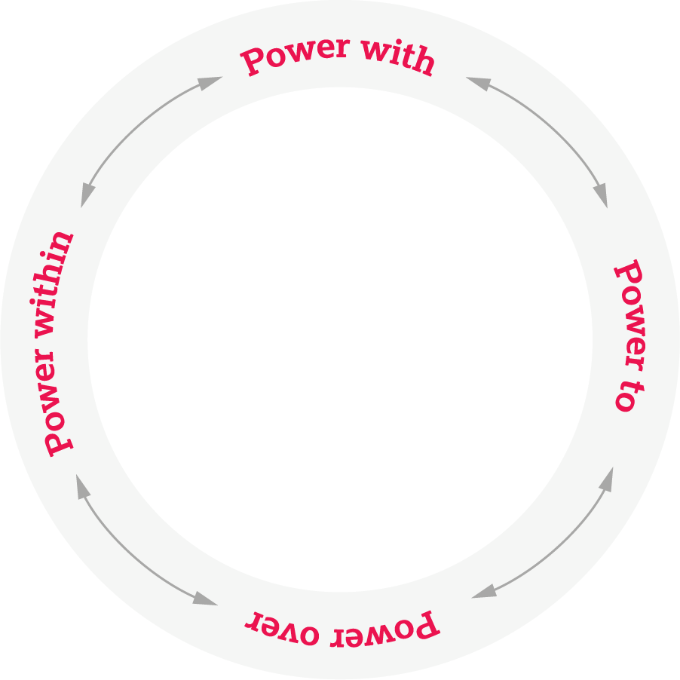
Forms of power
‘Power over’ influential people and key aspects of their own lives
‘Power to’
claim their rights and be heard
‘Power within’ themselves
‘Power with’ others to press for their rights
Notes:
Present Slide 15 (Forms of power)
Explain to participants that it is crucial to think about the power that different older people hold. For example, older women and men hold different roles and their status in society varies. And the power we hold can also depend on varying characteristics. If we are older and live with a disability, we are likely to face challenges in influencing decisions about our communities or our own lives.
Social, political, economic, cultural, environmental and physical factors, and legal rights frameworks (to the extent that they exist) all affect power relationships. Power can manifest itself in different forms (visible, invisible and hidden), at different levels (individual, household, local, national and global) and in different spaces (invited/formal or claimed/informal). Power relationships have a significant impact on what actions people can take to promote older people’s Voice.
In summary:
Power over – dominance
Power to – being able to act, make decisions or create change
Power within – sense of confidence, dignity and self-esteem that comes from gaining awareness of one’s situation
Power with – collective action and solidarity

Slide 16
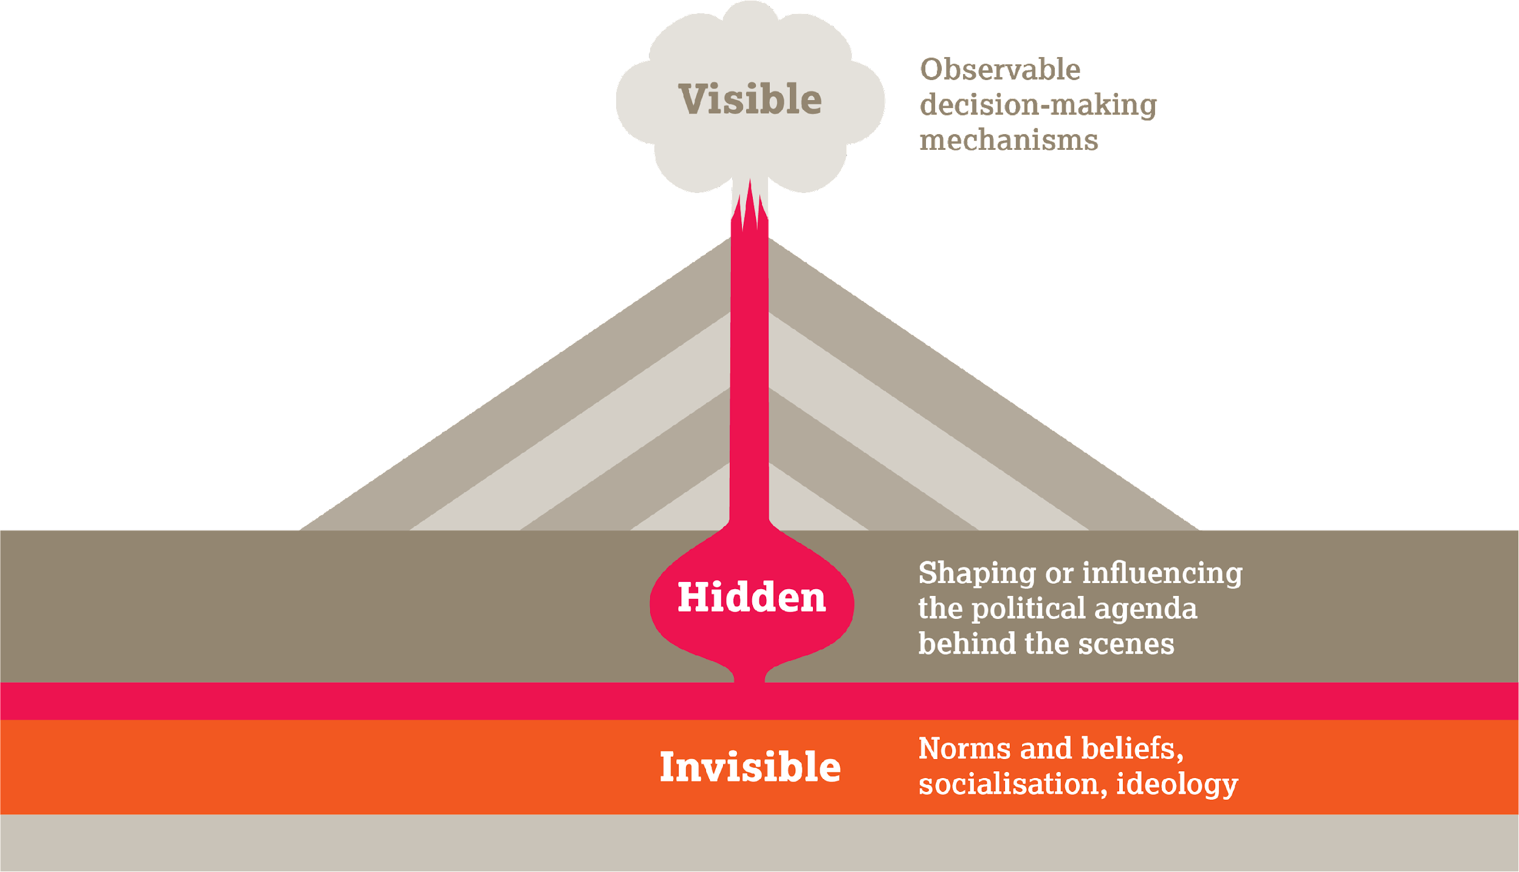
Power:
Visible
Invisible
Hidden
Número de registro de organización benéfica: 288180 © HelpAge International 2021
Notes:
Present Slide 16 (Power: visible, invisible and hidden)
Lead participants into an explanation and discussion around visible and hidden power.
Visible power:
Formal rules, structures, institutions and procedures
How the game is currently played
Instruments of formal power: constitutions, laws, policies, budgets, etc. The voice of the powerless is not always represented.
Hidden power:
Takes place in informal spaces. Not what people commit to publicly
Many decisions are taken in private
Real power is often hidden
Invisible power:
• Dominant ideologies, values and social norms shape attitudes, expectations and behaviour
• Constitutes ‘the natural order’ of things
• Perceived as acceptable (social norms)
• Fear of social sanctions by your peers
• Within communities, families, individuals and can be transferred from one generation to another
“Invisible power often determines the capacity of change movements to influence visible and hidden power. It shapes the belief systems about what is ‘normal’ or ‘natural’...”
Duncan Green, How Change Happens
Power can operate at all levels: household, local, national, international

Slide 17
Individual and group characteristics that influence people’s ability to raise their Voice, which intersect with each other
Age
Gender
Disability
Socio-economic group
Class
Caste
Religion
Ethnicity
Race
Sexual identity
Notes:
Present Slide 16 (Individual and group characteristics that influence people’s ability to raise their Voice, which intersect with each other). Ask participants what some of these characteristics might be.
Point out that for older people, age, gender, ability, disability, socio-economic group, class or caste, religion, ethnicity and sexual identity are particularly significant factors affecting their ability to use their Voice. More information on Voice and ageism can be found in Module 2 of the Voice Training Toolkit.
A person’s experience of ageing is not “one size fits all”. For example, women, people with disabilities, and older people from indigenous communities or different socio-economic backgrounds may have diverse experiences, both in exercising their Voice and how they experience the community they live in. We’ll be looking at this in more detail throughout the training.

Slide 18
The Voice domains
Engaged: Activities to motivate older people to engage in decision-making processes.
Informed and empowered: Activities to support older people to be informed about issues that affect their lives and empowered to participate in decision-making processes.
Shared and combined: Activities to enable older people to share their experiences, identify their needs and rights, and combine their views to create a collective Voice.
Amplified: Activities to support older people to communicate their views by using different channels of communication.
Heard: Activities to support older people to have their Voice heard and responded to by those in positions of power.
Notes:
Present Slide 18 (The Voice domains). Explain that the Voice framework includes five domains, and read them out: engaged, informed and empowered, shared and combined, amplified, and heard.
The framework suggests that older people’s voices are strongest when all the domains of Voice are addressed together. Read out each of the domains, and the description. Encourage participants to think about how these might relate to age-friendly cities and communities as we go through the different sessions.
Later, we will explore together how these domains relate to age-friendly cities and communities and will provide some examples.
For more information on Voice and accountability, refer participants to Module 3 of the Voice Training Toolkit.
Para más información sobre Voz y rendición de cuentas, refiera a los participantes al Módulo 3 del Kit de Instrumentos de Capacitación en Pro de la Voz.

Slide 19
Questions?
Notes:
Present Slide 19 (Questions?). Before you wrap up this session, ask participants if they have any questions about the Voice framework.

Slide 20
Session 3
Age-friendly Cities and Communities from an intergenerational perspective

Slide 21
What is an intergenerational approach?
An intergenerational approach encourages two or more generations to work together for their mutual benefit and to promote greater communication, understanding and respect. It is a crucial tool in combating ageism.
The benefits of this approach include:
Breakdown and reduction of stereotypes
A stronger combined Voice
Heightened local knowledge passed through generations
Decreased social isolation among older people
Increased social awareness and academic performance among younger people.
Notes:
Present Slide 21 (What is an intergenerational approach?). Ask participants, ‘what is an intergenerational approach?’ and follow this up with ‘what are some of the benefits of an intergenerational approach?’
Talk participants through the basic definition and benefits of intergenerational approaches.
Ensure that you are familiar with HelpAge’s intergenerational approaches guide, Bringing generations together for change.

Slide 22
Key principles
Understand power dynamics and context.
Don’t start from scratch.
Involve diverse members of the community from the outset.
Pay attention to who leads and who can lead.
Start with the premise that everyone has a skill and some knowledge to transfer.
Go beyond participation to meaningful engagement.
Think “structural” changes.
Notes:
Present Slide 22 (Key principles). Run through these seven principles of intergenerational projects and discuss how they could relate to age-friendly cities and communities.
Understand power dynamics and context.
Carry out a detailed stakeholder analysis to understand existing dynamics, including gender, power or social dynamics, and the issues that people are facing in their community.
Make sure the approach is specific to the context and promotes local ownership; knowledge of the local, regional and national context will help ensure that the project avoids doing harm and is more likely to succeed.
Don’t start from scratch.
What groups have already been formed and what are their power dynamics? Are there existing older people’s groups or youth groups in the community?
Involve diverse members of the community from the outset.
People are diverse in their identities; an approach that looks at how these identities intersect will highlight the nature of dynamics and any reasons why some people are excluded or discriminated against.
Pay attention to who leads and who can lead.
Try to avoid reproducing or reinforcing unequal power relations.
Younger and older people might have different leadership styles.
Start with the premise that everyone has a skill and some knowledge to transfer.
Whatever their age and background, everyone has a skill to share that has equal value and should be appreciated.
Go beyond participation to meaningful engagement.
Ensure that your project supports those taking part so that they can engage with each other meaningfully to find common goals.
Think “structural” changes.
To maximise the impact of your work, think about how it can support enduring change – not just around policies but also in terms of social norms.

Slide 23
Exercise:
The Candy Game
Instructions
For each color, mention something about how your character feels about their neighborhood.
Notes:
For this section, there are two exercises to choose from. If the training is delivered in person, participants will engage in The Candy Game. If online, the Power Walk is an alternative option.
Present Slide 23 (Exercise: The Candy Game). This game encourages participants to express their views about their community from the point of view of older and younger people.
Objectives
● Help young people and older adults get to know more about the issues that people in other age groups care about.
● Help participants learn that even though they may be of different ages, as neighbours they share some of the same concerns.
Steps
Put participants into groups of 5–7 people.
Give a bag or bowl of multi-coloured M&Ms/Skittles to each group, alongside one bowl or bag containing the same number of character slips. Distribute Handout 2: The Candy Game.
Ask participants to take turns selecting candies and character slips from the bag or bowl (without looking). For each Skittle they choose, they should say something about how they feel about their neighbourhood based on the colour* they choose and the point of view of their character.
Red: Say something you dislike about your neighbourhood.
Purple: Say something you like about your neighbourhood.
Green: Say something about what you like to do in your neighbourhood.
Yellow: Say something about your neighbourhood that you would like to change.
Orange: Say something about your neighbourhood that you fear.
Allow the groups to go through this exercise at least 4 times.
Then bring the groups back together in plenary. Ask participants to discuss common themes that emerged from each group. Highlight the most common themes mentioned (likely to be ‘safety’ and ‘accessibility’) and how they can be linked to the following sessions on urban planning.
Lead the plenary discussion by reading out the below statements on power, and ask participants to comment on how they feel, based on their characters and experiences in the game:
Whenever you write a complaint letter to the local authority regarding a nuisance in your neighbourhood, you are getting a response and an invitation to a meeting
You understand how decisions are made about local urban improvements in your locality and know how to influence them
You are comfortable using social media to know what advocacy campaign is going on to make improvements in transports and pollution levels
Your suggestions are taken into account by local authorities and they consult with you and your peer groups in your locality
Ask participants to think about how those themes can also be linked to older people’s Voice.
*Colours to be changed based on the candies/sweets used.
Adapted from the Intergenerational activities sourcebook from PennState College of Agricultural Science

Slide 24
Exercise:
Power walk
Separate the plenary by
Observers
Participants
Instructions
For each statement, the participants representing a character must either step forward or remain in place, depending on whether or not the statement applies to them.
Notes:
Present Slide 24 (Power Walk)
This exercise enables participants to visualise how different social and economic characteristics lead to inequalities of power, and how that affect who has a Voice and whose Voice is heard.
Objectives:
Put a face to diversity and intersection of identities
Understand and discuss forms of power and implications on Whose Voices count
Steps:
Depending on total number of participants, the exercise can be either done in small groups or in plenary
Select 8-10 participants (or less if in small groups) and share with them secretly (handing a piece of paper or typing a secret message to them) the profile of a personae they will be representing (see examples below)
Tell the other participants they will be observers of the activity initially.
Read out a few prepared statements, supplied below.
For each statement, participants representing a character either take a step forward (or raise the online meeting hand) or stay in place, depending whether the statement applies to them (example below)
Once all the statements are read out, ask participants to share how they feel about where they stand/how many hands they were able to raise and how they feel about their power, based on their characters’ point of view and also their own.
Ask a few observers to make comments about what they saw and the connection they make between ‘status’, power and ability to create changes in their cities.
Character examples (you will need to add more depending on the numbers of participants and the context):
You are a 75-year-old woman, middle class and the wife of the local counsellor
You are an 80-year-old disabled woman, widow and living in a high rise in a poor neighbourhood
You are an 18-year-old male climate and environment activist, in final year of high school, about to enter university
You are a 24-year-old local ‘Youth Club’ president and involved in local politics (running to be a Youth Member of Parliament)
Examples of statements:
Whenever you write a complaint letter to the local authority regarding a nuisance in your neighbourhood, you are getting a response and an invitation to a meeting
You understand how decisions are made about local urban improvements in your locality and know how to influence them
You are comfortable using social media to know what advocacy campaign is going on to make improvements in transports and pollution levels
Your suggestions are taken into account by local authorities and they consult with you and your peer groups in your locality

Slide 25
Session 4
Urban planning concepts: welcoming, green, safe and walkable communities

Slide 26
Let’s explore…
Welcoming, safe and walkable communities
Notes:
Present Slide 26 (Let’s explore… Welcoming, safe and walkable communities).
Explain to participants that in this session, as an example of an issue that is often important to older people’s daily lives, we will discuss some of the key planning issues and decisions around how to create welcoming, safe and walkable communities.
It is important that communities have a basic understanding of urban planning concepts to be able to form informed opinions and develop effective advocacy goals.
If participants find this topic interesting and relevant, there are suggestions on how they can take this forward to fully understand the experiences older people have in their communities, and what change can look like, and how they can exercise that change.
This session is intended to introduce the topic and have some initial discussions that might inspire further action.

Slide 27
What are some of the planning principles that create an inclusive and age-friendly community?
Notes:
Present Slide 27 (What are some of the planning principles that create an inclusive and age-friendly community?).
Explain that this session will look at different planning principles that can make communities more welcoming, safe and walkable for everyone, including older people. Throughout this training, we will explore how some cities and communities are making improvements to be greener, safer and more walkable. It also discusses key concepts that might be relevant to participants’ communities.
Explain to participants that different stakeholders and decision-makers are involved in policy and planning.
These stakeholders include local government, private developers, local departments of urban works, transportation departments and others.
These decisions involve many political choices – for example, whether to give more space to cars or pedestrians, whether to build homes or offices, and whether or not to include space for community facilities.
There are planning principles that can help create communities that are more age-friendly and inclusive – but these principles are not always applied when decisions are made.
This session will explore how these principles might work in your community.

Slide 28
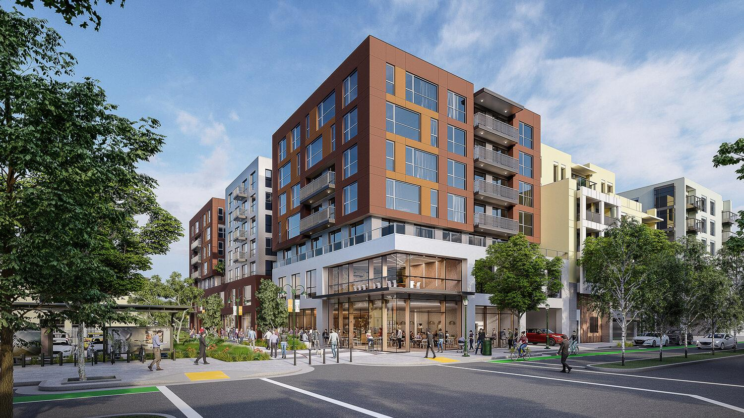
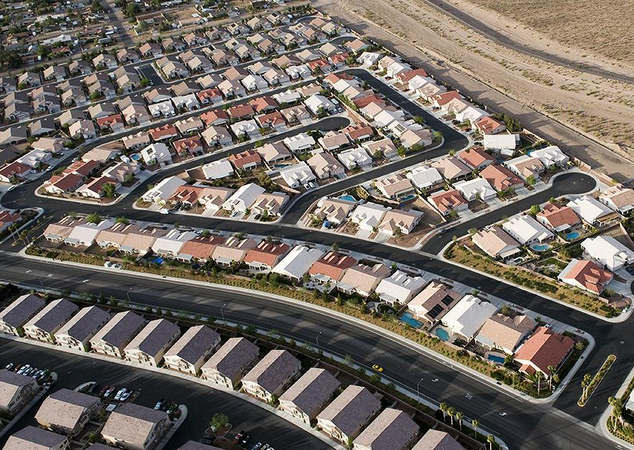
Density and mixed use
Notes:
Present Slide 28 (Density and mixed use).
Explain that some cities and communities are separated into zones, with offices and commercial activities in the centre, and housing and residential areas entirely separate. This means that people cannot easily walk to work, to a health facility, or to the shops or market, and so they have to drive or use (and pay for) public transport.
Many cities aim to have mixed-use communities with higher levels of population density – this means having more people living in the community so that local services such as shops, public transport and green spaces are more likely to be vibrant and sustainable.
It also means mixing uses so that people’s homes have shops and other services and green spaces nearby, ideally within a 10-minute walk.
This approach avoids sprawling residential suburbs where everything is far away and difficult to get to without a car.
Mention that many established or traditional communities are already mixed use, but places such as food markets or small independent shops are increasingly threatened when large supermarkets or developments are built, sometimes near a highway, taking away business. Developments are often built in places that are difficult to walk to and are designed for use by people with a car.

Slide 29
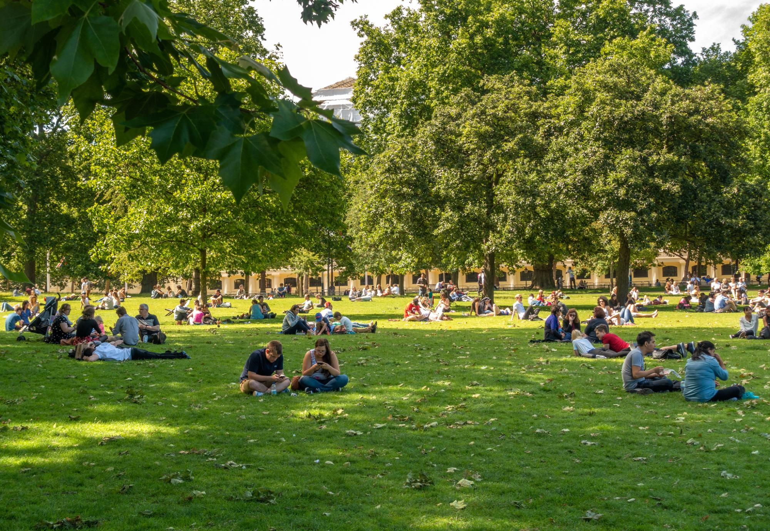
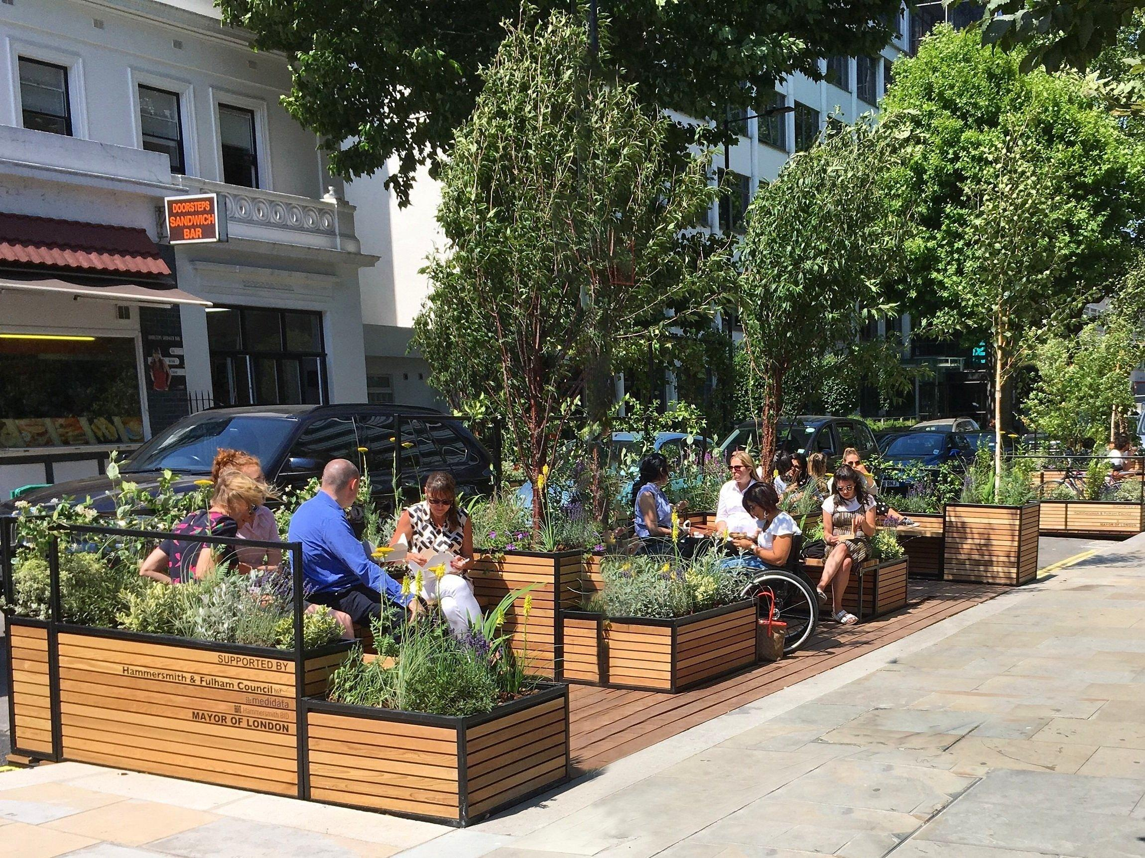
Green spaces and parks
Notes:
Present Slide 29 (Green spaces and parks). Explain the following:
Parks, gardens and shared spaces provide opportunities for people to connect with nature, to reflect, to socialise, and to do physical exercise.
Pocket parks are small pieces of land or parking spaces that are turned into mini green spaces.
Green spaces are not limited to public parks but can include community gardens and streets with grass buffers (between the road and the street).

Slide 30
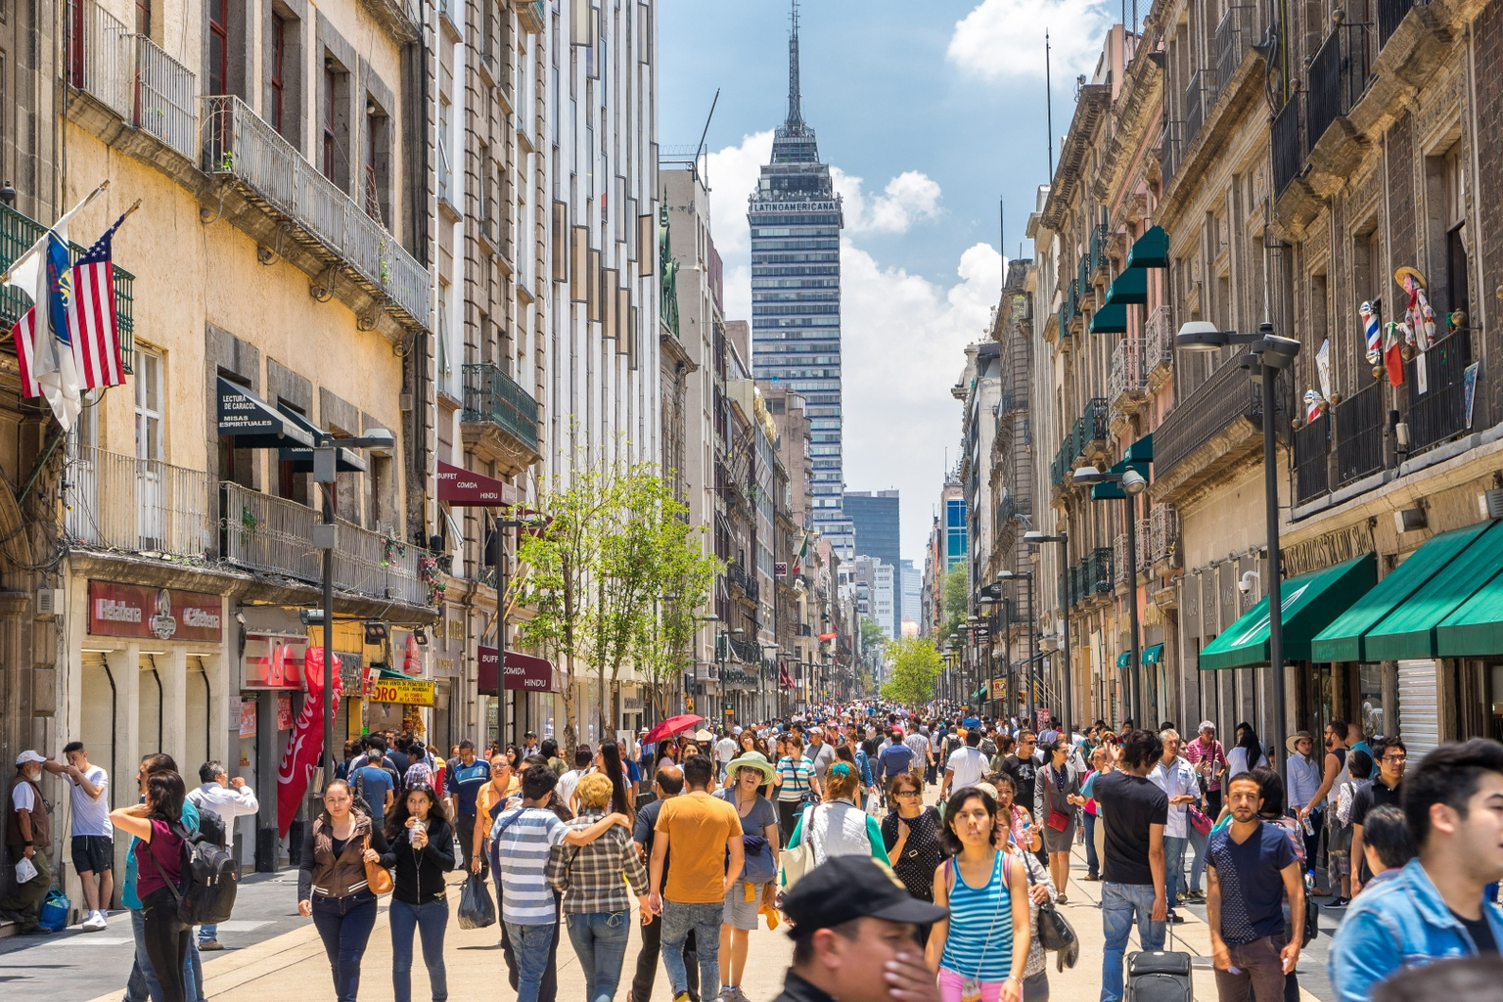
Walkability and pedestrian infrastructure
Notes:
Present Slide 30 (Walkability and pedestrian infrastructure).
Talk about how encouraging people to walk to get to places is good for their health. Not only is walking a good form of physical exercise but it also presents opportunities to see neighbours and friends along the way.
Another benefit is that when people walk to places, they are more likely to stop at other places, such as small local businesses or the local library.
Policy makers can encourage walking by making sure that streets are well designed and maintained, with plenty of space for pedestrians, low levels of traffic and slow traffic speeds, places to rest, and good signage showing people how to get to places.
Mention that the availability of toilets is often a concern for older people and something that prevents them from walking too far from home or places where they know they won’t have access to a bathroom.

Slide 31
Safety through design
Notes:
Present Slide 31 (Safety through design).
Explain to participants that design decisions can influence whether a space feels safe and whether it encourages or discourages crime.
These decisions include making sure there is adequate lighting, avoiding building corners and hidden spaces where criminals can hide, and having streets and public spaces that are overlooked by residents and businesses (crime is less likely to happen when other people are watching).
Most people would feel uncomfortable and fearful walking down a quiet street with poor lighting, hidden corners and nobody else around. This can mean that they avoid going for walks altogether.
When designing buildings, streets and public spaces, younger and older people could use their Voice together and/or separately to influence policies and design decisions

Slide 32
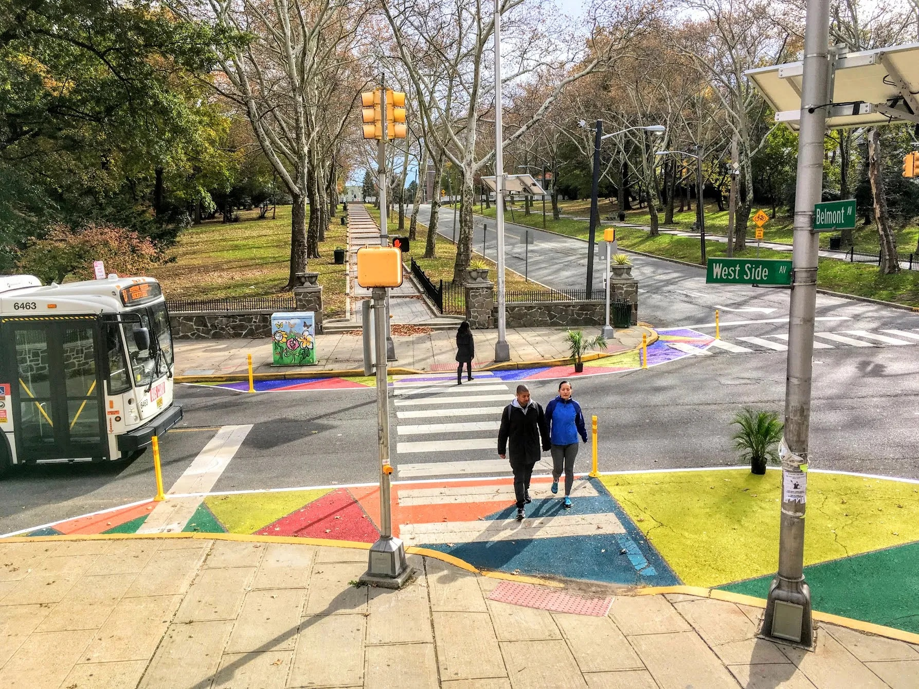
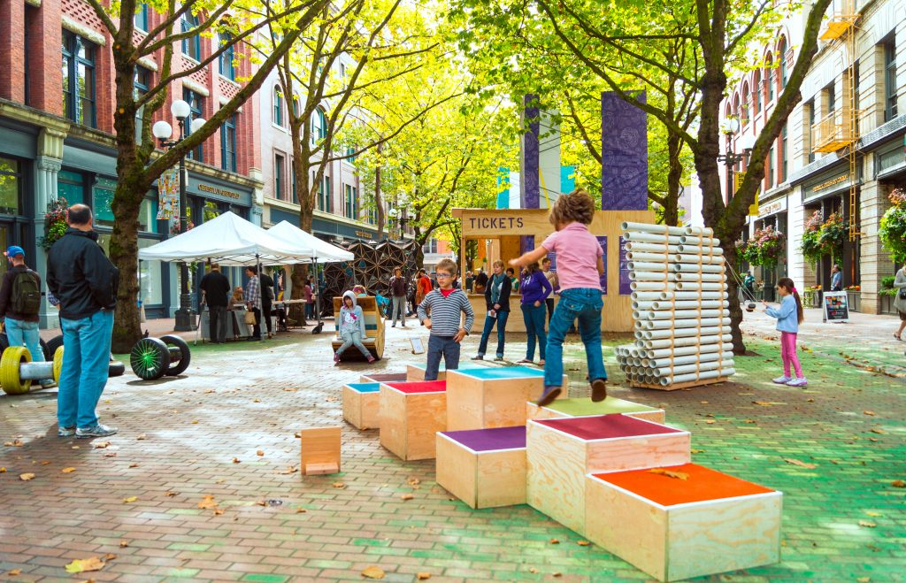
Change through tactical urbanism
Notes:
Present Slide 32 (Change through tactical urbanism).
Introduce the concept of tactical urbanism, which is when communities make small and simple changes to improve older people’s daily lives. This can include creating new road crossings, extending sidewalks or creating community art. Sometimes this is done without the permission of the local authorities.
These kinds of initiatives can be the first step in building momentum for greater change in a community, across all age groups.

Slide 33
Group discussion
1
What would you like to have within a
15-minute walk in your community?
2
Which public and green spaces in your community do you enjoy spending time in, and why?
3
How do you feel when walking along different streets in your community? What help and support do older people who can’t walk very far need?
4
How could more nature be brought back into your community?
Notes:
Present Slide 33 (Group discussion).
Ask participants to form small groups of 4–5 people and discuss 1 – 2 questions per group:
What are the community assets and services you would like to have within a 15-minute walk? What’s missing?
Which public and green spaces in your community do you enjoy spending time in, and why?
How could more nature be brought back into your community?
Give groups 15 minutes to discuss and ask them to write their responses on Post-it notes.
After they have finished their discussion, they should place the Post-it notes on the corresponding flipchart paper on the wall.

Slide 34
What are some examples of initiatives that create welcoming, safe and walkable communities?
Walking routes in cities in the United States.
Community created shared spaces in Beirut.
15-minute neighbourhood policies in Paris.
Community gardens in Bogotá.
Improvements to local parks in New Delhi.
Notes:
Present Slide 34 (What are some examples of initiatives to create welcoming, safe and walkable communities?).
Lead participants through the following examples of initiatives that have been undertaken elsewhere to create better communities.
A non-governmental organisation (NGO) in the United States provides guidance on mapping local community assets, planning routes and creating signage to encourage walking in the local community. It signposted accessible routes and maps to encourage older people to walk and become aware of local spaces and services they can enjoy.
Residents in Beirut turned an unused car park into a community space with seating, a garden and community art. The space provides opportunities for local residents to socialise, rest and relax. The walls around the space have murals painted by local artists. There’s also a bookcase where residents can leave used books and pick up something new to read.
In Paris, city authorities are changing policies to encourage mixed-use housing and businesses so that residents can access everything nearby. The local government has committed to ensuring that every community has access to basic services – health, food and transport – within a 15-minute walk.
Residents in a community in Bogotá, Colombia, created a community garden with workshops to plant new saplings and to provide a shared space for older people to get together and socialise.
Residents in a community in New Delhi, India, explained to the local government how important their local park was to them and pushed for repairs and improvements to paths, fences and seating.
En París, las autoridades de la ciudad están cambiando políticas para promover viviendas y negocios de uso mixto, de tal manera que a los residentes les resulte cercano acceder a todo. El gobierno local se ha comprometido a asegurar que cada comunidad tenga acceso a los servicios básicos (salud, alimento y transporte) caminando 15 minutos.
Los residentes en una comunidad en Bogotá, Colombia, crearon un jardín comunitario con talleres para plantar nuevos arbolitos y para proporcionar un espacio compartido para que las personas mayores se reúnan y socialicen.
Los residentes de una comunidad en Nueva Delhi, India, explicaron al gobierno local lo importante que era para ellos su parque local y presionaron para que se repararan y mejoraran los caminos, las cercas y los asientos.

Slide 35
How can we explore this topic further?
Community mapping.
Review plans.
Guided walks.
Place-making strategy.
Notes:
Present Slide 35 (How can we explore this topic further?).
If participants are particularly interested in this topic, these additional exercises could help them to think in more depth about how to create welcoming, safe and walkable communities.
Community mapping: co-create a map of your community to identify what assets and services are available in walking distance, and what’s missing.
Review plans: evaluate recent or planned changes to your community (for example, a new supermarket or road) to determine whether they have helped make your community a 15-minute walkable community.
Guided walks: arrange a group walk around your community to identify assets and characteristics that either support or challenge the idea of a walkable community that has key services within easy reach.
Develop a place-making strategy that identifies simple changes that could reinforce a sense of place, belonging and value in your neighbourhood.

Slide 36
Session 5
Urban planning concepts: mobility and transportation for everyone

Slide 37
Let’s explore…
Mobility and transportation
Notes:
Present Slide 37 (Let’s explore… Mobility and transportation).
Explain to participants that in this session, as an example of an issue that is often important to older people, we will introduce and discuss some of the key planning issues and decisions around mobility and transportation in a community.
It is important that communities have a basic understanding of urban planning concepts to be able to form informed opinions and develop effective advocacy goals.
If participants find this topic interesting and relevant, there are suggestions on how they can take this forward to fully understand older people’s experiences in relation to mobility and transportation, and what change can look like.
This session is intended to introduce the topic through some initial discussions that might inspire further action.

Slide 38
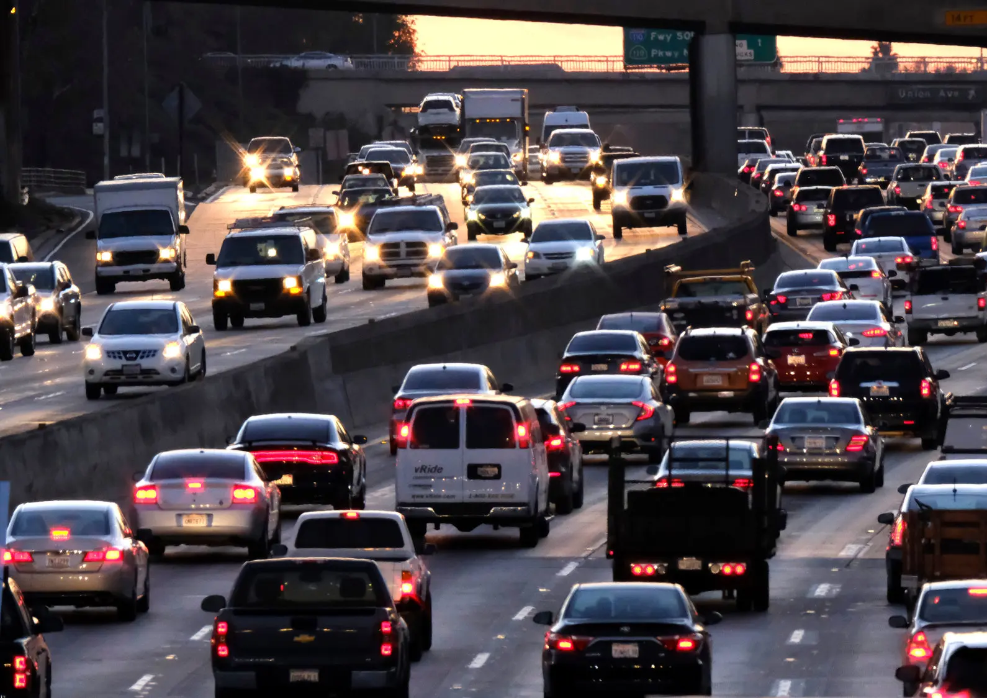
What is the impact of traffic and air pollution on older people?
Charity Registration no. 288180 © HelpAge International 2021
Notes:
Present Slide 38 (What is the impact of traffic and air pollution on older people?).
Ask participants what impacts they think traffic and air pollution have on older people. Follow up by explaining that many cities have high traffic levels as they were built to prioritise cars over pedestrians and public transport. Road traffic congestion creates unhealthy communities, with high levels of air pollution, road accidents, noise, and delays on public transport. Remind participants that these problems are the results of policy and political choices, based on who has most power and influence.

Slide 39
Impacts of traffic and air pollution
Poor air quality
Road accidents
Noise
Delays on public transport
Notes:
Present Slide 39 (Impacts of traffic and air pollution).
In many cities, poor air quality is responsible for thousands of premature deaths each year, linked to heart and lung conditions in young people and older people alike.
Air Quality Index (AQI) data is available online for many cities and communities, and can inform people about the levels of air pollution they experience, as well as daily updates at times when air pollution is particularly bad.
Roads with heavy traffic are difficult and unpleasant for pedestrians and can lead to injury and sometimes death, while streets and public spaces can be noisy and unwelcoming if they are surrounded by heavy traffic.
Congestion also means that journeys on public transport (such as buses and trams) can take longer.
Poor air quality, unpleasant public spaces and longer public transport journeys affect older people in particular, as they may experience more negative health impacts and they tend to rely more on public transport.

Slide 40
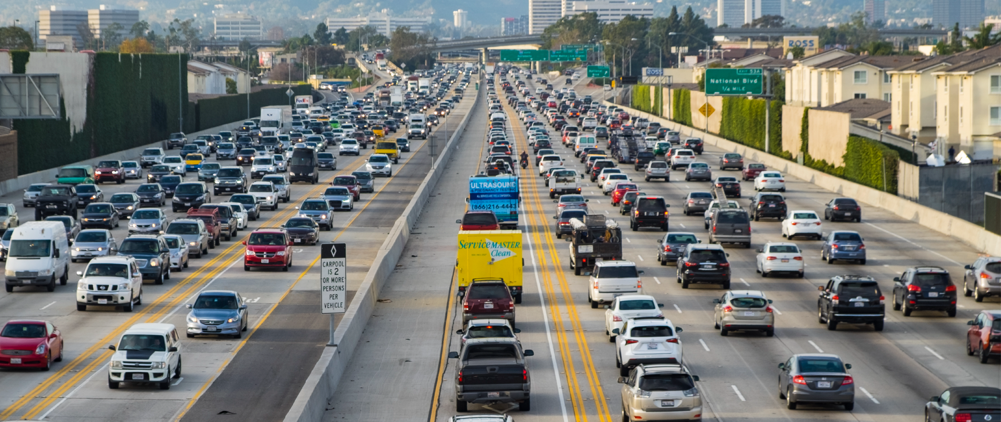
Are more and wider roads the solution to traffic congestion?
Notes:
Present Slide 40 (Are more and wider roads the solution to traffic congestion?).
Ask participants the question on the slide. Give time for them to briefly discuss their answers.
Lead into a discussion, highlighting the following points:
People often believe that building new roads or adding lanes to existing roads will reduce traffic congestion and pollution.
Yet this has been disproven by research and data, which shows that new and larger roads – albeit reducing traffic initially – actually encourage more journeys by road in the longer term, thus adding to traffic congestion.
The only way to reduce traffic and air pollution is to encourage active travel (walking and cycling) and to invest in affordable and accessible public transport.

Slide 41
What can be done to ease traffic congestion?
Discourage driving
Traffic calming
Improve pedestrian safety
Prioritise public transport
Notes:
Present Slide 41 (What can be done to ease traffic congestion?).
Ask participants what they think can be done to reduce traffic congestion and air pollution, and to mitigate the negative impacts on people in their community.
During the discussion, highlight the following points:
Policies and design decisions can discourage driving and reduce traffic from private vehicles. This can include closing local roads to traffic that is travelling to another part of the city, and reducing the availability of parking in the area.
Traffic can be slowed down and ‘calmed’ by reducing the size of the road (removing lanes, for example), adding trees or road humps so that vehicles travel more slowly, or introducing lower speed limits.
Pedestrian safety can be improved by having better crossing points, and adding or planting trees to provide a buffer between road vehicles and pedestrians, and adopting traffic calming measures.
Public transport and the people who use it can be prioritised by having bus-only lanes, better bus stops with seating and updated information, and investing more in these services instead of road maintenance or expansion.

Slide 42
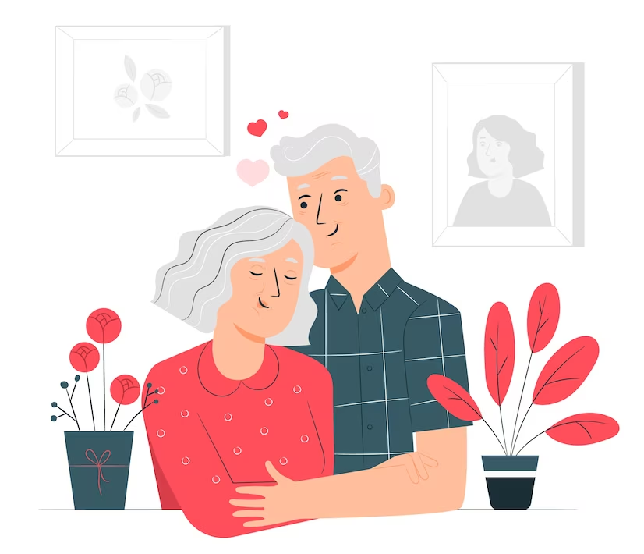
What is important to older people when using public transport services?
Notes:
Present Slide 42 (What is important to older people when using public transport services?).
Ask participants why public transport is especially important for older people.
Explain that most communities have some form of public transport (in the form of buses, metro, train or railway systems). Public transport can also include informal and collective forms of transport such as rickshaws or minibuses.
Older people commonly rely on public transport as they are less likely to own a private car. Public transport provides a means for them to visit friends and family, go to the shops or to a health facility.

Slide 43
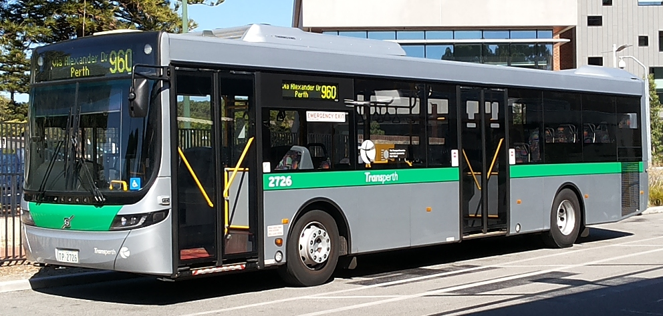
Affordability
Notes:
Present Slide 43 (Affordability).
Many people who use public transport live on lower incomes and so it’s critical that public transport is affordable, so that everyone has the opportunity to access it.
Many cities around the world provide free or discounted public transport services for older people, although sometimes they are limited to off-peak or certain less-popular routes.

Slide 44
Routes and destinations
Notes:
Present Slide 44 (Routes and destinations).
Public transport systems are often planned with commuters in mind, taking workers into the centre of the city.
But public transport should serve everyone in a community, covering the variety of journeys and destinations they want to travel to.

Slide 45
Group work
1
Do high levels of traffic and air pollution discourage you from certain activities in your day-to-day life?
2
What could change in your community if traffic and air pollution were reduced?
3
Is public transport adequate in your community?
4
Do you have the means to travel to the places you need to go to each day?
5
What improvements could be made to transport in your community?
Notes:
Present Slide 45 (Group work).
Ask participants to form small groups of 4–5 people and discuss these questions:
Is public transport adequate in your community?
Are there bus routes and other public transport services that can take you to the places you need to go to each day?
What improvements could be made to transport in your community?
Give groups 10 minutes to discuss and ask them to write their responses on Post-it notes. Once finished, groups should put the Post-it notes on the corresponding flipchart paper on the wall. For online trainings, use a whiteboard application to allow participants to engage in real time.

Slide 46
What are some examples of initiatives to improve public transport?
Pedestrianising streets in Mexico City
Low emissions zone in London, England
Sensitising bus drivers and transport providers in Costa Rica
Free transport
Notes:
Present Slide 46 (What are some examples of initiatives to improve public transport?).
Go through the following examples of initiatives that have been undertaken to improve public transport.
Madera Street in Mexico City was pedestrianised with all traffic removed, creating a safer, healthier and more pleasant environment for people who were shopping and walking.
The city of London introduced low emission zones where only newer vehicles that emit fewer emissions are allowed to enter, or they face an additional charge.
Bus drivers and transport companies in Costa Rica spent time in older people’s care homes to understand their needs and how they could improve their services for older people.
Many cities provide free transport to people over a certain age, recognising that older people often have less income and are more dependent on public transport.

Slide 47
How can we explore this topic further?
Look at data
Transport audit
Campaign
Notes:
Present Slide 47 (How can we explore this topic further?).
If participants are particularly interested in this topic, these additional exercises could help them think in more depth about public transport in their community.
Look at data: many cities gather data on air pollution levels and road traffic accidents. Where in your city, and at what times, is traffic congestion and air pollution worst? Who is most affected by road traffic accidents, and in which areas of the city?
Transport audit: do an audit of the transport options available in your community, including assessing how suitable they are for older people, whether routes go to the places older people want to travel to, etc.
Campaign: planning a campaign to improve public transport would include discussing what issues you want to raise with stakeholders and service providers.

Slide 48
Session 6
Why older people’s Voice is essential in building age-friendly cities and communities

Slide 49
Group discussion
Why are older people’s voices essential in building age-friendly cities and communities?
What roles can older people play in building age-friendly cities and communities?
Notes:
Present Slide 49 (Group discussion).
Ask participants to share why they think older people’s voices are important to creating age-friendly cities and communities. Ask participants to split into small groups to discuss this question. Allow 15 minutes. (If the training is online, you can use break-out groups or ask people to respond to the questions in plenary.)
As participants share their ideas, write them down on a piece of flipchart paper. Summarise the discussion and ideas to wrap up. Allow 5 minutes.

Slide 50
Value of Voice
Intrinsic value The opinions we hold, the decisions we make, and the actions we take constitute a significant part of who we are. Having choice and agency is central to our dignity, wellbeing and sense of self-worth, and to a rights-based approach to ageing.
Instrumental value Including people’s voices in decision-making about issues that affect them can improve access to services and improve the quality of services as well as of shared spaces in cities and communities.
Notes:
Present Slide 50 (Value of Voice).
Explain that Voice has intrinsic value. It is an essential part of who we are – the opinions we hold, the decisions we make, and the actions we take. Having choice and agency in relation to these is central to our dignity, wellbeing and sense of self-worth, and to a rights-based approach to ageing.
Voice also has instrumental value, serving as a means to pursue a goal. For example, older people might decide to come together to use their Voice to demand improvements by governments or local authorities to ensure that the streets where they live are accessible and safe, or that public transport serves everyone in their community, including older people.

Slide 51
Benefits to older people of including them in community initiatives
Feel valued
Increased confidence, enjoyment of life, and improved health and wellbeing
Express their needs and ideas
Increased trust
More effective age-friendly communities initiatives as a result of older people’s participation
Notes:
Explain that we’ll now explore the benefits of including older people in community initiatives.
Before presenting Slide 51, ask participants to share what they think are the benefits to older people of including them in community initiatives. Allow 5 minutes.
Present Slide 51 (Benefits to older people of including them in community initiatives) and read out these points:
Feel valued for their insights, input and life experiences.
Increased confidence, enjoyment of life, and improved health and wellbeing.
Opportunities to express their needs and ideas.
Increased trust in government, feel like someone is really listening.
Help to develop age-friendly and intergenerational-friendly communities that reflect the lived experiences, needs and aspirations of older people.

Slide 52
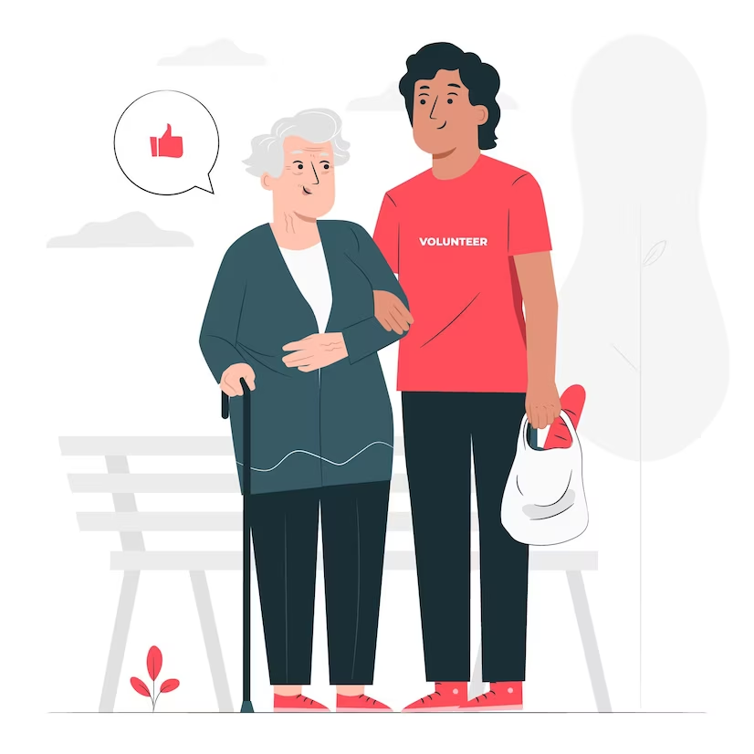
Benefits to communities of including older people in community initiatives
Learn from diverse knowledge, experience and insights
Older people as contributors at all times and many ways
Age-friendly cities and communities are good for all generations.
Benefits of intergenerational participation
Improves quality of decisions and outcomes
Notes:
Present Slide 52 (Benefits to communities of including older people in community initiatives) and read out these points:
Learn from older people’s diverse knowledge, experiences and insights around accessibility and community life, which can lead to a more inclusive community for everyone.
Older people can contribute to the community regardless of age – for example, in times of disaster, or regular volunteering.
Communities that are welcoming and friendly for people of all ages are good for all generations. For example, a bus driver who waits and is patient is not only better for older people who use public transport but also for someone carrying heavy bags, someone with a baby or a child, or someone with a disability.
Intergenerational participation supports community cohesion, social capital and ownership over decisions.
It also improves the quality of decisions and outcomes for communities.

Slide 53
Benefits to government bodies of including older people in community initiatives
In particular, government-related bodies that focus on the built environment, such as municipal authorities, town planning departments (not just national or local governments in general).
Learn from diverse knowledge, experience and insights
Understand opportunities of consumer market
Learn from experienced change agents
Increase confidence in the openness of government
Be at the front of a new approach to ageing
Greater success and impact from initiatives as a result of community involvement
Notes:
Present Slide 53 (Benefits to government bodies of including older people in community initiatives).
Ask participants what they think the benefits are to government bodies of including older people in community initiatives. Allow a brief discussion and be sure to highlight the following points:
Learn from older people’s diverse knowledge, experiences and insights.
Learn from experienced change agents – civil rights, environmental and gender equity activism were all driven by today’s older generation.
Increase older people’s confidence in the openness of government to community ideas.
Be at the front of a whole new approach to ageing.
Greater success and impact from initiatives as a result of community involvement.
Understand the opportunities of a growing consumer market.

Slide 54
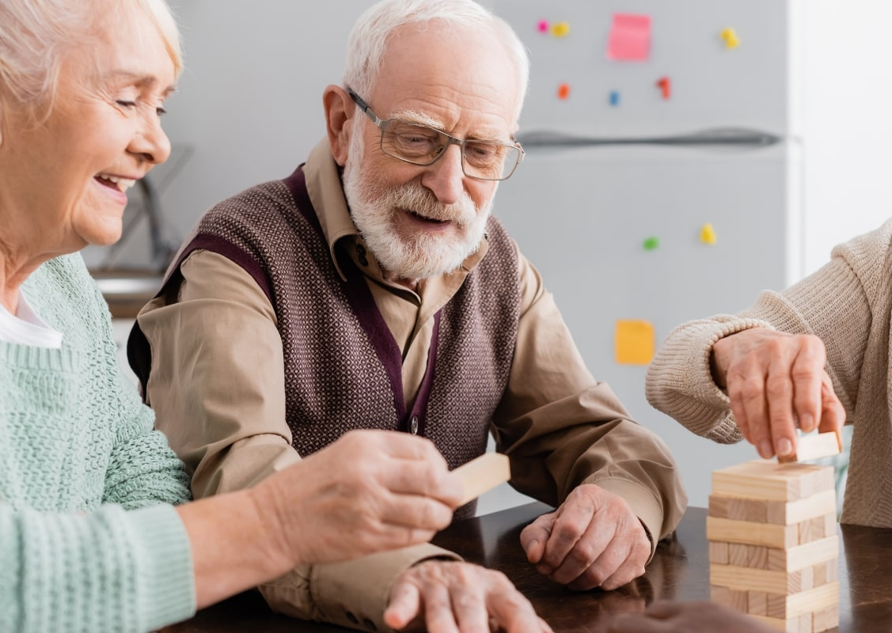
Recap
Why older people’s Voice is essential for building age-friendly cities and communities
Número de registro de organización benéfica: 288180 © HelpAge International 2021
Notes:
Present Slide 54 (Why older people’s Voice is essential for building age-friendly cities and communities – recap).
Use this section to re-cap what has been covered up until now.

Slide 55
Tips on
how to consider Voice in relation to age-friendly cities and communities
Notes:
Present Slide 55 (Tips on how to consider Voice in relation to age-friendly cities and communities).
Ask participants to think about how older people are included in community planning and community consultation processes. Are they being included in a meaningful way? Is there more that can be done to reach out to older people who don’t usually participate in these processes?
For example:
Use the ‘Let’s go!’ guide, on how to build great places for people to grow older in, and follow some of the tips included in it.
Involve older people in decision-making and leadership structures, recognising that it often takes specific and sustained focus and support to ensure that older women in particular can access these structures.
Help to set up older people’s organisations. Build their capacity to support each other and to advocate for the older people they represent.

Slide 56
Session 7
Putting Voice at the centre of age-friendly initiatives

Slide 57
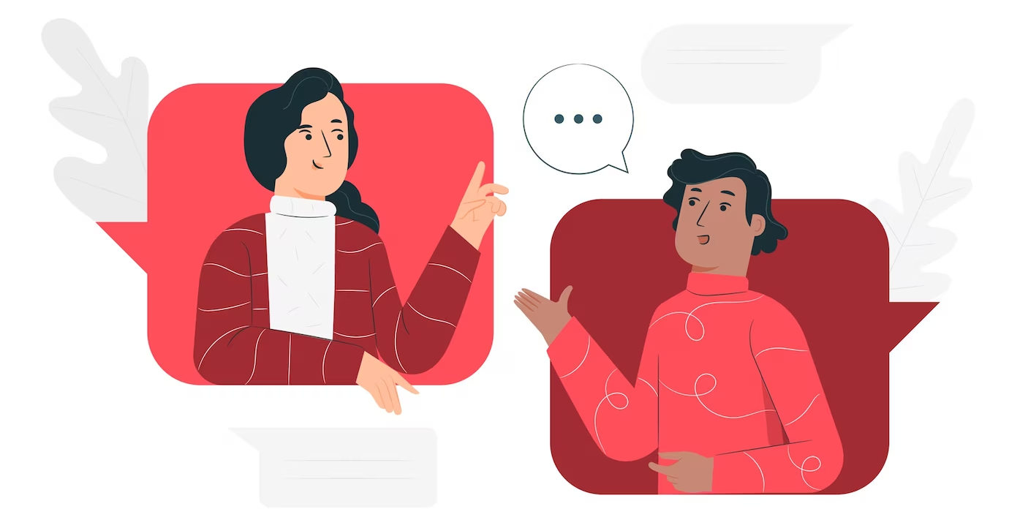
The value of using the Voice framework to think about age-friendly initiatives
Notes:
Present Slide 57 (The value of using the Voice framework to think about age-friendly initiatives).
Recap with participants that Voice work has both intrinsic value (with older people feeling more empowered and having more confidence) and instrumental value (with older people having the skills to advocate for improved services).
In this session we will share examples of age-friendly initiatives that fit into the different Voice domains (see Session 2, Slide 15). You might also have some suggestions of your own. Please share with participants any that come to mind throughout the session.
The Voice framework suggests that older people’s voices are strongest when all the domains of Voice are addressed, from making sure that older people are engaged in Voice-related activity, to making sure that their voices are heard by those in power, and that they can bring about change. When developing age-friendly activities, we should think about the different range of activities that older people can be involved in.

Slide 58
“
Engaged
I can participate, and feel motivated to participate, in activities that strengthen my voice and my rights regardless of my identity, individual or group characteristics, or the context in which I live.
“
Notes:
Present Slide 58 (Engaged).
Explain to participants that the goal of the “engaged” domain is for older people to be able to say, “I can participate, and feel motivated to participate, in activities that strengthen my Voice and my rights regardless of my identity, individual or group characteristics, or the context in which I live.”
This domain is also concerned with engaging older people from diverse backgrounds, as well as those who are usually excluded from opportunities to participate.
Like many decision-making processes, older people are often not engaged in decisions around the design of services or community spaces. For older people to have Voice and be able to participate in those decisions for creating age-friendly communities, they first need to be engaged.

Slide 59
Examples of activities for creating age-friendly cities and communities that sit under the “engaged” domain:
Generate greater awareness among older people about how they can be involved in age-friendly activities in their communities, or how they can advocate for improved services.
Motivate and involve diverse older people in any of the initiatives you’re working on related to age-friendly cities and communities
Trialling outdoor physical activities for older people
Intergenerational and group activities
Short, guided walks or tours with older people
Simple surveys in local parks
Focus groups about city life
Notes:
Present Slide 59 (Examples of activities for creating age-friendly cities and communities that sit under the “engaged” domain).
Explain to participants that activities to create age-friendly cities and communities that could sit under the “engaged” domain include the following:
Generating greater awareness among older people about how they can be involved in age-friendly activities in their communities, or how they can advocate for improved services.
Motivating and involving older people from diverse backgrounds in any of the initiatives you’re working on in relation to age-friendly cities and communities.
Trialling outdoor physical activity classes in public spaces (such as taster sessions on tricycles) could provide opportunities for older people to understand the impact that access to age-friendly public spaces can have on their lives.
Providing opportunities for older people to engage younger people through outdoor intergenerational games and community gardening enables older people to meet others (including young people) and to share their experiences.
Doing participatory research with older people by taking walks through the community to identify challenges, barriers and opportunities can motivate older people to participate in community decision-making.

Slide 60
“Engaged” domain case study
Bringing people together through community gardens”
Notes:
Present Slide 60 (“Engaged” domain case study).
In a project in Ciudad Bolivar, a low-income community on the outskirts of Bogotá, Colombia, older people formed a grassroots collective to support other older people who are vulnerable to isolation and loneliness.

Slide 61
“
Informed and empowered
I have access to information and knowledge related to my rights and I have the resources, skills and confidence to demand those rights and raise my Voice.
“
Notes:
Present Slide 61 (Informed and empowered).
Explain to participants that the goal of the “informed and empowered” domain is for older people to be able to say “I have access to information and knowledge related to my rights and I have the resources, skills and confidence to demand those rights and raise my Voice.”
Information is power. Having access to information is critical for older people to be able to have a say in decisions on issues that affect their lives. In order for older people to exercise their Voice in relation to building age-friendly cities and communities, they must have the information they need to understand basic design concepts and principles relating to the built environment.
When thinking about information, it’s not only important to make sure that older people have access to information, but that as civil society, we are also engaging with councils and other bodies about the needs and rights of older people.

Slide 62
Examples of activities for creating age-friendly cities and communities that sit under the “informed and empowered” domain:
Information and training on design concepts and principles relating to age-friendly cities and communities
Fostering leadership roles for older people
Establishing and participating in planning and consultation processes
Sensitising transport providers
Notes:
Present Slide 62 (Examples of activities for creating age-friendly cities and communities that sit under the “informed and empowered” domain).
Activities under this domain could include:
Providing accessible information and training to older people about the design concepts and principles relating to age-friendly cities and communities. This could help them to think about what could be improved in their communities, and provides them with information so that they are able to speak on issues in an informed way.
Fostering leadership roles as one way of empowering older people. You might think about how older people take on leadership roles when it comes to engaging with decision-makers.
Making sure that older people are aware of proposed changes, developments and projects in their community and providing an opportunity for them to give feedback in a meaningful way.
Sensitising bus drivers or other transport workers and providers to help them understand older people’s needs.

Slide 63
“
Leadership skills
I learned many beautiful lessons from my father about being a leader, serving, and offering that knowledge as a leader to the community, to the people around me, not only the older people, but the entire community. I’ve always liked participating, guiding, helping my community with all my affection, and putting into practice or at the service of my communities what I was taught about being a leader.
“
Jesús, aged 82, Colombia
Notes:
Present Slide 63 (Leadership skills).
Read out the quote on Slide 59. Explain to participants why it is vital that they build the leadership skills of the older people they work with.

Slide 64
“
Shared and combined
“
I have the opportunity to meet with others, share my experiences, and debate with them. We’re all able to express our needs, identify solutions, and form a collective, legitimate and representative Voice.
Notes:
Present Slide 64 (Shared and combined).
Explain to participants that the goal of the “shared and combined” domain is for older people to be able to say “I have the opportunity to meet with others, share my experiences, and debate with them. We’re all able to express our needs, identify solutions, and form a collective, legitimate and representative Voice.”
“Shared” refers to providing older people with the opportunities and capacity to meet in a safe space to share their experiences and increase their awareness of issues that affect them.
“Combined” means supporting older people with different views to create a ‘collective Voice’.
The process of sharing and combining voices can, in itself, be empowering. It increases people’s consciousness of their situation, and encourages them to confront discrimination and inequality together, in order to realise their rights.

Slide 65
Examples of activities for creating age-friendly cities and communities that sit under the “shared and combined” domain:
Creating a collective Voice: providing older people with the opportunities and the capacity to come together with others in a safe space to discuss issues that affect their lives
Forming older people’s groups
Forming intergenerational groups
Notes:
Present Slide 65 (Examples of activities for creating age-friendly cities and communities that sit under the “shared and combined” domain).
Activities under this domain could include:
Supporting older people to create a collective Voice and demands, and encouraging older people to come together in a safe space to discuss the different barriers they face in their communities.
Forming older people’s groups as a way of creating space for older people to come together to share and combine their voices.
Forming intergenerational groups, which is an effective way of combining the voices of younger and older people. These groups offer great potential in tackling issues together and influencing discussions and decisions that affect both younger and older people’s lives. When younger people work with older people on issues that affect both generations, it amplifies older people’s Voice. Younger people can be engaged by remembering that the changes they push for today will affect their own lives as they grow older.
Remember that if you’re involved in creating spaces for older people to come together, consider the diversity of group members and the power dynamics within the group. Make sure that everyone has an equal opportunity to speak and be heard.

Slide 66
The Vancouver protocol
The Vancouver protocol is a methodology to surface issues facing older people in their community
Número de registro de organización benéfica: 288180 © HelpAge International 2021
Notes:
Present Slide 66 (The Vancouver protocol).
For older people to have a shared and combined Voice, the Vancouver protocol can be useful. It includes a set of questions that encourage people to discuss the key issues facing older people in their communities. It can also be used as a first step in discovering what older people’s priorities are based on their day-to-day experiences.

Slide 67
Amplified
“I have the opportunity to raise my Voice through a variety of channels and to join with others to campaign, influence agendas, and create movements for change.”
Supporting older people to communicate their individual or collective Voice through diverse channels at different levels.
Older people’s voices can be amplified in a wide variety of ways (including advocacy and campaigning through different channels).
Notes:
Present Slide 67 (Amplified).
Explain to participants that the goal of the “amplified” domain is for older people to be able to say “I have the opportunity to raise my Voice through a variety of channels and to join with others to campaign, influence agendas, and create movements for change.”
The “amplified” domain involves supporting older people to exercise their individual or collective Voice through diverse channels at different levels. This could mean an older person communicating individually with someone in power, either in private or in public. Or it could mean an older person or group of older people exercising their collective Voice.

Slide 68
Examples of activities for creating age-friendly cities and communities that sit under the “amplified” domain:
Advocacy training focused on AFCC
Co-creating community murals
Outdoor photography exhibition
Partnering with journalists
Public or social media campaigns or protests
Notes:
Present Slide 68 (Examples of activities for creating age-friendly cities and communities that sit under the “amplified” domain).
Activities under this domain could include:
Providing training for older people on advocacy, including who makes decisions at the community level around community planning and design of infrastructure, and how to engage with them.
Participating in the co-creation of a community mural or creating a public photography exhibition as a means of amplifying older people’s Voice and providing an attention-grabbing and creative outlet for older women’s and men’s views and opinions.
Partnering with journalists to generate media coverage to amplify older people’s Voice.
Organising public campaigns or protests to amplify older people’s demands and gain decision-makers’ attention, to get older people’s Voice heard in relation to creating age-friendly cities and communities.

Slide 69
“Amplified” domain case study
A campaign in Bogotá launched by HelpAge and the Council of Wise Men
Notes:
Present Slide 69 (“Amplified” domain case study).
In Bogotá, Colombia, HelpAge and the Council of Wise Men launched a campaign led by older people to highlight the problems they face in their communities.
Hearing from older people themselves was critical to make sure that the campaign responded to their views and that the proposed changes would have real impact. The campaign held two workshops: the first on the issues facing older people in urban areas, and the second on how to run an effective campaign to influence local authorities, using HelpAge's Age Demands Action (ADA) methodology.
The older people who participated in the workshops explained that the green spaces in the area were rugged and not accessible to them. They shared photos to show the dilapidated sidewalks and stairs with no handrails. They also described the things they liked about their community, such as tailored fitness classes, wide sidewalks, and small parks where they could relax.

Slide 70
“
Heard
“
My Voice is heard through my active participation and influence in decision-making processes. Governments and other power-holders are responsive to my needs and my rights.
Notes:
Present Slide 70 (Heard).
Explain to participants that the goal of the “heard” domain is for older people to be able to say “My Voice is heard through my active participation and influence in decision-making processes. Governments and other power-holders are responsive to my needs and my rights.”
This domain is about making sure that older people’s voices are not only amplified, but that they are heard and responded to.

Slide 71
Examples of activities for creating age-friendly cities and communities that sit under the “amplified” domain:
Speak with older people about whether governments are responding to their advocacy initiatives
Conduct a stakeholder analysis or political economy analysis
Engaging with decision-makers about agreeing a city declaration
State-citizen interfaces: meet with service providers to hear key concerns, needs and follow-up to ensure that action is taken
Monitoring of community services by older people
Notes:
Present Slide 71 (Examples of activities for creating age-friendly cities and communities that sit under the “amplified” domain).
Activities under this domain could include:
Speaking with older people about whether governments are responding to their advocacy initiatives and taking action to address the needs of older people and their communities.
Working with older people to consider who makes decisions about government spending on infrastructure or community projects. You might want to conduct a stakeholder analysis or a political economy analysis. This can help you to identify who you should be targeting in your advocacy, and what interests are at play that underlie a particular problem. It’s vital that older people have access to the right spaces and decision-makers so that they can deliver effective messages and get a response.
Getting agreement on a city declaration on the issues facing older people means their Voice and experiences are more likely to be heard and responded to by those in positions of power.
Using state–citizen interfaces that allow civil society and citizens to have spaces where their voices are heard. In relation to age-friendly cities and communities, it’s important that service providers hear older people’s concerns and needs, so that they can take action to address them.
Building older people’s skills to monitor local services or government plans for creating age-friendly cities and communities. They can then provide feedback on what is and isn’t working, using data they have collected.

Slide 72
Older people’s monitoring groups in Mexico
Notes:
Present Slide 72 (Older people’s monitoring groups in Mexico).
In Jalisco, Mexico, older people’s groups help monitor and evaluate how the local government’s strategic plan is carried out, and provide feedback (direct from local older people) about what is and isn’t working. The groups are also represented on municipal citizen councils and the metropolitan council.

Slide 73
“Heard” domain case study
Municipal government in Costa Rica responds to older people’s demands around how they are treated on buses
Notes:
Present Slide 73 (“Heard” domain case study).
Older people in the city of Cartago, Costa Rica, often expressed their disappointment at how they were treated on buses, so the city authorities decided to act to improve things.
Through direct, ongoing engagement with older people to better understand and respond to their lived experiences, the municipal government enlisted 15 transport companies to make improvements to the quality of services.
Bus drivers were invited to daycare centres where they spoke to older people about the challenges they experience getting on and off buses. While they were there, they even helped to provide some care and support during mealtimes. This enabled the bus drivers to better understand older people’s needs, and in turn to provide a more considerate bus service.
The bus drivers were given a certificate in recognition of their participation in these improvement activities. The municipality also ran a campaign on social media and through posters on buses and at bus stations along routes, to raise everyone’s awareness about how important it is to show care and respect towards older people.

Slide 74
Session 8
Interactive exercise: linking Voice domains to age-friendly environments

Slide 75
Linking Voice domains to age-friendly environments
Problem statement: interactive exercise
Notes:
Present Slide 75 (Problem statements: interactive exercise).
Split participants into three groups and give each group Handout 3: Problem statements for group discussion.
Ask each group to discuss their problem statement and consider the prompts, considering how the statement relates to any of the five Voice domains. Allow 10 minutes.
Have groups come together in plenary and discuss how each problem statement relates to a particular Voice domain (or domains).

Slide 76
“
Example 1
I don’t own a car, and I struggle to get around and visit friends and families. Buses are the only option available to me, but they are difficult to use. To get to the hospital for an appointment means I must take three different buses. I never know what time they are due to arrive, and when they do come, the bus driver is often impatient with me and starts moving before I’ve even been able to find a seat. The bus is often crowded, and I sometimes have to stand for the entire journey.
“
Notes:
Present Slide 76 (Prompts).
Ask participants to think about what could be done to address the problems older people face – route destinations relevant to them, how services could be improved, how their journey could be made more pleasant.
How could older people highlight these issues and bring them to the attention of service providers? Who are the stakeholders relevant to the issue? Is it the local authority? Bus companies? Others?

Slide 77
“
Example 2
I sometimes feel lonely and isolated staying at home all day. There is a small public square down the street, but the pavements around it are broken and so I’m afraid of falling. When I do get to the square, there are not enough places to sit, and there is nothing really there for me to do. I feel that some activities would bring the community together and give an opportunity to get to know my neighbours. But the local authority just doesn’t prioritise those spaces at all.
“
Notes:
Present Slide 77 (Prompts)
Ask participants to think about what activities could demonstrate to the community the value and importance of inclusive public spaces.
How can the community come up with realistic proposals to improve the public spaces where they live?

Slide 78
“
Example 3
The city is changing so quickly around me, but I never get asked what I think, or have the opportunity to participate in decision-making. They are building a new shopping centre at the end of the road and making the road wider and I’m worried about all the extra traffic it will generate. I don’t really feel a part of the community when I don’t have any Voice in how it changes in the future.
“
Notes:
Present Slide 78 (Prompts).
Ask participants to think about what activities can bring the community together to share their thoughts on different issues that the local authority makes decisions on.
What kinds of mechanisms could be used to encourage or persuade decision-makers to listen to – and respond to – older people’s Voice?

Slide 79
Plenary discussion
Notes:
Present Slide 79 (Plenary discussion).
Bring groups back together to discuss how they dealt with the problem statements and prompts on their handout, and to share conversations and learning from their small groups. Allow 5–10 minutes.

Slide 80
Session 9
Advocacy action planning
Notes:
Give participants Handout 4: Advocacy plan. Ask them if they have experience with similar exercises, and ask, what are the most important aspects to consider?
Explain how the advocacy plan can help participants to strengthen older people’s Voice, and that these actions are strengthened further by using an intergenerational approach.

Slide 81
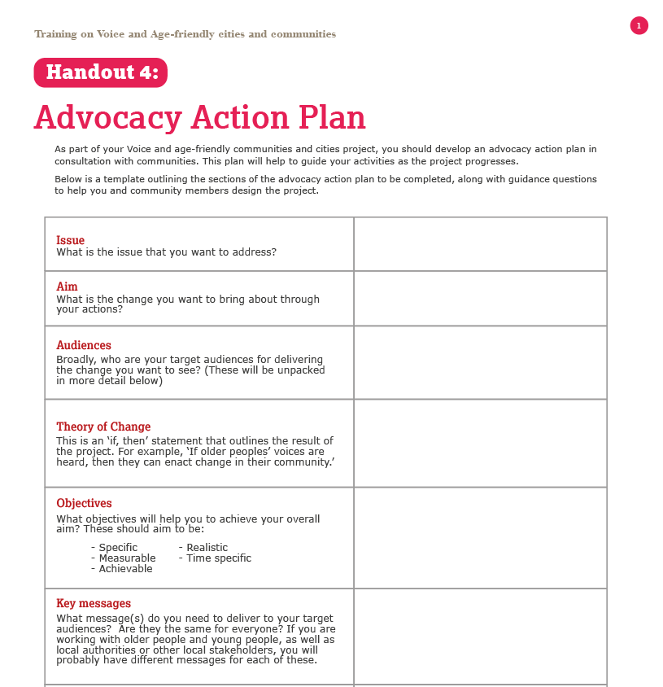
Developing an advocacy plan
Notes:
Present Slide 81 (Developing an advocacy plan).
Talk through the template with the group, making sure that you highlight any areas that might be unclear. Answer any questions participants might have.
Go through each section of the action plan and briefly discuss:
The different sections of the advocacy plan, including the guiding questions to support with completion
Highlight the importance of community participation: How will they engage with community members, especially older people, to identity advocacy messages, targets and objectives?

Slide 82
Session 10
Wrap-up

Slide 83
Objectives from the first session
1. Help participants understand why the voice of older people is important and how it can be raised.
2. Introduce urban design principles and concepts to encourage communities to think about the issues they may want to look at in more detail.
3. Provide ideas and examples of how communities can articulate voice to bring about change on these issues.
Notes:
Present Slide 83 (Objectives from the first session).
Bring up the objectives originally set out in the first session (Slide 2). Review one-by-one how we hope the training has achieved these.

Slide 84
Review of content
Introduction to age-friendly cities and communities
Introduction to Voice and intergenerational approaches
A look at the concepts of age-friendly cities and communities: a) and b)
A look at the Voice framework
Linking the concepts of Voice and age-friendly cities and communities
Advocacy Action Plan and Call for Proposals
Notes:
Present Slide 84 (Review of content)
Lead a brief review on the content covered.
Ask participants if they have any final conclusions or questions on anything that was discussed.

Slide 85
Thank you
Notes:
Present Slide 85 (Thank you).
Thank participants for their participation. Administer the feedback form (either hard copy or via a link) and ask them to complete this.
As they are completing their form, refer them to the handouts and the training materials that they will be able to use as resources in their Voice and age-friendly cities and communities projects going forward. Refer participants to key resources, including HelpAge’s Voice framework, the Let’s Go guide, and Bringing Generations Together for Change.

