Slide 1

Voice training
Module 4: Monitoring, evaluation and learning
Sachin Shrestha/HelpAge International

Slide 2
Module 4: Monitoring, evaluation and learning
      The Voice training toolkit has been developed for training HelpAge staff and network members to understand the key elements of the Voice framework and the concepts underpinning it, and to strengthen their ability to implement Voice-related activities.
      This is the last of four PowerPoint Modules designed to accompany the Facilitator’s guide when working through the sessions. Module 4 introduces tools and approaches to monitoring, evaluation and learning, and explores key enablers and barriers to Voice work.

Slide 3
Module 4: Outline
      Energiser and recap from Day 2
      Monitoring, evaluation and learning
      Using the Voice framework
      Final reflection
      Workshop evaluation

Slide 4
Monitoring, evaluation and learning

Slide 5
Why do it?
      Keeps you on the right track and tells you if you need to change what you are doing
      Accountability to donors, partners and to older people
      Evidence gathering for the next phase of Voice work

Slide 6
Challenges with measuring Voice work
      Voice work often takes place over a long period of time.
      The impact may not be evident in the short-term so it’s important to choose a range of methods and tools.
      Attributing a policy change to Voice work can be hard to prove, so you need to consider how to track your contribution when working with others
      Working as part of a coalition can make it hard to see how your organisation’s efforts have contributed to a change
      Voice work often takes place in complex environments, which means you need to plan carefully how to monitor and evaluate it

Slide 7
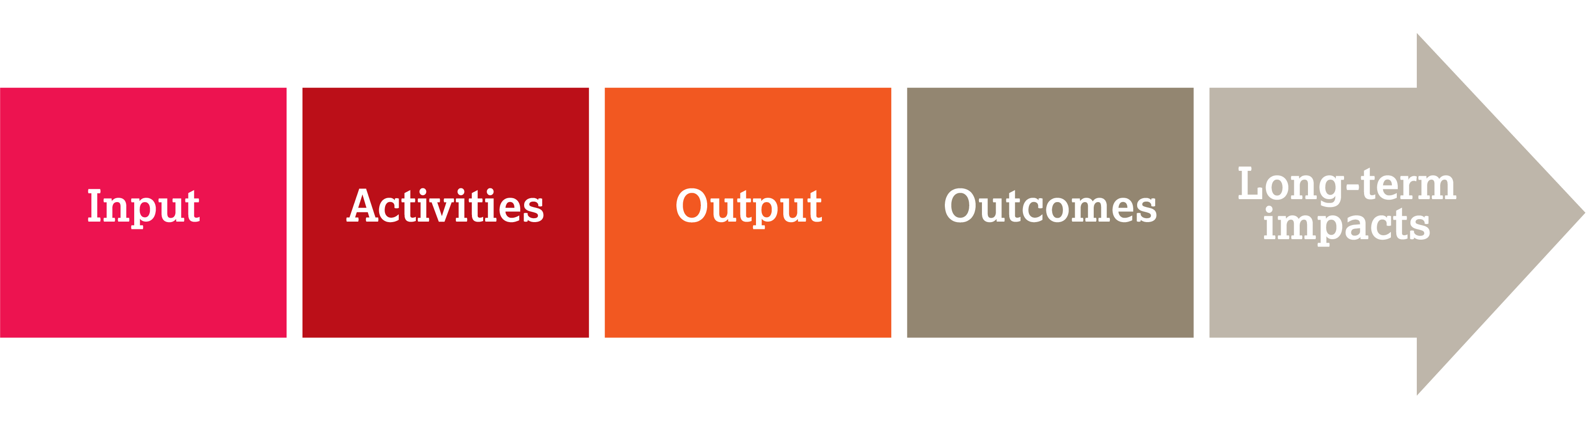
Theory of change and logframes
Understand how change happens in the contexts you’re working
Identify your role in contributing to these changes
Develop a causal pathway illustrating how your efforts will contribute to identified changes
Identify the assumptions that will be needed to be tested through the programme
Develop a MEL framework for your TOC
Continuously monitor change through your change pathway, test and adapt

Slide 8
Quantitative and qualitative information
Quantitative
      Online surveys
      Paper surveys
      Mobile surveys
      Face-to-face interviews
      Telephone interviews
Qualitative
      Direct observation
      Open-ended surveys
      Focus group discussions
      Case studies
      Outcome mapping
      Bellwether interviews
      Outcome harvesting

Slide 9
Sample indicators for measuring Voice outcomes
Voice domain | Output and outcome indicators
Engaged | # and % of older people motivated to engage in Voice work # and % of participants from different groups – older women, older people with disabilities
Informed and empowered | # and % of older people feeling confident to raise issues with decision-makers # of older people trained on their rights and social accountability mechanisms
Shared and combined | # of older people’s associations formed # of older people trained on their rights and collective action
Amplified | # of media articles published that focus on ageism # of civil society organisations forming a coalition
Heard | Improvement in the quality and appropriateness of services Changes in policy makers’ attitude toward the issue at the centre of the advocacy campaign

Slide 10



Qualitative approaches to measuring Voice outcomes
      Outcome mapping
      Bellwether interviews
      Outcome harvesting

Slide 11
Outcome mapping
      This is a methodology for planning and assessing projects that aim to bring about real, tangible change.
      It has been developed with international development in mind. It can also be applied to projects or programmes aiming to communicate research findings, influence policy or promote take-up of research findings.
      Outcome mapping consists of looking at different stories or moments of change and capturing them on a regular basis. You can do this as if you were writing a diary and then discuss in regular meetings.

Slide 12
Bellwether interviews (interviews with important people)
      Bellwethers are influential people whose opinions are felt to matter
      Interviews with them can reveal what they think about the issues you are aiming to address
      They can show where a particular issue is positioned on the political agenda

Slide 13
Outcome harvesting
      This means collecting evidence about what has been achieved and, by working backwards, determining whether and, if so, how an intervention has contributed to the changes you aim to bring about.
      It means identifying key questions and agreeing what information needs to be collected. For example:
      Who has changed their behaviour?
      What has changed?
      When did it change?
      Where did it happen?

Slide 14
The three biggest mistakes when monitoring and evaluating development projects
      1.
      Only focusing on outputs (how many meetings, how many publications)
      2.
      Only focusing on impacts (decrease in mortality, increase in life expectancy, new legislation, access to water, incidence of malaria)
      3.
      Assuming a causal
      link between the two

Slide 15
Appropriate strategies and practices for monitoring, evaluation and learning
      Are flexible and adapted to a complex and changing environment
      Help us see quickly what we need to change so we can adapt our approach
      Allow for timely and frequent information or data collection
      Enable us to look continuously for the unintended consequences of our interventions
      Create spaces for shared learning with stakeholders

Slide 16
Using the Voice framework

Slide 17
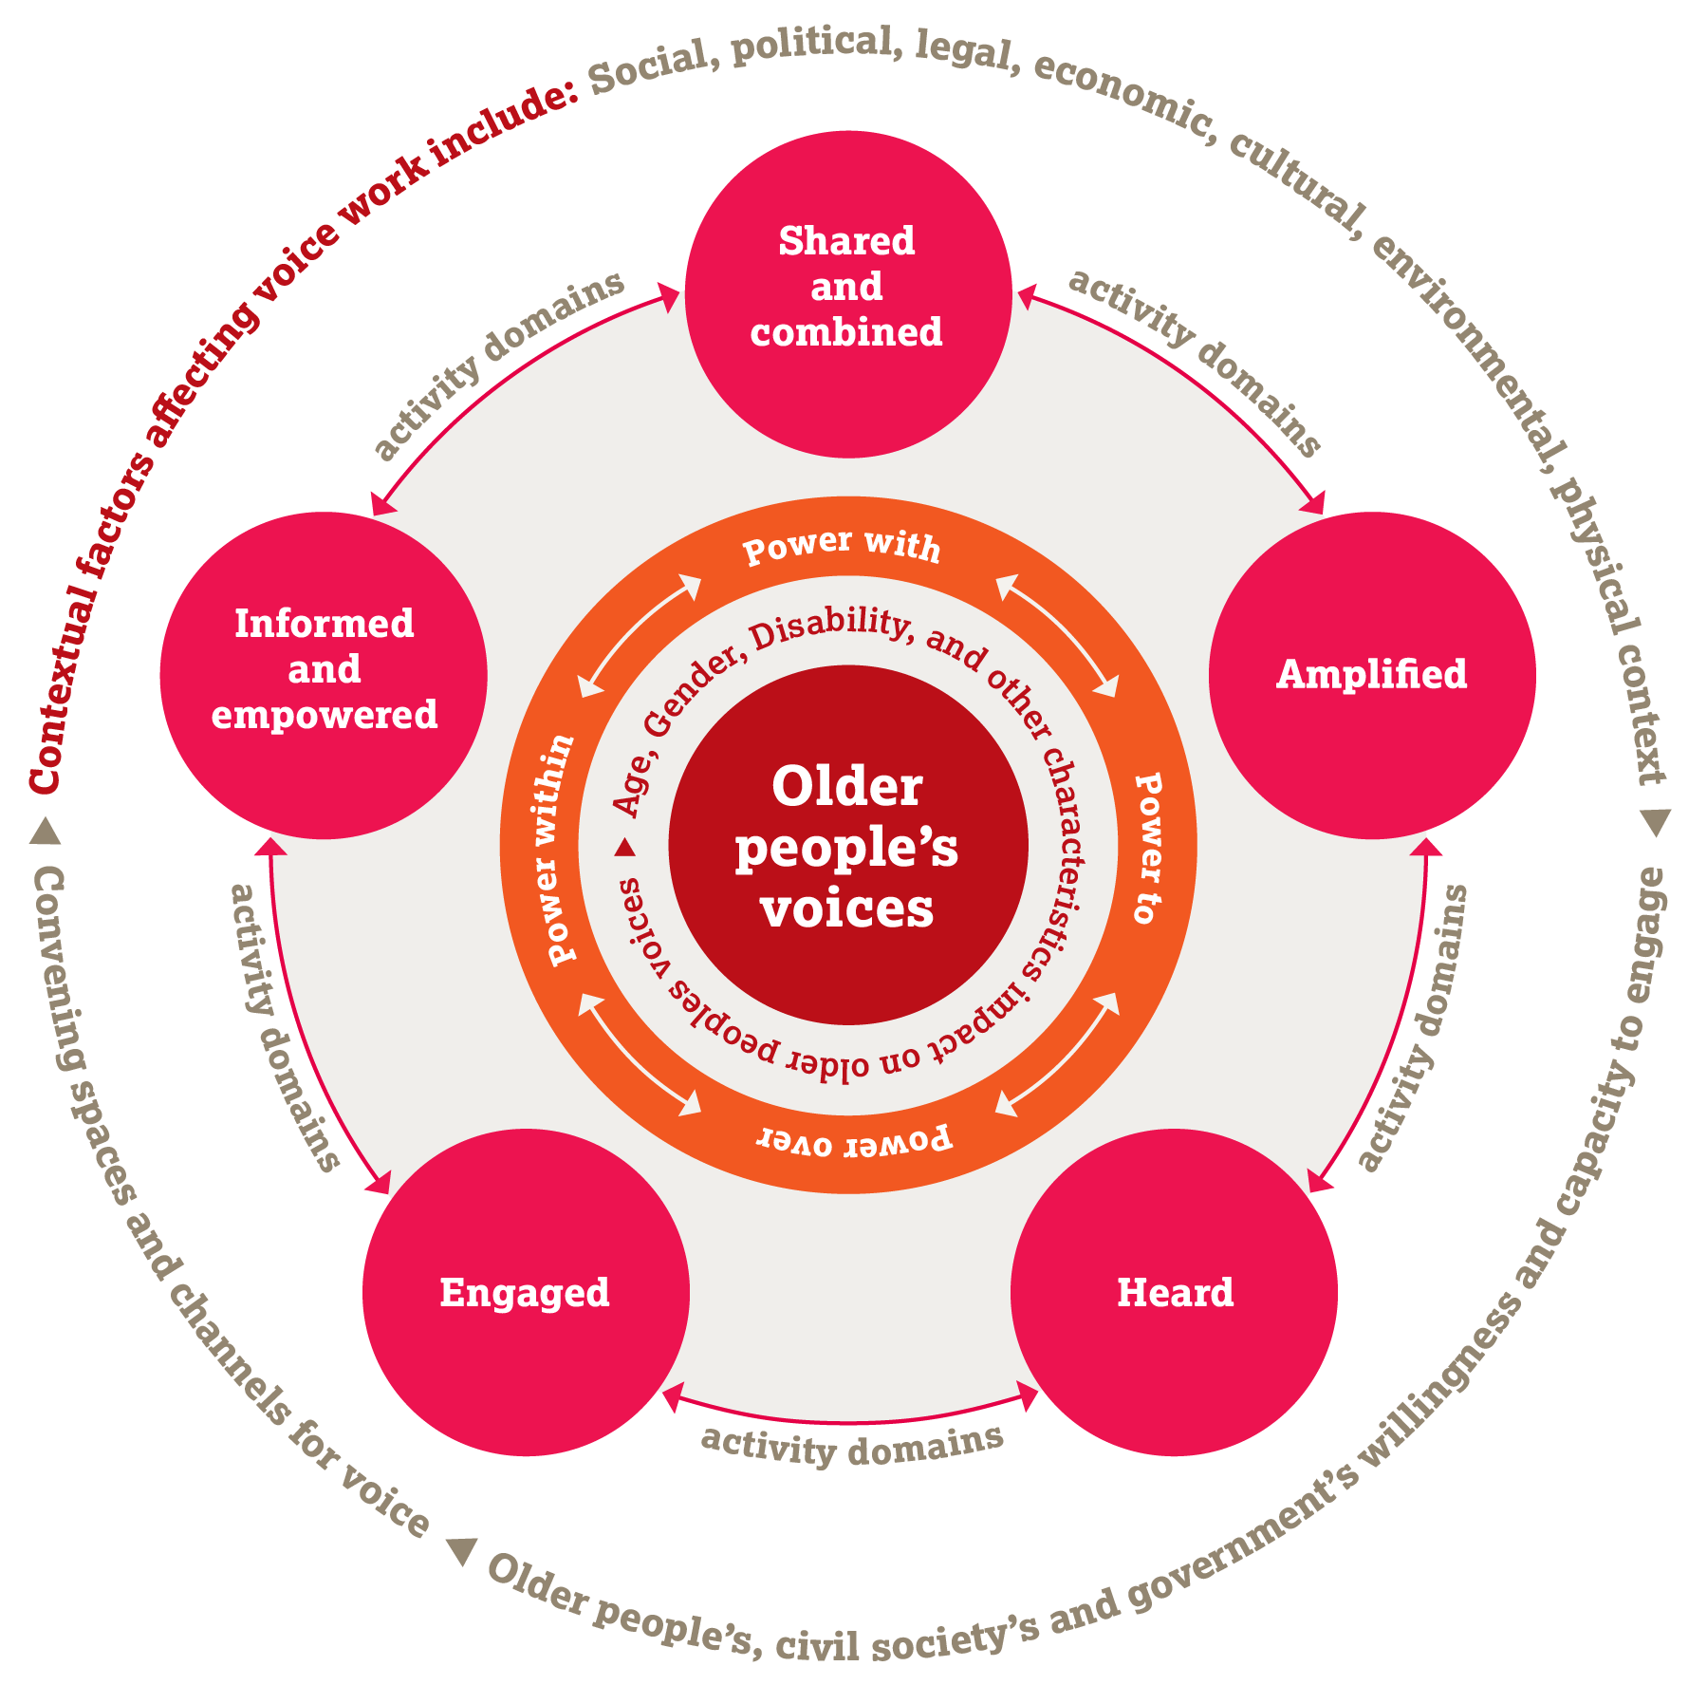
Using the Voice framework

Slide 18
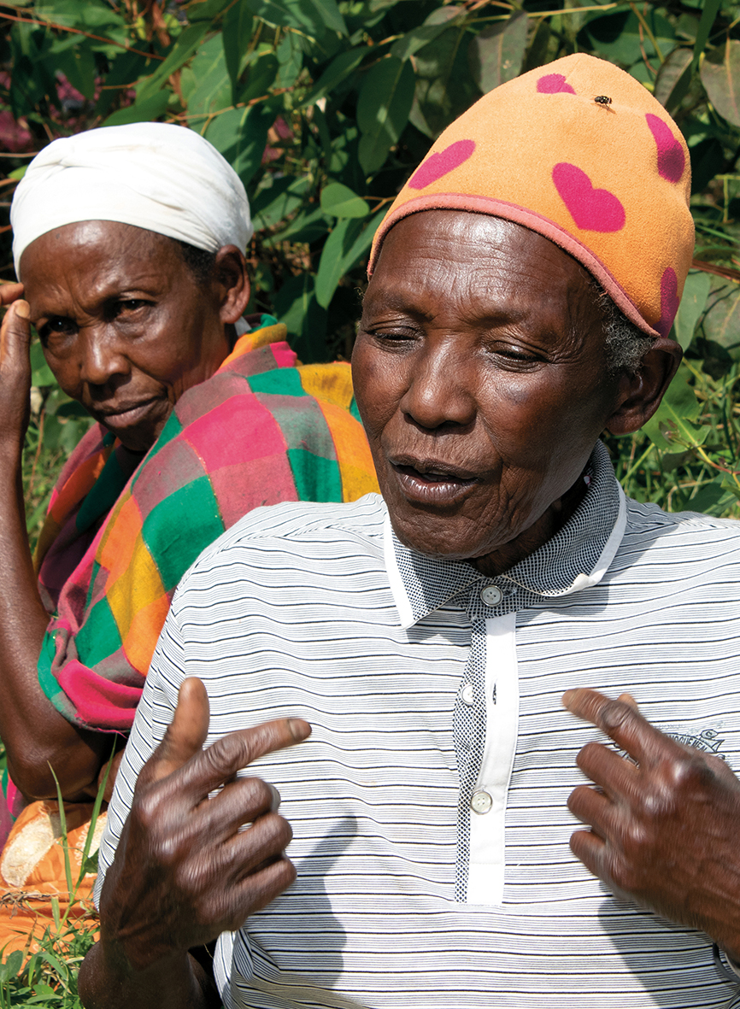
Thank you
Ellie Parravani/HelpAge International

