Slide 1
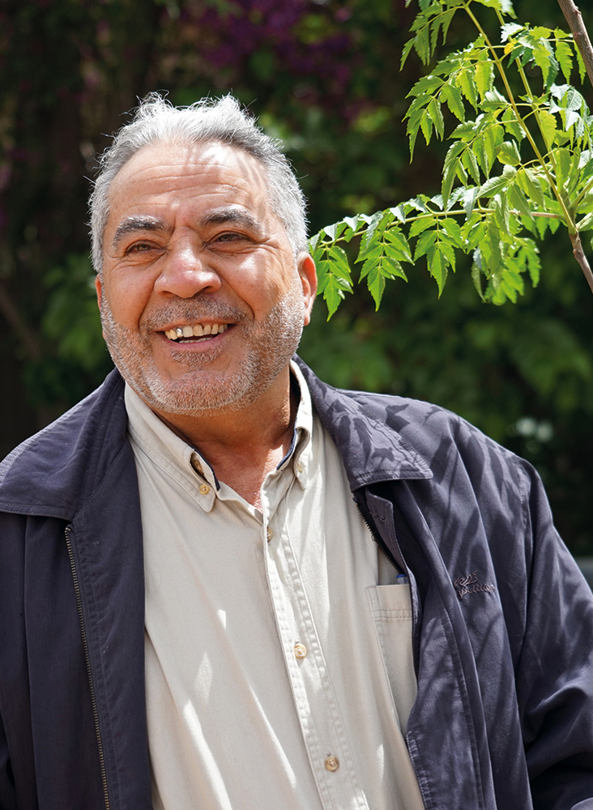
Voice training
Module 2:
Behind the scenes
Feda’a Qatatshsah/HelpAge International

Slide 2
Module 2: Behind the scenes
      The Voice training toolkit has been developed for training HelpAge staff and network members to understand the key elements of the Voice framework and the concepts underpinning it, and to strengthen their ability to implement Voice-related activities.
      This is the second of four PowerPoint Modules designed to accompany the Facilitator’s guide when working through the sessions. Module 2 considers how intersecting characteristics, as well as social norms, including ageism, can affect older people’s ability to exercise their voice. It also introduces the notion of power and explains why it is relevant to Voice work.

Slide 3
Introduction to Module 2

Slide 4
Module 2: Outline
      Introduction to Module 2
      Link between Voice and
      a rights-based approach
      Value of Voice work
      Settings for Voice work
      Recognising diversity
      Relevance of power
      Power: over, to, within, with
      Power: visible, invisible and hidden
      How power manifests itself
      Concluding Module 2

Slide 5
A rights-based approach

Slide 6
Rights-based approach
Two objectives:
      1.
      Empower
      rights-holders to claim and exercise their rights
      2.
      Strengthen capacity of duty-bearers to respect, protect, promote, and fulfil rights

Slide 7
Rights and voice
    “Having a voice enables people to exercise their civil and political rights to realise their social, economic and cultural rights.”

Slide 8
Value of Voice work

Slide 9

Value of Voice work
  Intrinsic value
      The opinions we hold, the decisions we make, and the actions we take constitute a significant part of who we are. Having choice and agency is central to our dignity, wellbeing and sense of self-worth, and to a rights-based approach to ageing.
      Instrumental value
      Including people’s voices in decision-making about issues that affect them can lead to better access to and quality to public services.

Slide 10
Settings for Voice work

Slide 11

Understanding spaces
What is a decision-making space?

Slide 12
Understanding spaces
What is a decision-making space?
      Spaces for public participation and engagement can be categorised as:
        — invited/formal
      — claimed/informal
      The boundaries between these different types of spaces are flexible, not always clear cut and may change over time.

Slide 13
Formal/invited spaces
      Forums, platforms and consultation processes Local development committees, participatory budget committees, roundtables, village assemblies, focus groups, citizen panels, etc.
      Risk of being co-opted or taken over by elites Space is captured by those with power or technical knowledge at the expense of those who are less educated, less confident, and civil society participation is manipulated
      May not reduce inequalities Creating formal spaces by institutionalising informal spaces may not reduce inequalities

Slide 14
Claimed/informal spaces
      Demanded, created and opened up by civil society Demonstrations, civil society groups, blogs and other social media forums, public information meetings organised by civil society, street theatre, etc.
      Useful for:
      — channelling the demands of those who are excluded and may face barriers to participating in formal spaces
      — holding informal negotiations before entering formal spaces
      — ensuring diversity and autonomy of civil society

Slide 15

Plenary discussion
      In your work, which decision-making spaces have you worked in?
      Do you have any lessons you can share from working in different spaces, either formal or informal, to ensure that older people’s views or another group’s voices have been heard?

Slide 16
Recognising diversity

Slide 17
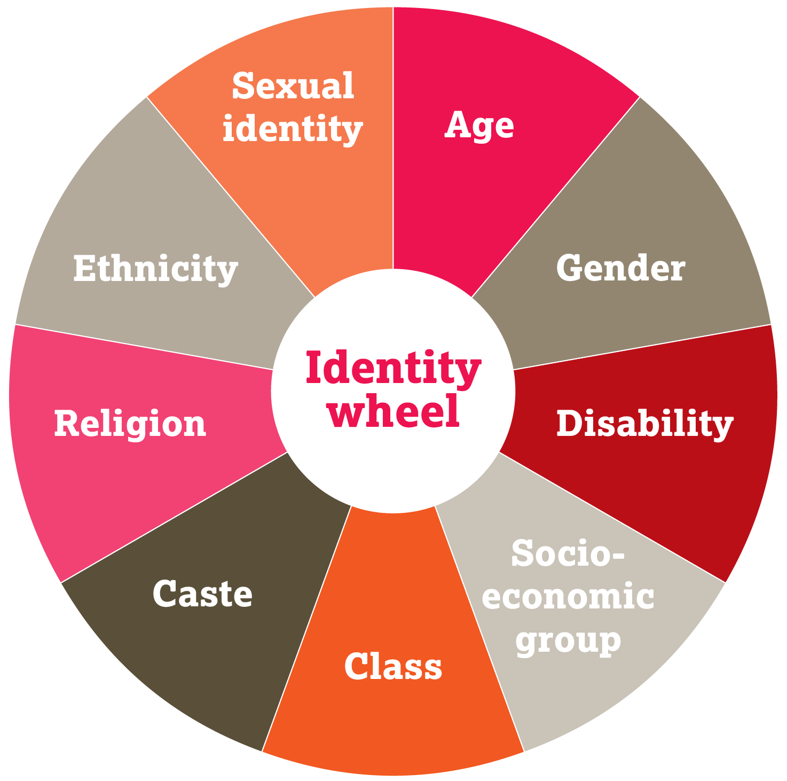
Recognising diversity

Slide 18
Individual and group characteristics that influence people’s ability to raise their voice, which intersect with each other
      Age
      Gender
      Disability
      Socio-economic group
      Class
      Caste
      Religion
      Ethnicity
      Sexual identity

Slide 19
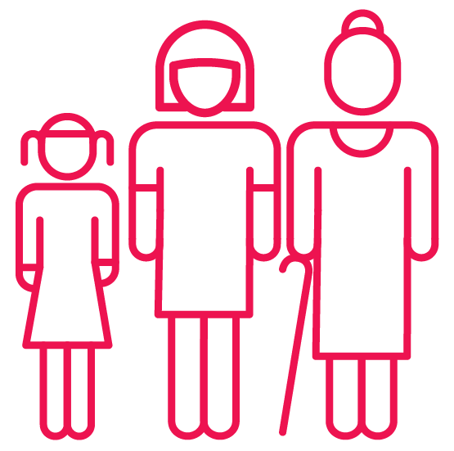
Age and ageism
      Age affects a person’s ability to make their voice heard
      Ageism exists at all levels of society
      Older age can give someone more of a voice or it can be disempowering
      Ageism can lead to violence, neglect and abuse

Slide 20
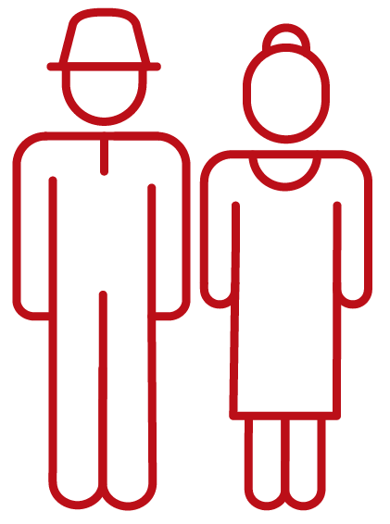
Gender
      Gender-based discrimination
      Accumulated disadvantages over the life course
      Intersection with other characteristics

Slide 21

Disability
      Older people with disability can face multiple forms of exclusion:
      Attitudinal
      Environmental
      Institutional
      Internalised

Slide 22
Relevance of power

Slide 23

Relevance of power
      Women and men hold multiple roles.
      Their level of power can vary.
      A person’s experience of power depends on
      various characteristics.
      Power:
      — can be economic, political, social, cultural or symbolic
      — socially constructed
      — occurs at different levels
      — is acted out in different spaces
      — takes different forms

Slide 24
Power: over, to, within, with
Source: VeneKlasen L, and Miller V, ‘Power and empowerment’, PLA Notes, 43: 39–41, 2002, and Comic Relief Maanda Initiative, A framework for women and girls’ empowerment: Guidance for Maanda applicants and grantees, Comic Relief, 2014. Useful resource, https://www.powercube.net/

Slide 25
Power: over, to, within, with
      Power over
      Power to
      Power within
      Power with

Slide 26
Power: over, to, within, with
      Power over – dominance
      Power to – being able to act, make decisions or create change
      Power within – sense of confidence, dignity and self-esteem that comes from gaining awareness of one’s situation
      Power with – collective action and solidarity

Slide 27
Power: visible, invisible and hidden

Slide 28
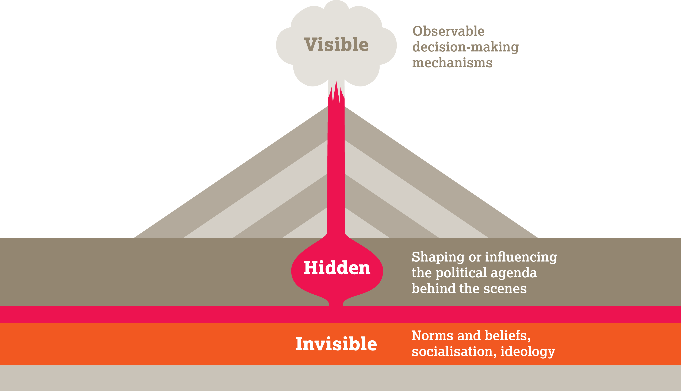
Power: visible, invisible and hidden

Slide 29
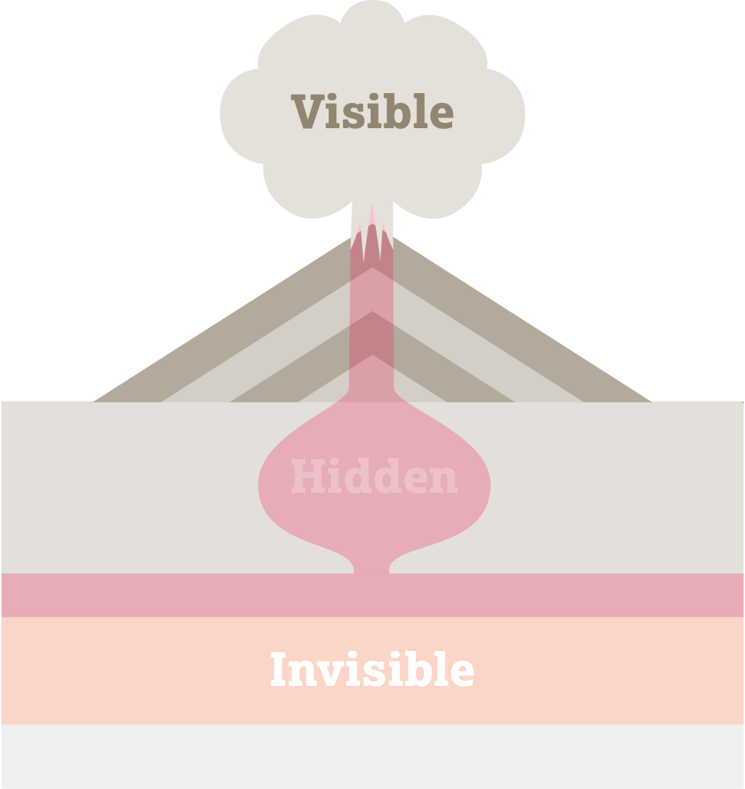
Visible power – the public ‘yes’
      Formal rules, structures, institutions and procedures
      How the game is currently played
      Instruments of formal power: constitutions, laws, policies, budgets, etc. The voice of the powerless is not always represented.

Slide 30
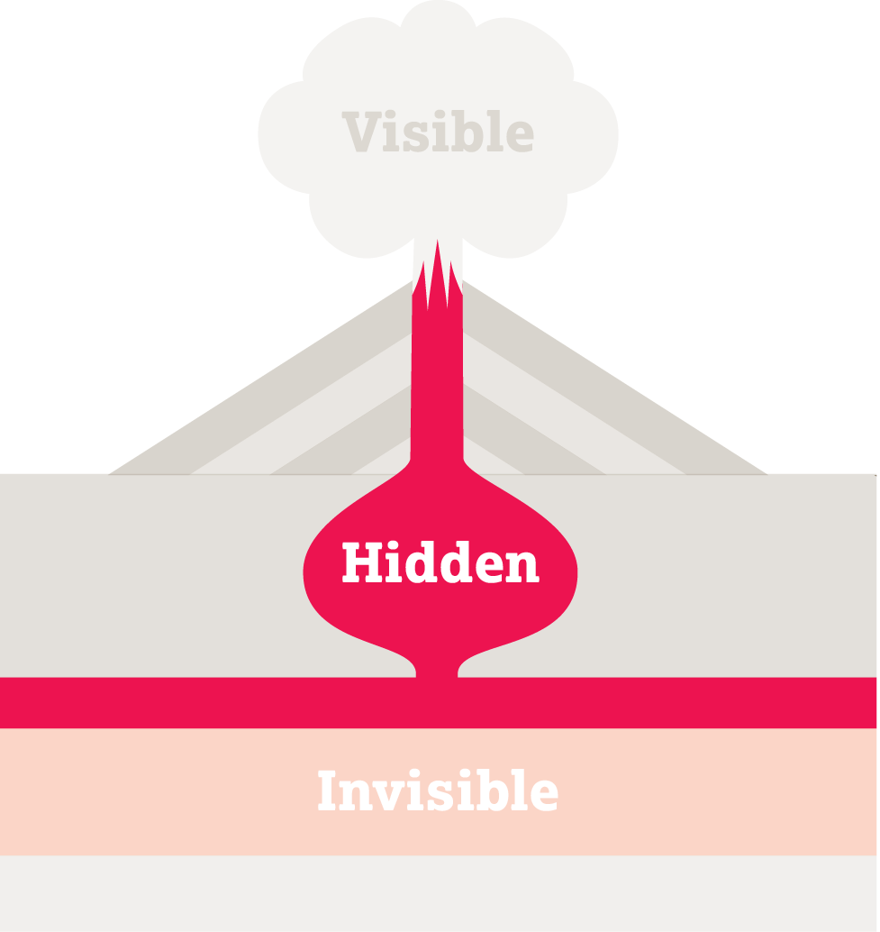
Hidden power – the private ‘no’
      Takes place in informal spaces.
      Not what people commit to publicly
      Many decisions are taken in private
      Real power is often hidden
      Informal rules of the game
      Protects vested interests
      Excludes and delegitimises voices of potential opposition

Slide 31
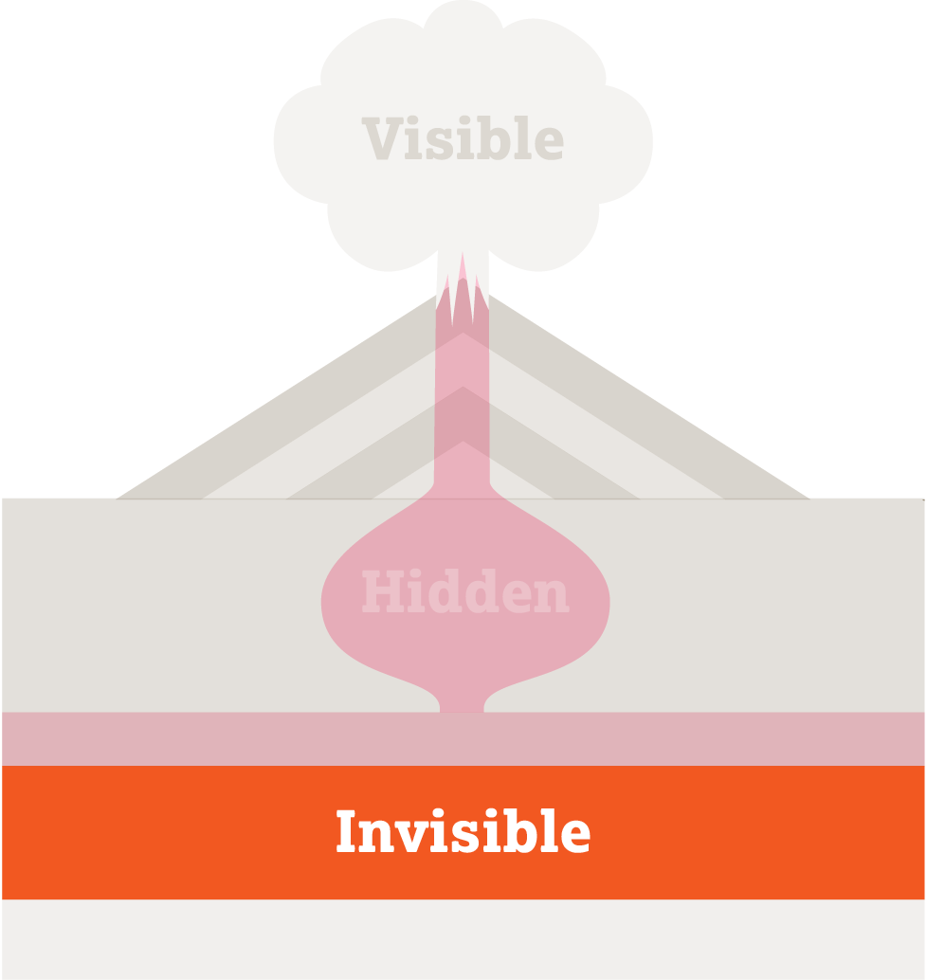
Invisible power
    “Invisible power often determines the capacity of change movements to influence visible and hidden power. It shapes the belief systems about what is ‘normal’ or ‘natural’...”
    Duncan Green, How Change Happens

Slide 32
Invisible power – the ‘normal’
      Dominant ideologies, values and social norms shape attitudes, expectations and behaviour
      Constitutes ‘the natural order’ of things
      Perceived as acceptable (social norms)
      Fear of social sanctions by your peers

Slide 33

Power operates at all levels

Slide 34
How power manifests itself

Slide 35

Group exercise
      Think of the same older person you thought of before.
      Pick a key issue that affects the person’s quality of life. You can be very precise and look at a specific issue.
      Discuss how the different forms of power
      (visible, invisible and hidden) influence this issue.
      At which level (household, local, national or international) are these different forms of power having an influence?

