Slide 1
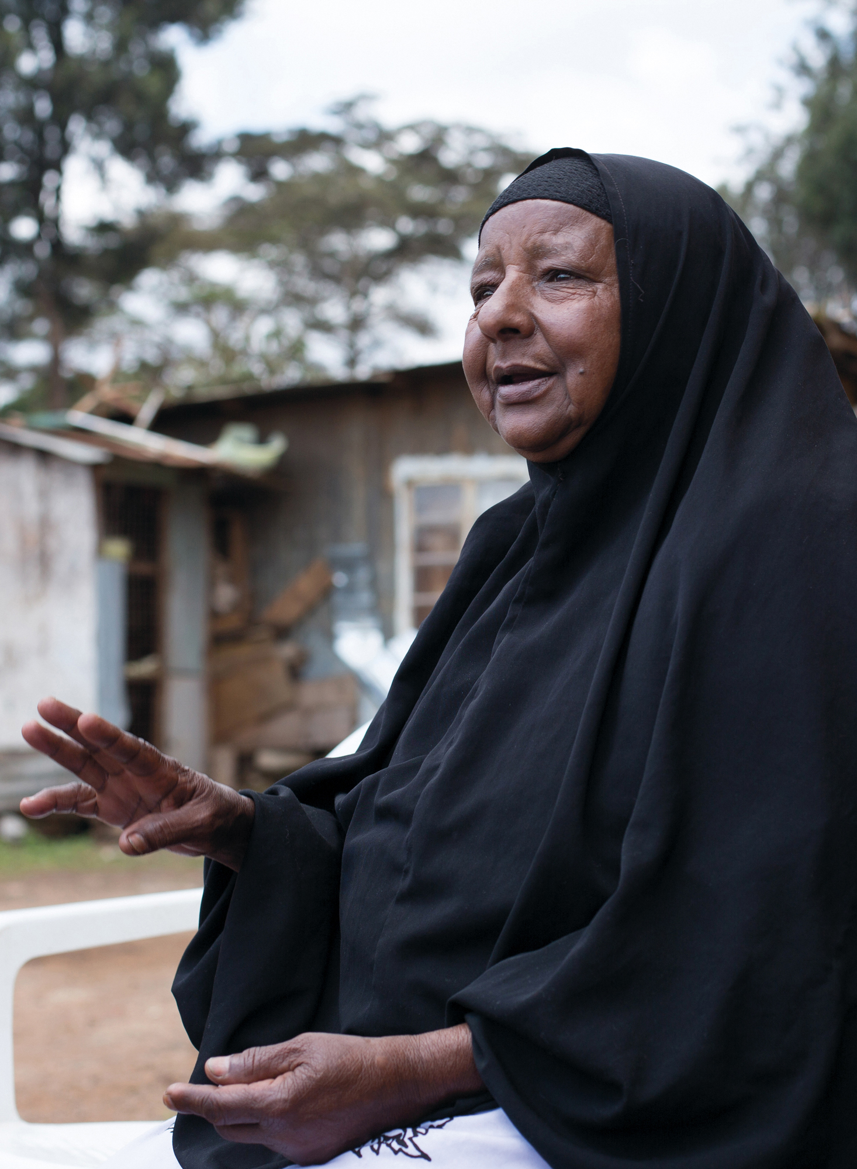
Voice training
Module 3:
The Voice framework and accountability approaches
HelpAge International

Slide 2
Module 3: Unpacking the domains of the Voice framework
      The Voice training toolkit has been developed for training HelpAge staff and network members to understand the key elements of the Voice framework and the concepts underpinning it, and to strengthen their ability to implement Voice-related activities.
      This is the third of four PowerPoint Modules designed to accompany the Facilitator’s guide when working through the sessions. Module 3 examines the different domains within the Voice framework and looks at social accountability mechanisms.

Slide 3
Module 3: Outline
      Critical contextual factors
      Engaged domain
      Informed and empowered domain
      Shared and combined domain
      Amplified domain
      Heard domain
      Principles of accountability
      Older citizen monitoring
      Community score card
      Social audit
      Budget work
      Reflection on social accountability approaches
      Enablers and barriers to
      Voice work

Slide 4
Introduction to Module 3

Slide 5
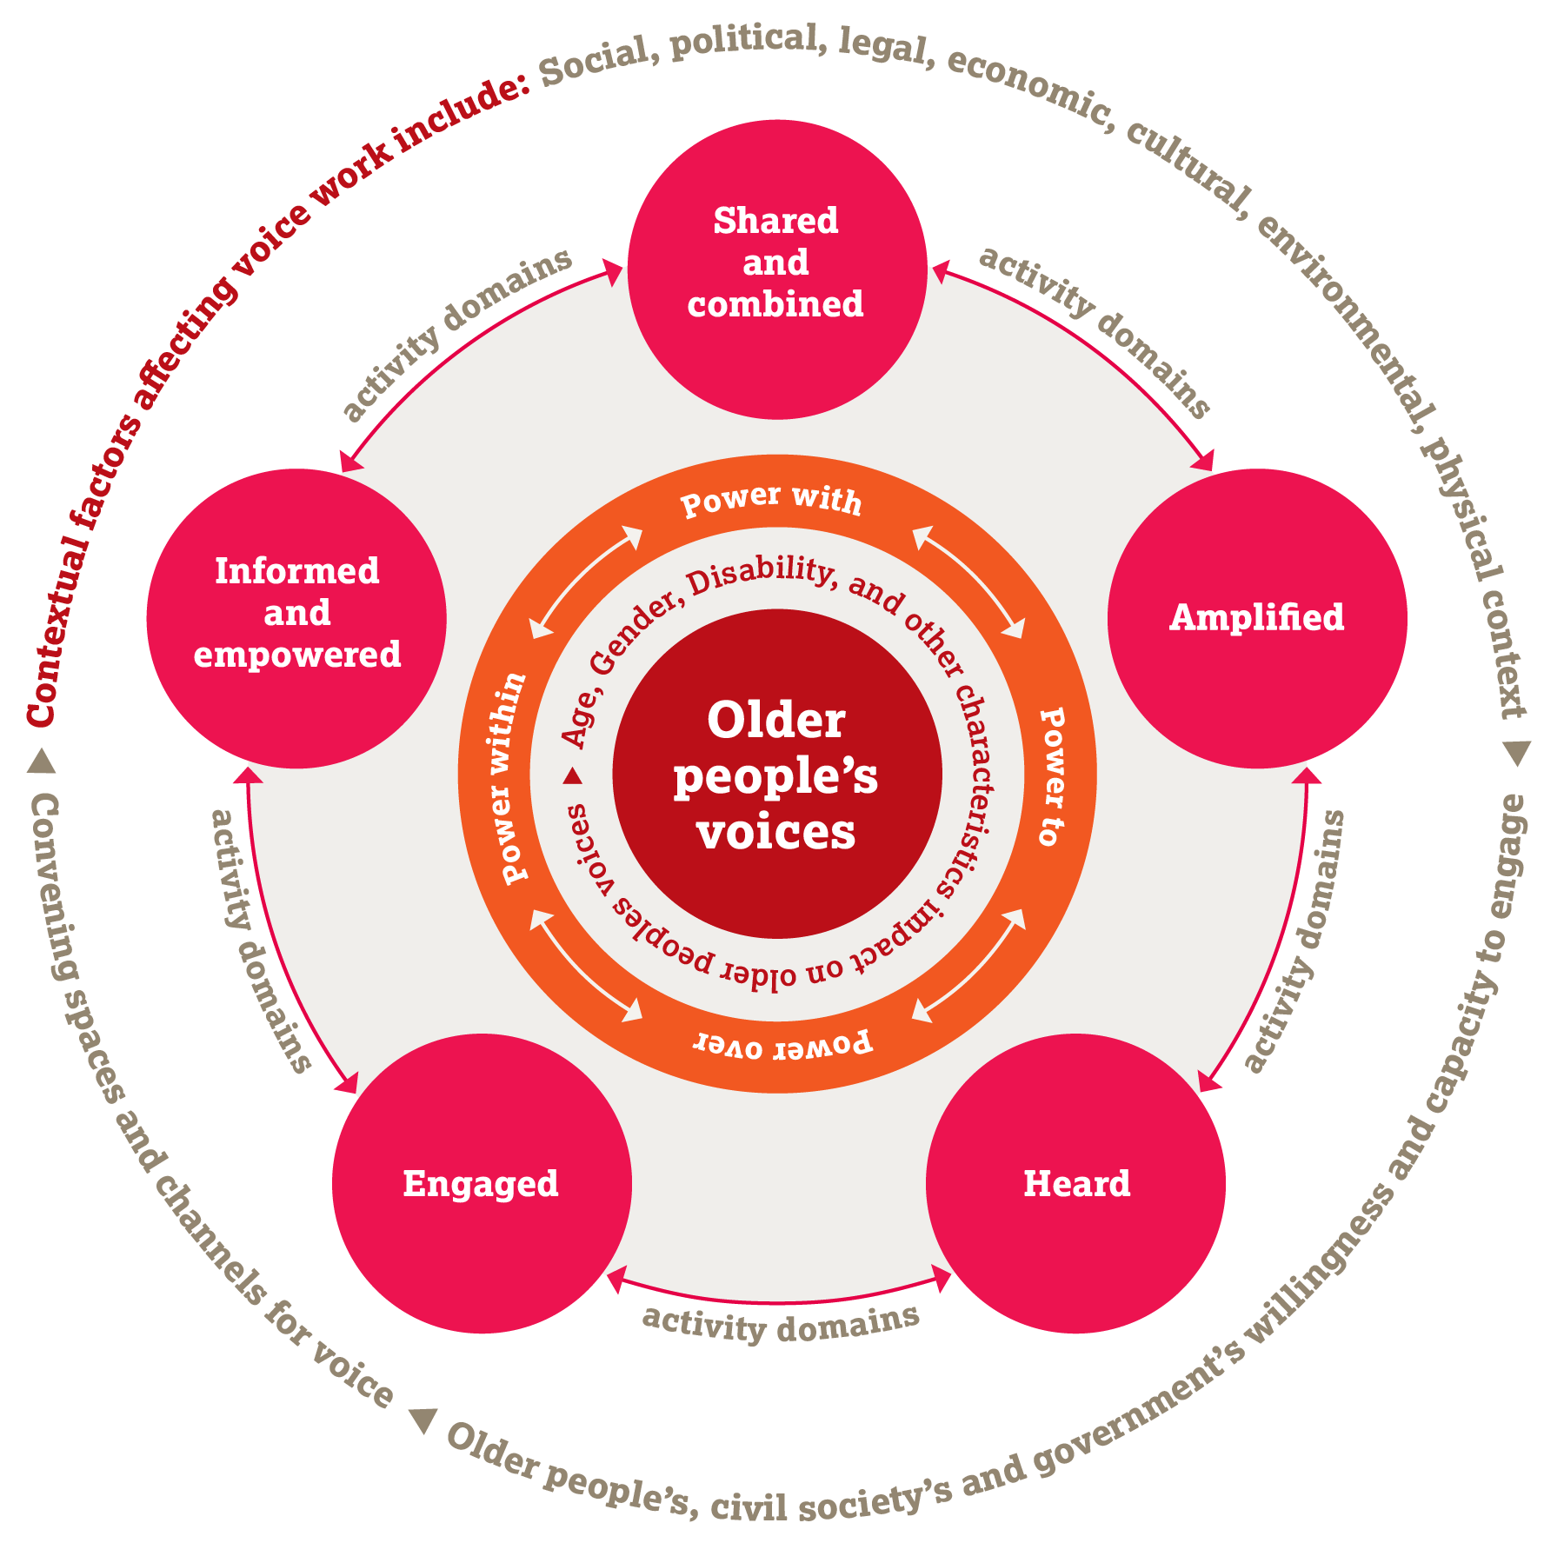
Voice framework

Slide 6
4-power framework
      Creating opportunities for older people to have:
      ‘Power over’ influential people and key aspects of their own lives
      ‘Power to’ claim their rights and be heard
      ‘Power within’ themselves
      ‘Power with’ others to press for their rights

Slide 7
Critical contextual factors

Slide 8

Group exercise
      What might make stakeholders (older people, civil society organisations or government) unwilling to engage in activities that strengthen older people’s voices?
      How can these be addressed?

Slide 9
Engaged
      “I am able and motivated to take part in activities that strengthen my voice and my rights regardless of my identity, individual or group characteristics, or the context in which I live.”
      Raising older people’s awareness about Voice activity and rights
      Motivating them to engage

Slide 10

Group discussion
      What approaches has the project used to try and be more inclusive?
      What other approaches could be used?
      Why is inclusion important?
      Have you learnt anything from your own experience that you would like to share?

Slide 11
Informed and empowered
      “I have access to information and knowledge related to my rights and entitlements and I have the resources, skills and confidence to claim these rights and raise my voice.”
      Accessing information
      Supporting power within, increasing autonomy
      Being an agent of change
      Fostering leadership

Slide 12

Accessing information
      Information is power
      Should be accessible and timely
      What are the best channels for disseminating information? How can we make information accessible to the diverse older people we are working with?

Slide 13
Group discussion
      How do you think the process of empowerment takes place?
      What are the key enablers?
      How can you support this process with diverse people (including older women and older people with disability)?

Slide 14
Shared and combined
      “I have the opportunity to meet with others, share my experiences, and debate with them. We’re all able to express our needs, identify solutions, and form a collective, legitimate and representative voice.”
      Creating a collective voice: providing older people with the opportunities and the capacity to come together with others in a safe space
      A space to share experiences, debate, and identify common, specific needs

Slide 15
Group exercise
      Which spaces may be safe for older people to discuss issues and create a collective voice?
      What should you be particularly careful about as the convenor of such spaces?

Slide 16
Key issues about spaces
      How inclusive, representative and democratic are these spaces
      (older people’s groups, community groups, etc)?
      Are members of these spaces elected or appointed?
      What are the rules of the game for that space?
      Who calls the meeting, who chairs it, who decides the agenda, who talks?
      How volatile are these spaces? How often do their members change?
      Who are the members accountable to? For what?
      Is the space co-opted? What about the power dynamics
      within the space?
      How effective is the space? What type of decisions are taken?
      Can agreements be reached, decisions made and proposals put forward?

Slide 17
Group discussion
      What is leadership for you?
      Where do you look for leadership?
      How can you recognise a good leader?
      Why is it important to promote about women’s leadership?

Slide 18
Amplified
      “I have the opportunity to raise my voice through a variety of channels and to join with others to campaign, influence agendas, and create movements for change.”
      Involves supporting older people to communicate their individual or collective voice through diverse channels at different levels.
      Older people’s voices can be amplified in a wide variety of ways (including advocacy and campaigning through different channels).
      Older people need the strength, skills, resources and support to come together and build alliances, networks or platforms with wider civil society organisations.

Slide 19
Group discussion
      Why do you think campaigning and coalition-building can be effective tools for amplifying older people’s voices?

Slide 20
Heard
      “My voice is heard through my active participation and influence in decision-making processes. Governments and other power holders are responsive to my needs and my rights.”
      Power to: How to access the ’right’ spaces with effective messages to get a response from government representatives

Slide 21
Principles of accountability

Slide 22
Key aspects of accountability
      Duty-bearers (e.g. government) are accountable to rights-holders (e.g. the public)
      3 key concepts: answerability, responsiveness, sanctions
      — Answerability – introducing laws and policies that respond to people’s needs and rights
      — Responsiveness – responding to people’s needs and rights regardless of whether there are laws and policies in place
      — Sanctions – measures to punish duty-bearers who do not fulfil their responsibilities

Slide 23
What is social accountability?
      Driven by citizens
      Citizens demanding/questioning/contesting in order to access their rights.
      Collaboration and dialogue between rights holders and duty bearers

Slide 24
Older citizen monitoring

Slide 25
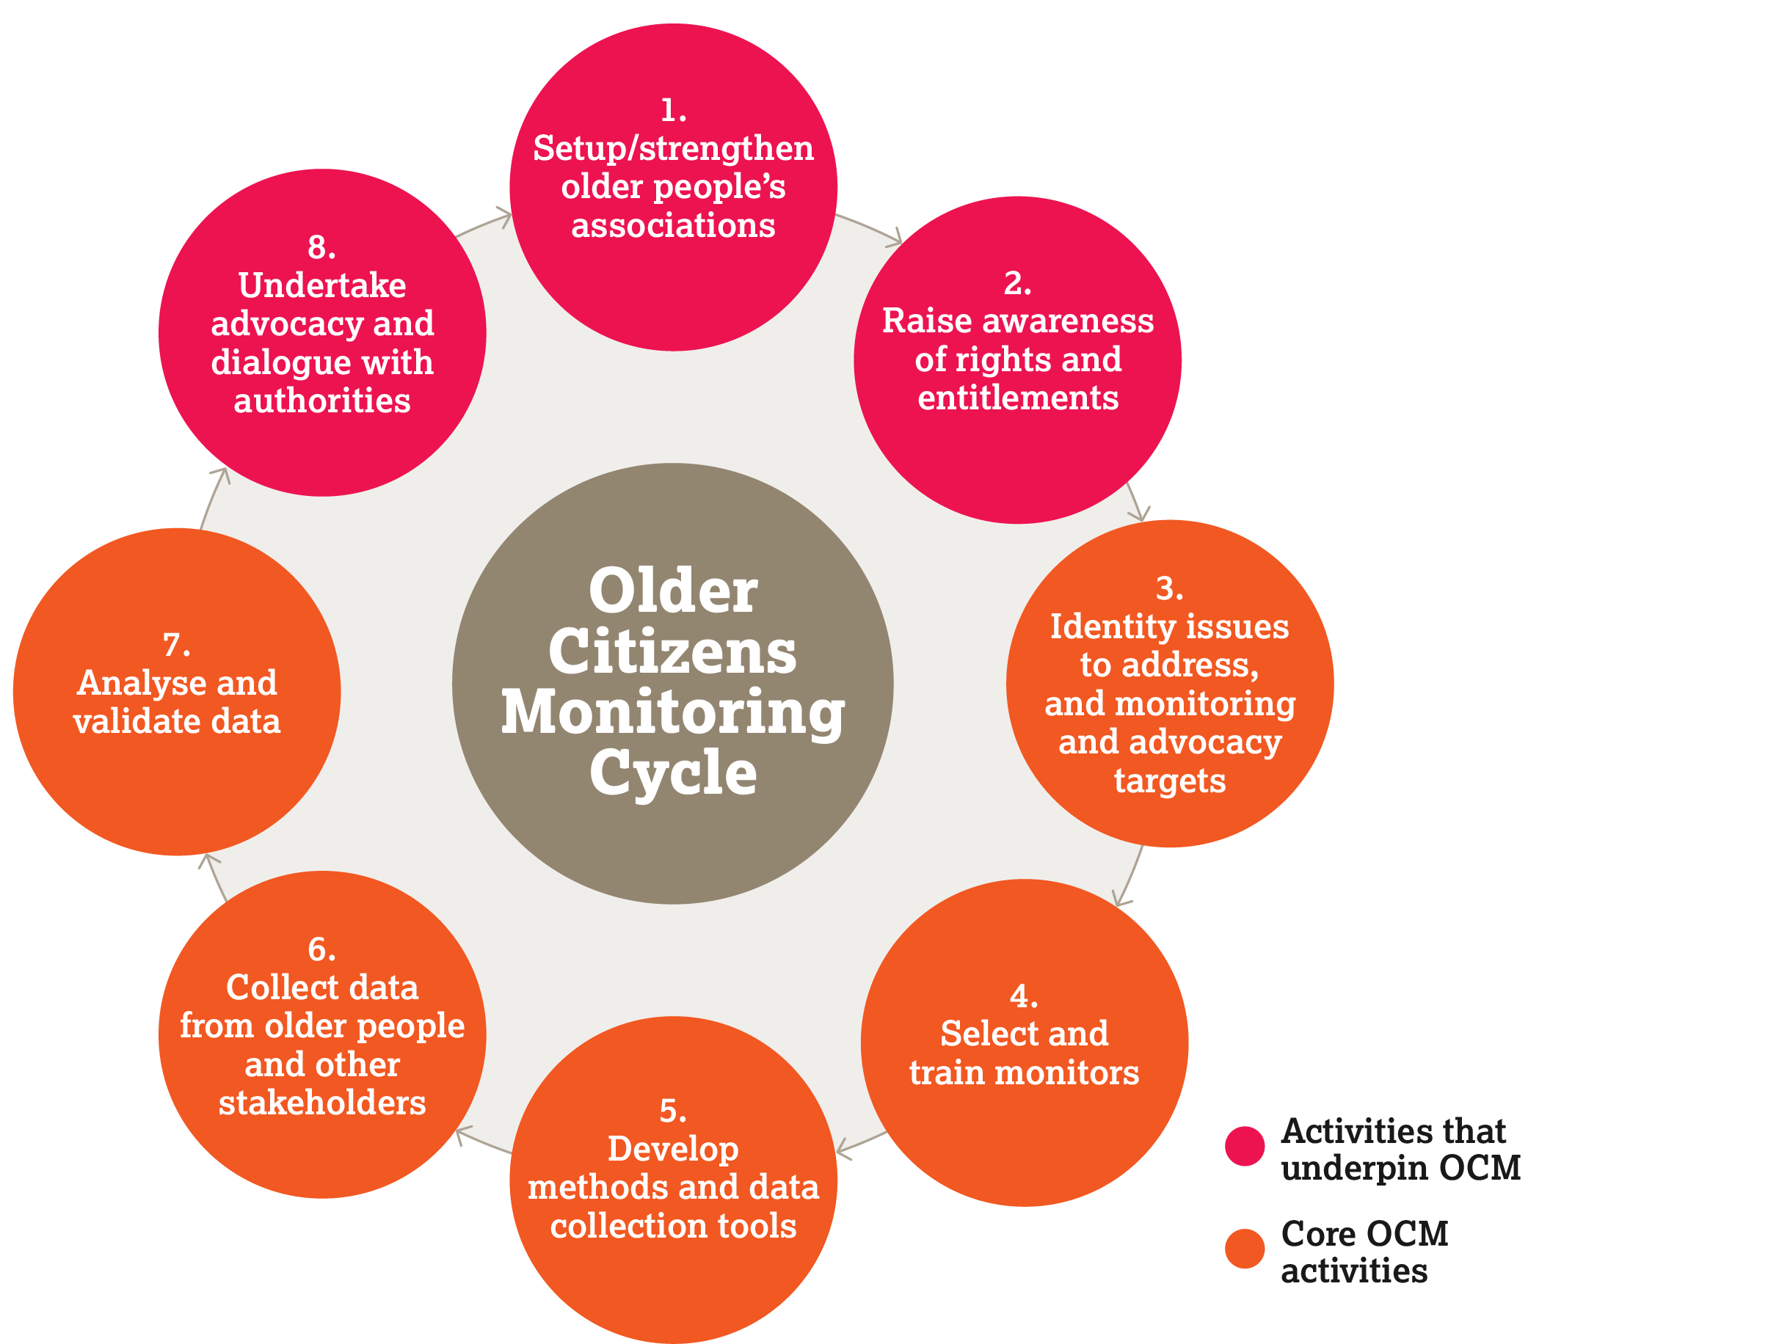
Older citizen monitoring cycle

Slide 26
Community score card

Slide 27

What is the community score card?
      Is a tool that community groups can use to monitor and assess public services. It is a way of making service providers more accountable to service users.

Slide 28
Benefits of the community score card
      Facilitates a common understanding of problems and solutions to them
      Promotes community participation and dialogue, and improves relationship with service providers
      Empowers service users, leading to community monitoring of services, and increases community ownership of services and projects
      Facilitates accountability, transparency, and responsibility by service providers
      Clarifies roles and responsibilities of service users in service delivery
      Can expose corrupt officials
      Can be used by service providers to monitor progress and service quality together with the community

Slide 29
Challenges of the community score card
      Requires time and excellent facilitation skills
      Can sometimes lead to conflict if not facilitated well
      Individuals can be targeted (rather than services and systems)
      Can raise high expectations, which may be difficult to meet in the short term
      Requires an enabling environment (democracy, decentralised systems, policies on social monitoring, willingness from government representatives, adequate budget allocation, inclusive approach to community participation)

Slide 30
Tips for facilitating the community score card
      Understand your context well (service delivery mechanisms and bottlenecks).
      Make sure the team using the community core card includes someone with good facilitation skills.
      Present the process as collective problem-solving rather than purely a ‘service assessment’ tool.
      Ensure buy-in from service providers and local government representatives at all levels.
      Sensitise users and service providers on their rights and duties before you use the card to give them a score
      Be explicit about both the potential and the limitations of
      community score card
      Ensure buy-in and support from civil society organisations and local leaders.

Slide 31
Social audit

Slide 32

Social audit
      Participatory method to investigate if government projects have been implemented as planned
      Often used for infrastructure projects
      Identifies if there are gaps between the plan and what has actually been delivered

Slide 33
Key steps
      Step 1. Improve citizens’ access to information contained in government documents, in accordance with their rights
      Step 2. Analyse information that appears to be
      evidence-based, accurate and impartial
      Step 3. Hold a public hearing

Slide 34

Outcomes of social audit
      Create awareness among users and providers of where and how public funds are being spent
      Monitors progress, helps to expose corruption and mismanagement and prevent fraud
      Allows citizens to influence the behaviour of the government

Slide 35

Challenges of social audit
      Can be difficult to get copies of project documents and government records
      Citizen group may not have the capacity
      Requires a relatively high level of technical assistance and facilitation
      Risk of backlash

Slide 36

It's Our Money. Where's It Gone?
      Video about a social audit in Kenya
      www.youtube.com/watch?v=z2zKXqkrf2E

Slide 37
Plenary discussion
      What are the key steps used in the process?
      What were the key challenges? How were they overcome?
      Can such a process be used to solve an issue you are familiar with?
      Any questions? Comments?

Slide 38
Budget work

Slide 39

What is a budget?
      The government’s most powerful social and economic policy instrument
      Basis of the social contract between people and government

Slide 40
Why are budgets important?
      Budgets show:
      Government priorities and trends and how they are aligned with citizens’ needs and rights
      Who will benefit or not
      How far policies or programmes are fulfilling rights and meeting commitments (effective monitoring tool)
      Whether a programmes is sustainability of
      (depending on the income source)

Slide 41
Group discussion
      Why is it important for the public to understand the basic principles of budget and policy decisions?
      Does your government make budget information publicly available?
      Do you know where to find the information or do you have to ask for it (using a freedom of information law if one exists in your country)?

Slide 42

Budget analysis
      Helps people understand the government’s spending priorities
      Shows which groups will or will not benefit
      Shows how far programmes have been implemented
      Shows how far the government is delivering on its commitments
      Crucial for citizens to have access to information and be involved in budget decision-making processes

Slide 43
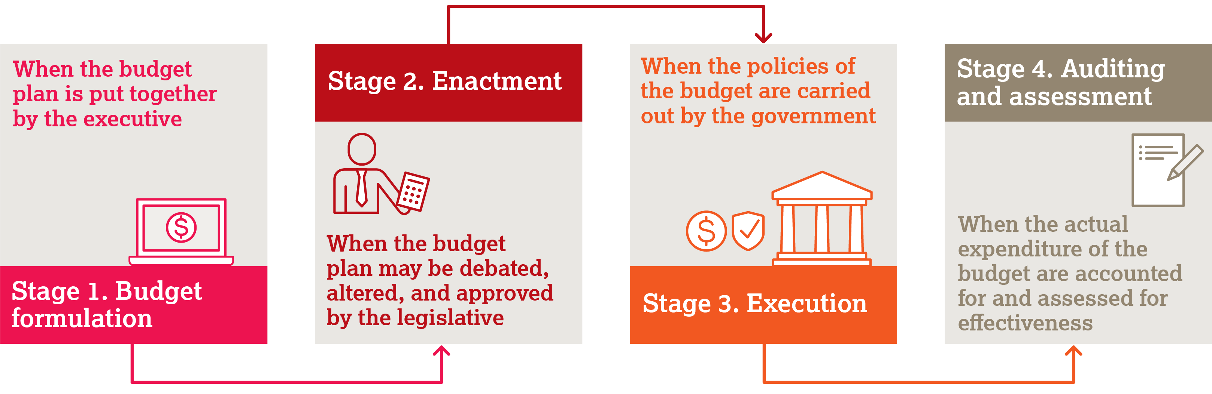
The budget cycle

Slide 44
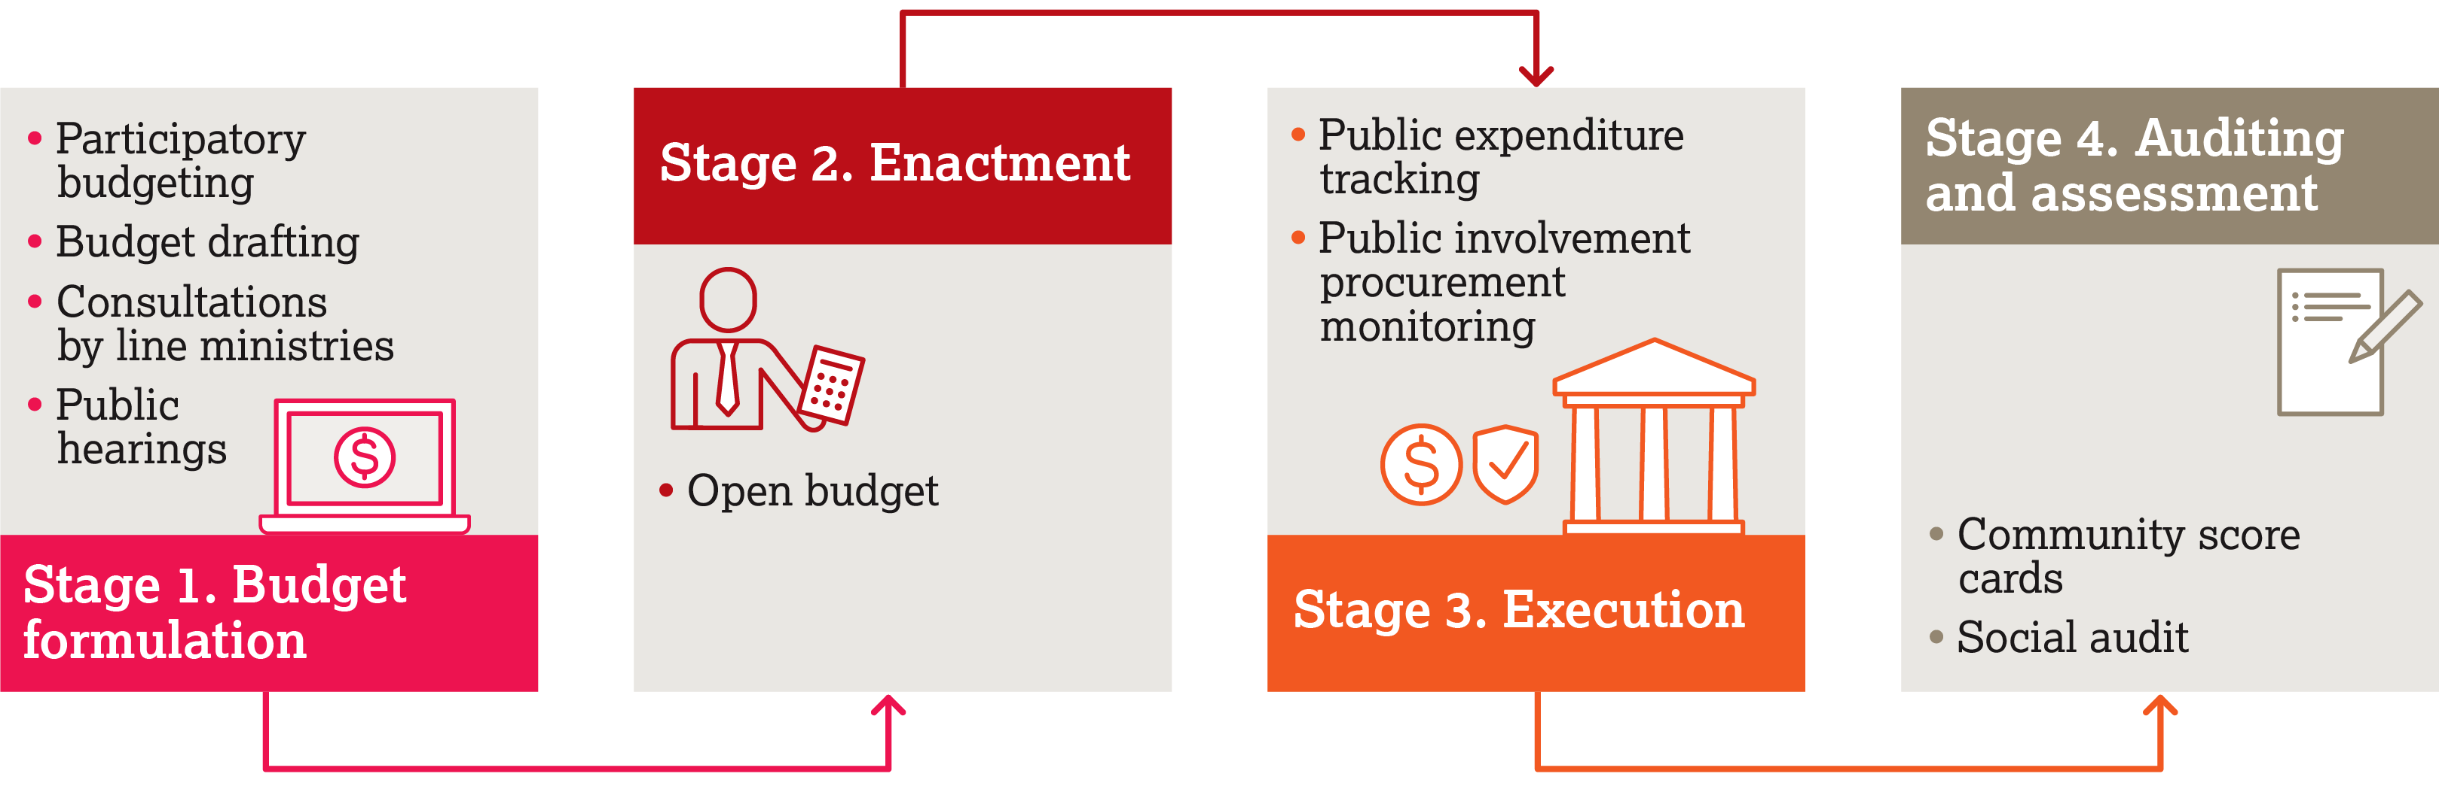
Influencing at the different stages of the budget cycle

Slide 45

Real money, real power: Participatory budgeting
        Video from The Participatory Budgeting Project, New York City
        www.youtube.com/watch?v=E1OQ-6_07TI&t=130s

Slide 46
Group discussion
      What are the benefits of participatory budgeting?
      What are the challenges?
      Do you think older people would face challenges to being a part of a participatory budget-making process?

Slide 47
Reflection on social accountability approaches

Slide 48
What could we be doing more of?
      Community score card to assess quality of services for older people
      Social auditing
      Participatory budgeting: in community/municipality
      Community score card/social audit to gather evidence to advocate for better resource allocation
      Budget expenditure tracking to identify bottlenecks
      Participate in budget-related platforms/networks
      Fund research on budget analysis

Slide 49
Enablers and barriers to Voice work

Slide 50
Enablers
      Older people understanding their rights and how to organise collectively
      Strong civil society to support Voice work
      Spaces for older people to come together
      (e.g. older people’s associations)
      Intergenerational work
      A collaborative approach and working with different stakeholders
      Engaging constructively with governments to shift power relations

Slide 51
Understanding how to engage with government representatives
      A stakeholder analysis is important for:
      Understanding incentives
      Understanding power relationships
      Recognising external and internal influences
      Moving away from the state-citizen dichotomy
      Adopting a collaborative approach
      Using ‘support to policy implementation’ as an entry point

Slide 52
Group discussion
      What are the most successful strategies you have encountered or used to engage with government representatives?

Slide 53
Tips on how to engage with government representatives
      Stakeholder analysis: key to understanding incentives, power relationships, capacity and resources.
      Collaborative approach: organising joint citizen-government capacity-building activities
      Sustainability of engagement with government representatives
      Convenor role: linking with NGOs and donors
      Involving government representatives from Day 1

Slide 54
Key risks
      Repression and violence
      Exacerbating conflicts
      Nurturing existing unequal power relationships and underlying social norms
      No direct tangible results
      Fatigue/ frustration
      Volatility of changes
      Making ‘easy’ assumptions

Slide 55
Overcoming barriers and mitigating risks
      Do a context analysis:
      — political and economic
      — environmental and physical
      — social and cultural
      Understand and address unequal power dynamics at all levels
      Understand the intersectionality between age, gender and disability and address it in each approach
      Adopt a ‘Do No Harm’ approach to your intervention
      Work with all political parties – non-partisan support
      Create multi-stakeholder coalitions

