Slide 1
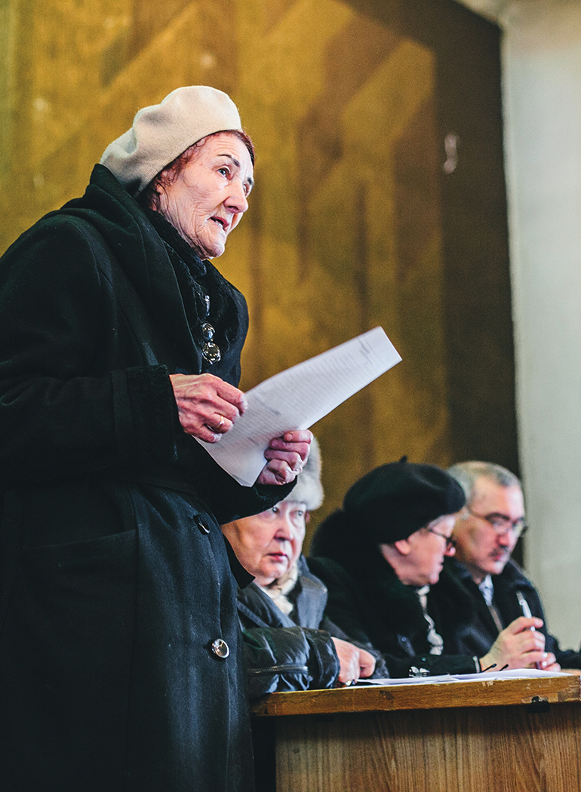
Voice training
Module 1:
Introduction to Voice
Malik Alymkulov/HelpAge International

Slide 2
Module 1: Introduction to Voice
      The Voice training toolkit has been developed for training HelpAge staff and network members to understand the key elements of the Voice framework and the concepts underpinning it, and to strengthen their ability to implement Voice-related activities.
      This is the first of four PowerPoint Modules designed to accompany the Facilitator’s guide when working through the sessions. Module 1 is an introductory module that looks at the objectives of the training and key concepts.

Slide 3
Module 1: Outline
      Objectives of the training
      Key audience
      Where we are coming from and where we are at
      Key concepts

Slide 4
Objectives and expectations

Slide 5

Objectives
      Understand what Voice means for HelpAge
      Understand the concepts underpinning the Voice framework
      Explore key social accountability and Voice approaches (particularly for project activities)
      Become familiar with tools and approaches for planning and monitoring projects centred on the Voice framework: monitoring, evaluation and learning

Slide 6
Key audiences

Slide 7

Key audiences
      HelpAge International staff
      Staff of HelpAge Global Network members
      Members of older people’s associations
      National platforms and federations of older people
      Community organisations
      Government representatives

Slide 8
Understanding Voice

Slide 9
Where are we coming from?
Where are we at?
      HelpAge International and network members have been implementing Voice activities for years. The Voice framework is informed by this work.
      At HelpAge, we use ‘Voice’ as an umbrella term covering participation, empowerment, agency, autonomy and accountability.
      We consulted older people in 2020 on how their ability to exercise their voice has been affected by the COVID-19 pandemic.
      The HelpAge International Strategy 2030 includes Voice as a key component.
      Voice work focuses on inclusion, challenging ageism and addressing diversity.

Slide 10

Group discussion
      What comes to your mind when you think of ‘Voice’
      (in relation to a community or individual)?

Slide 11
Linking Voice with the
Strategy 2030

Slide 12

How does this training fit within the latest organisational thinking?
      HelpAge International’s mission: Our mission is to promote the wellbeing and inclusion of older women and men and reduce poverty and discrimination in later life.

Slide 13
The three core functions of
HelpAge International
      1. Supporter
      Supporting network members
      (funding, sharing learning, joint actions)
      2. Convenor
      Bringing together stakeholders, fostering learning, sharing and collaboration
      3. Thought leader Developing new thinking, matched with practical solutions

Slide 14

The 10 focus areas of Strategy 2030

Slide 15
Key concepts underlying
Voice work

Slide 16
Key concepts underlying Voice work
      Agency
      Rights-based approach
      Autonomy
      Governance and good governance
      Citizenship
      Spaces (formal and informal)
      Participation
      Accountability, responsiveness and answerability
      Empowerment
      Access to information
      Power
      Advocacy and campaigning
      Independence
      Leadership

Slide 17
Wrap up Module 1

