Slide 1
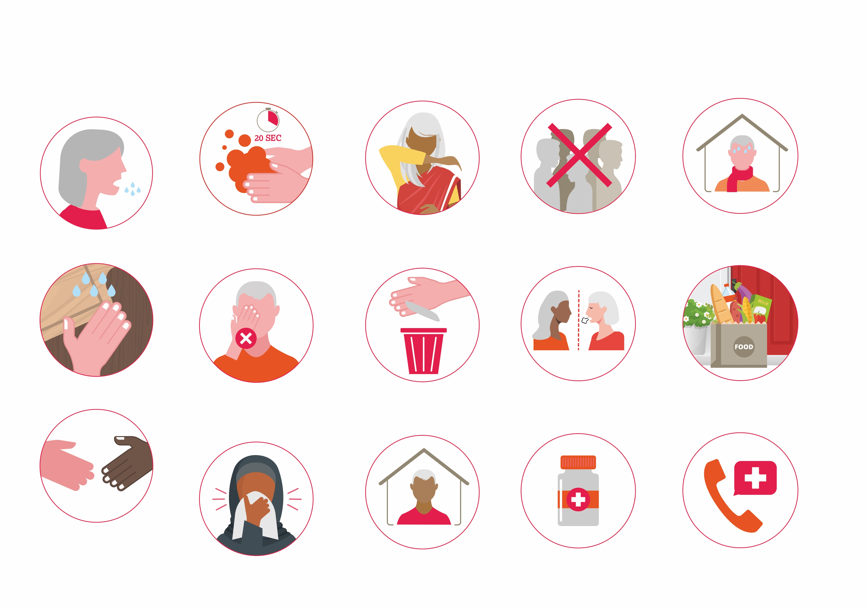
ADVICE FOR OLDER PEOPLE
Coronavirus (COVID-19)
HOW IT’S SPREAD
From person to person through small droplets when they cough or sneeze.
The virus can be passed by:
Breathing these droplets.
Touching surfaces where these droplets have landed and touching your eyes, nose and mouth.
Shaking hands with a person who has the virus and touching your eyes, nose and mouth.

Slide 2
PROTECT YOURSELF AND OTHERS
Regularly wash your hands with soap and water for at least 20 seconds
Don’t touch your eyes, nose and mouth
Cough or sneeze into a tissue

Slide 3
If you don’t have a tissue, cough or sneeze into your sleeve
Put tissues in the bin
Stay at home as much as possible

Slide 4
Avoid big groups of people
Avoid contact with people who sneeze or cough
If you have other health conditions, make sure you have a longer supply of your medicines than usual

Slide 5



Isolate at home if you feel unwell with a fever, cough or shortness of breath.
Ask friends, family or carers not to visit you
Ask friends, family or carers for help with picking up medicines or food
If you feel unwell seek medical help
For more advice visit www.helpage.org/covid19-guidance-and-advice-for-older-people
Published by HelpAge International in March 2020 | PO Box 70156, London WC1A 9GB Registered charity no. 288180

