Slide 1
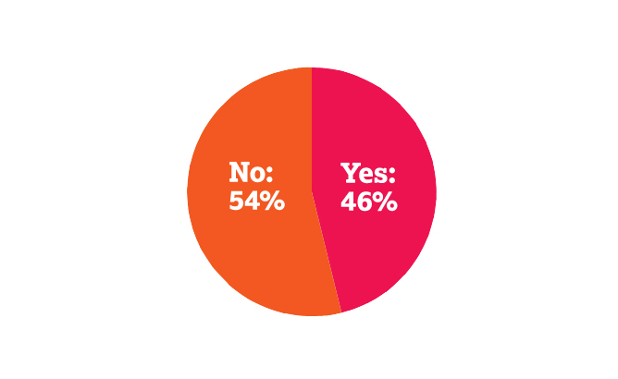
Free drugs are only available in 46% of countries asked
Question 1: Does the Health Service in your country provide free drugs for the treatment of high blood pressure (hypertension)?

Slide 2
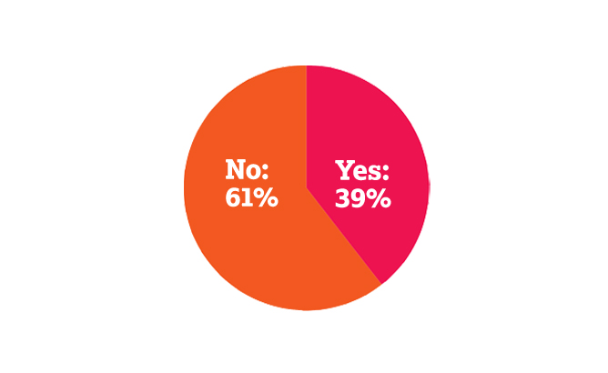
Free drugs are not easily obtainable for older people in urban areas in 61% of countries asked
Question 1a: If the answer to question 1 was YES, are these drugs easily obtainable for older people in urban areas?

Slide 3
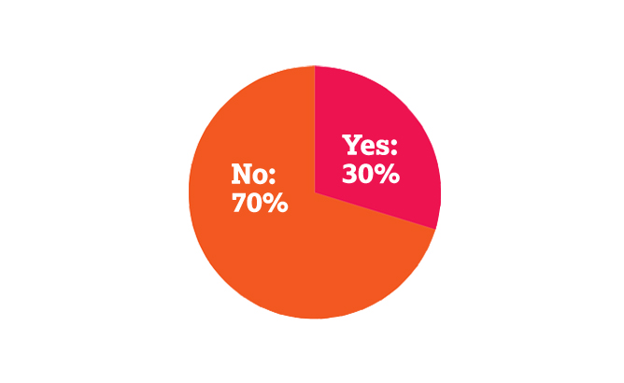
Free drugs are not easily obtainable for older people in rural areas in 70% of countries asked
Question 1b: If the answer to question 1 was YES, are these drugs easily obtainable for older people in rural areas?

Slide 4
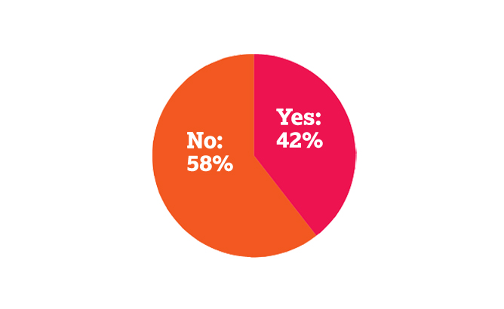
There is no information campaign about high blood pressure in 58% of countries asked
Question 2: Is there an information campaign (through leaflets, radio, television, newspapers or any other means) about high blood pressure in your country?

Slide 5

The government does not offer free screening for older people in 59% of countries asked
Question 3: Does your government say they offer free screening to older people for the detection of high blood pressure?

Slide 6
There is no easily accessible programme of free screening for older people in 70% of countries asked
Question 4: Does your government actually provide an easily accessible programme of free screening for older people?

